Slide 1
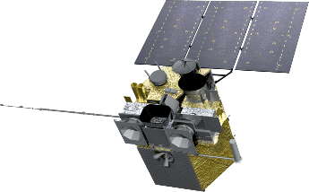
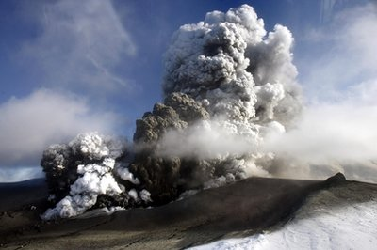
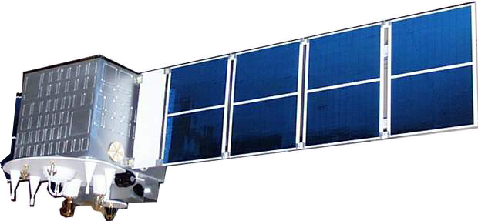
Remote Sensing of Global Volcanic Eruption using Fengyun Series Satellites
11th AOMSUC & 2021 FY Conference
Presented By: Lin Zhu
China Meteorological Administration (CMA)
National Satellite Meteorological Center (NSMC)
Email: zhulin@cma.gov.cn
Tel:86-10-68400967

Slide 2
Outline:
1. Volcanic eruption and FengYun satellites
2. Global Applications
3. Recent research
4. Summary and future work

Slide 3
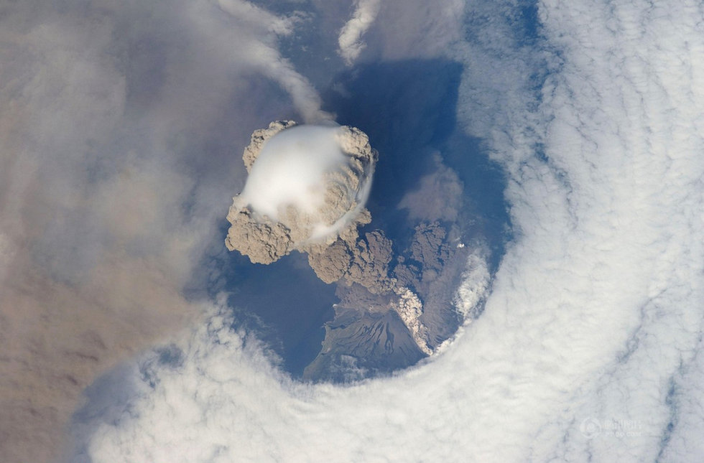
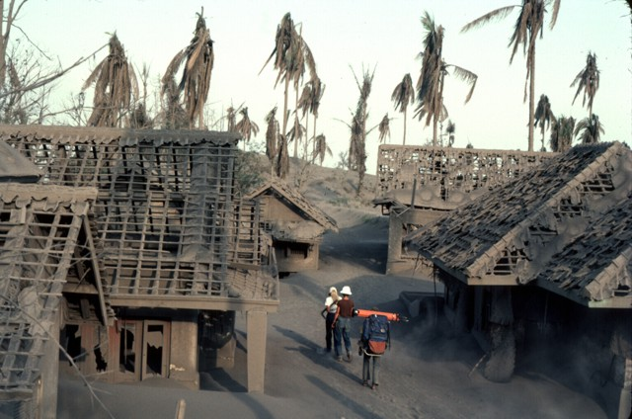
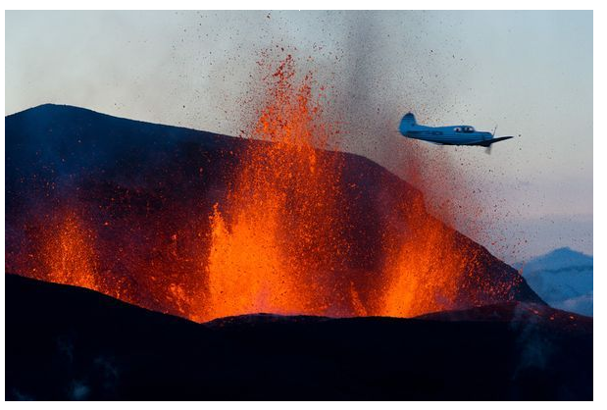
Volcanic eruption
Natural disaster
Human security
Aviation safety
Climate

Slide 4
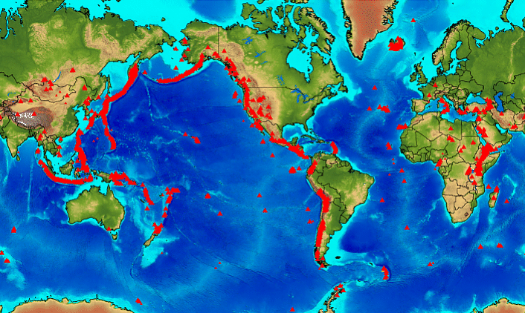
Global distribution of active volcanoes
~75% world’s active volcanoes in Ring of Fire！
1545 volcanoes with known or inferred eruptions in the last 10,000 years.

Slide 5
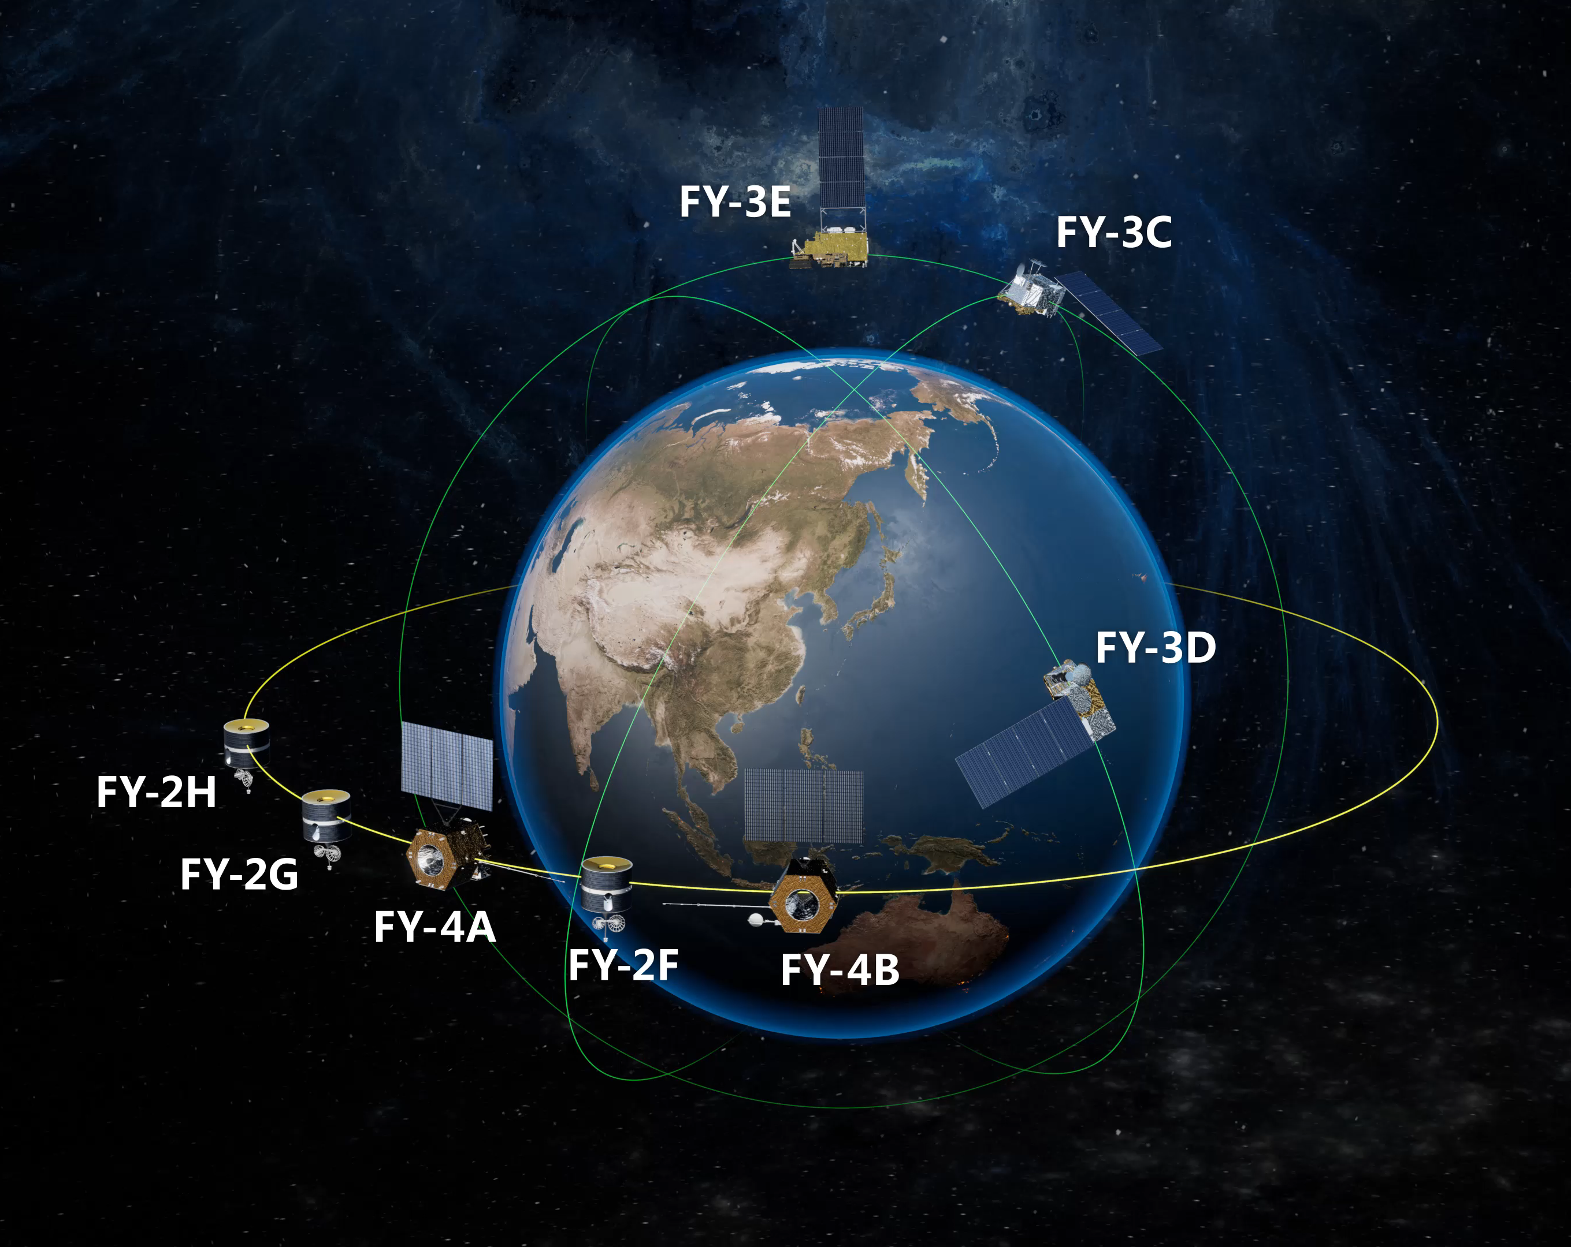
FengYun Satellites

Slide 6
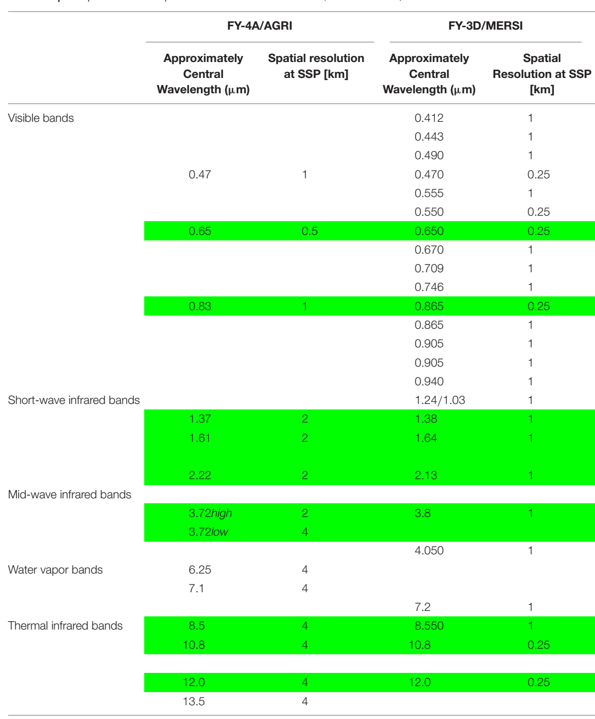
Ash detection
Ash detection
Hot spot detection
Ash detection & Micro-Physical properties of ash

Slide 7
Outline:
1. FengYun satellites
2. Global Applications
3. Recent research
4. Summary and future work

Slide 8
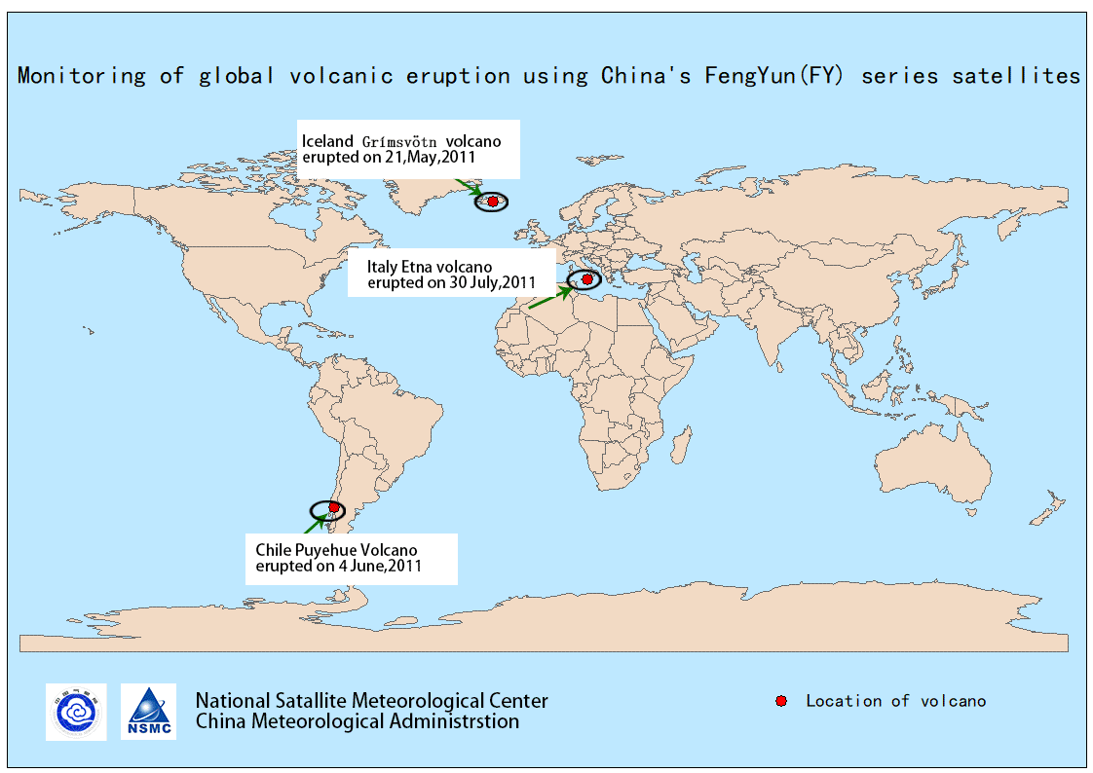
2. Global Applications

Slide 9
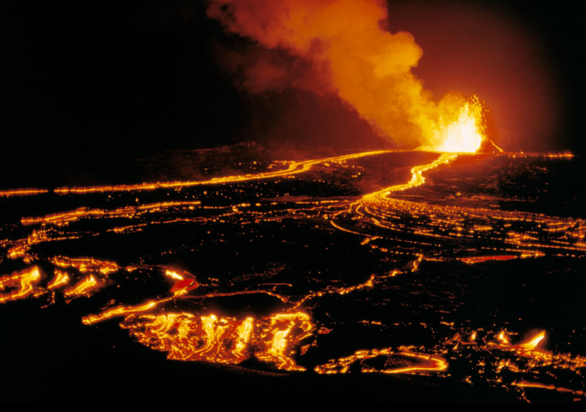
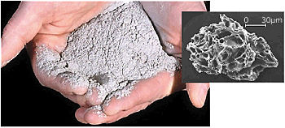
Hot Spot
detection
Micro-physical
features
风云气象卫星
全球火山爆发监测
Ash detection

Slide 10
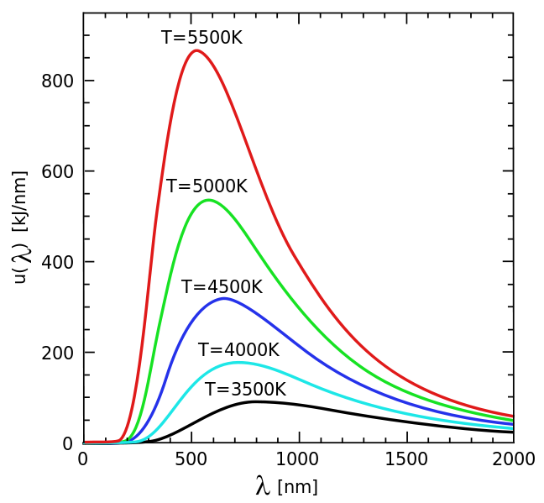
Hot spot detection—Basic theory
Wien‘s displacement law: there is an inverse relationship between the wavelength at the peak of the emission of a black body and its temperature when expressed as a function of wavelength.
Mid-infrared sensors with central wavelength at 2.0-3.0 μm can respond strongly to thermal emission from surface at magmatic temperatures even though those surface areas are very small.
Black body thermal emission intensity as a function of wavelength for various absolute temperatures.

Slide 11
A summary of FY instruments which can be used to observe thermal features of volcano
FY-3A,B/ VIRR channel 3 (3.55 ～ 3.93 µm)
FY-3A,B/ VIRR channel 4 & 5 (10.3 ～ 11.3 µm & 11.5 ～12.5 µm)
FY-3A,B,C,D/ MERSI channel 24 & 25 (10.8 um & 12.0 µm )
FY-3A,B,C,D/ MERSI channel 20 & 21 (3.8 µm & 4.05 µm)
FY-2D,E,F,H/VISSR channel 3 (3.55 ～ 3.93 µm)
FY-2C,D,E,F,H channel 4 & 5 (3.55 ～ 3.93 µm)
FY-4A,B/AGRI channel 7 (center wavelength 3.72 µm)

Slide 12
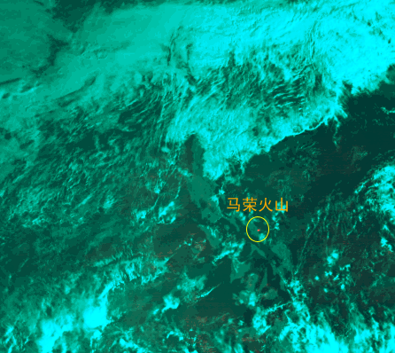
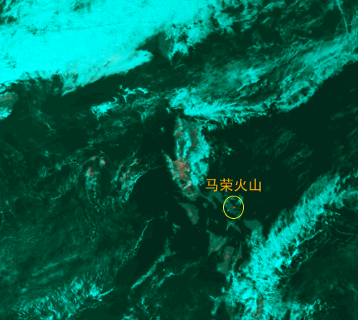
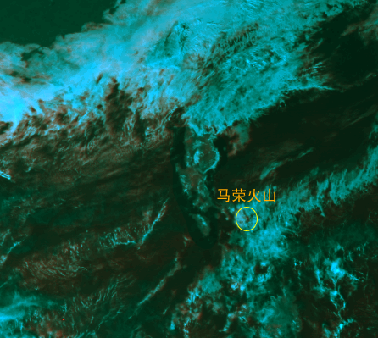
FY-2E detection of Mayon Volcano eruption in Philippine
18, December, 2009 (08:00)
5 km resolution
27, December, 2009 (14:00)
28, December, 2009 (14:00)
Mayon volcano
Mayon volcano
Mayon volcano
This three images are FY-2E daytime scenes (with 5 km resolution) showing 3.5～4.0 μm hotspots on Mayon volcano in Philippine acquired on 18～28, December, 2009. It is shown that the hotspot strength reached the highest on 27, December, 2009 and then it gradually calm down.

Slide 13
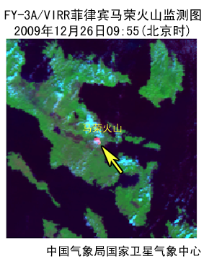
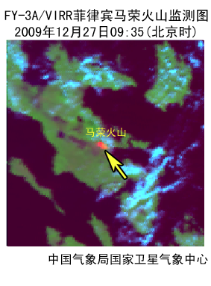
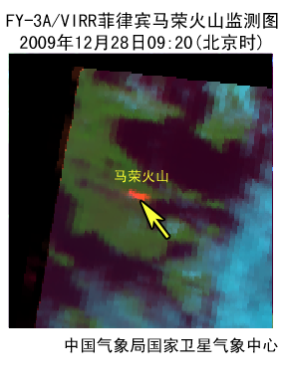
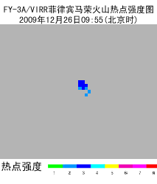
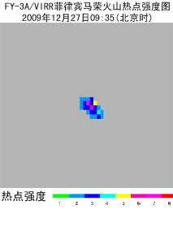
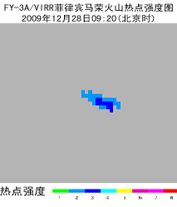
FY-3A/VIRR detection of Mayon Volcano eruption in Philippine
26, December, 2009 (09:55)
27, December, 2009 (09:35)
28, December, 2009 (09:20)
Mayon volcano
Mayon volcano
Mayon volcano
1 km resolution
Hotspot intensity
Hotspot intensity
Hotspot intensity
Compared with the FY2 satellite, the FY3 satellite has a higher spatial resolution, and we can clearly observe the intensity variations of the volcanic hot spot.
Notes:
Hotspot intensity

Slide 14
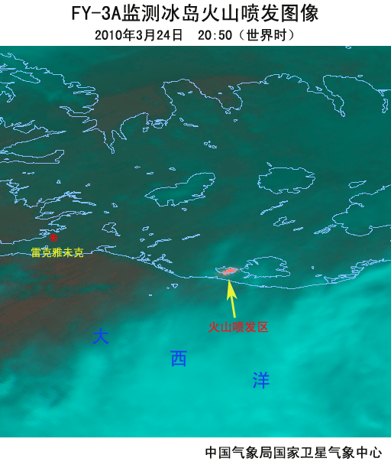
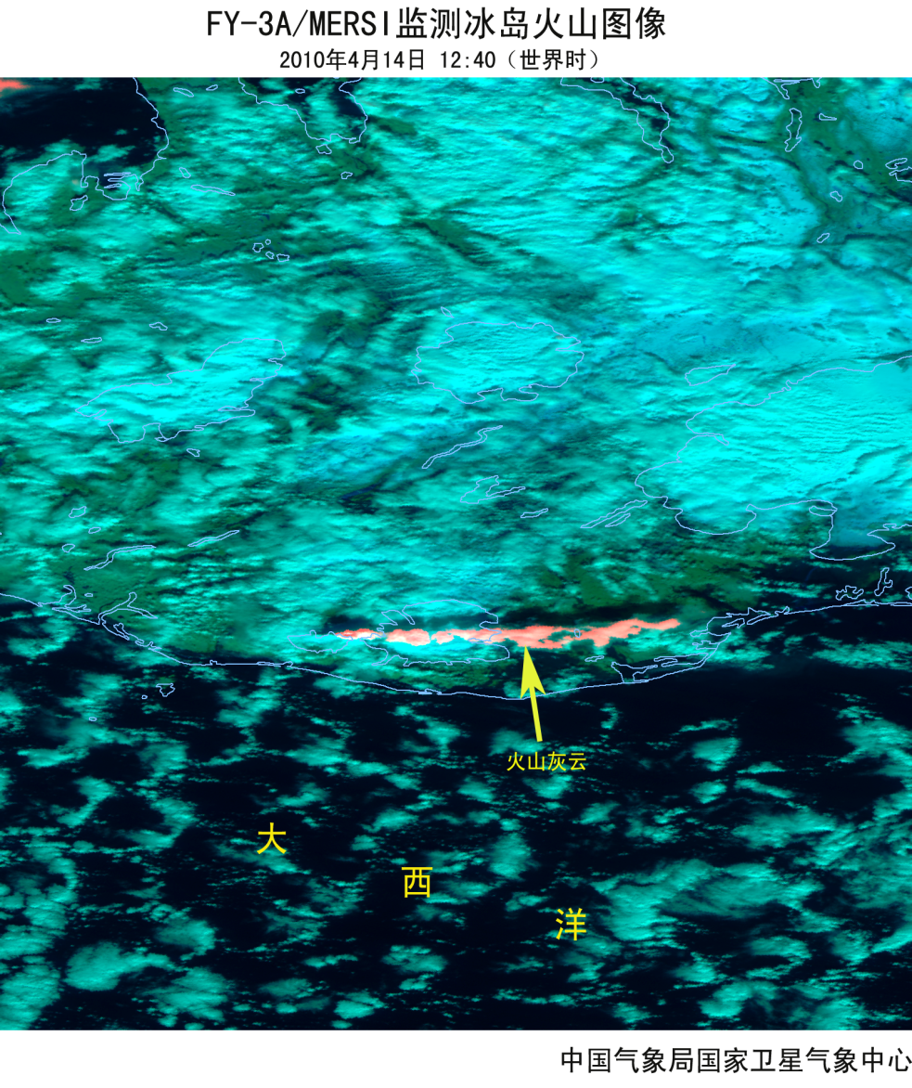
FY-3A detection of Iceland Eyjafjallajokull volcano eruption
250 m resolution
Using the 250-meter resolution data of the Fengyun-3 satellite, the strength and area of high-temperature lava can be estimated more accurately.

Slide 15
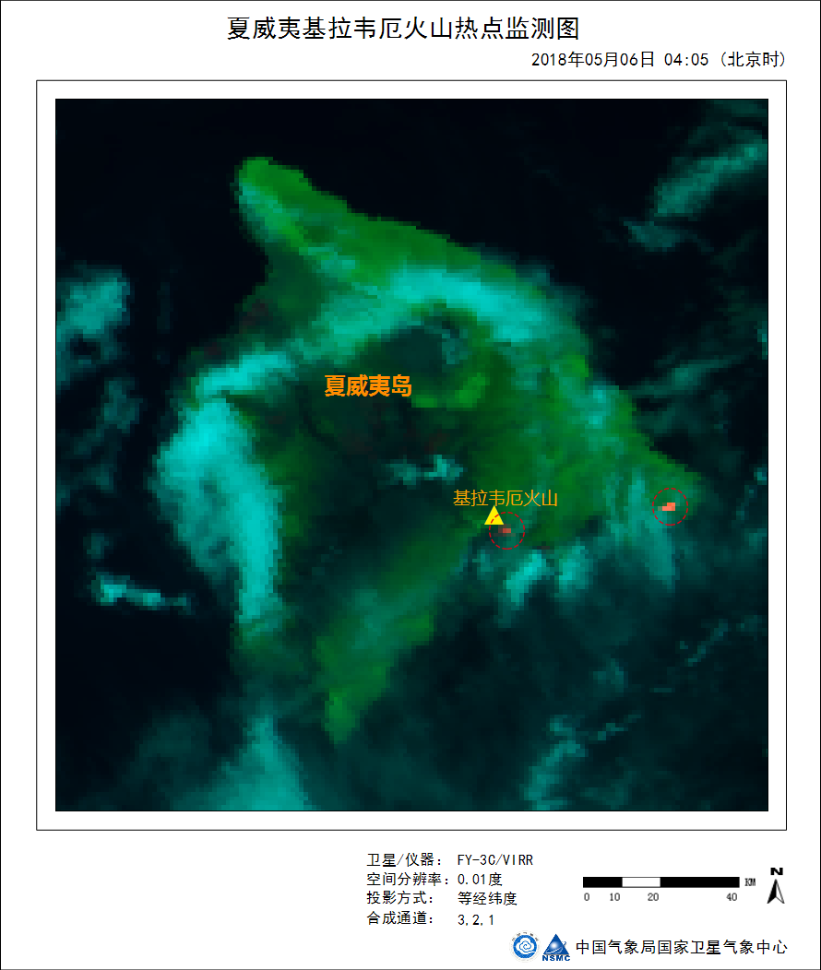
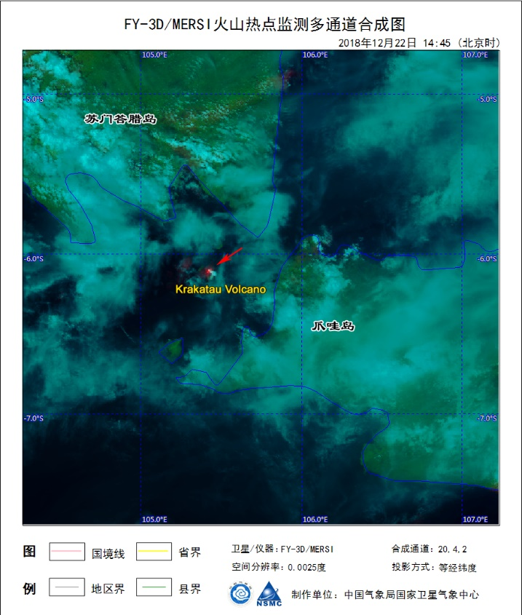
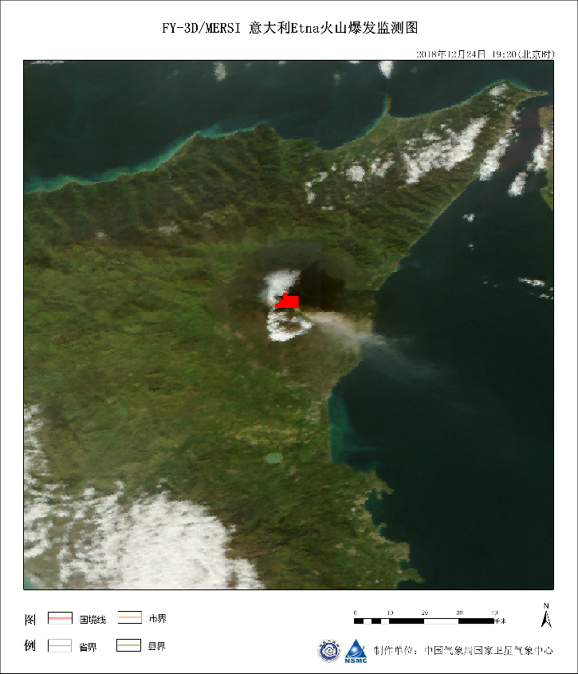
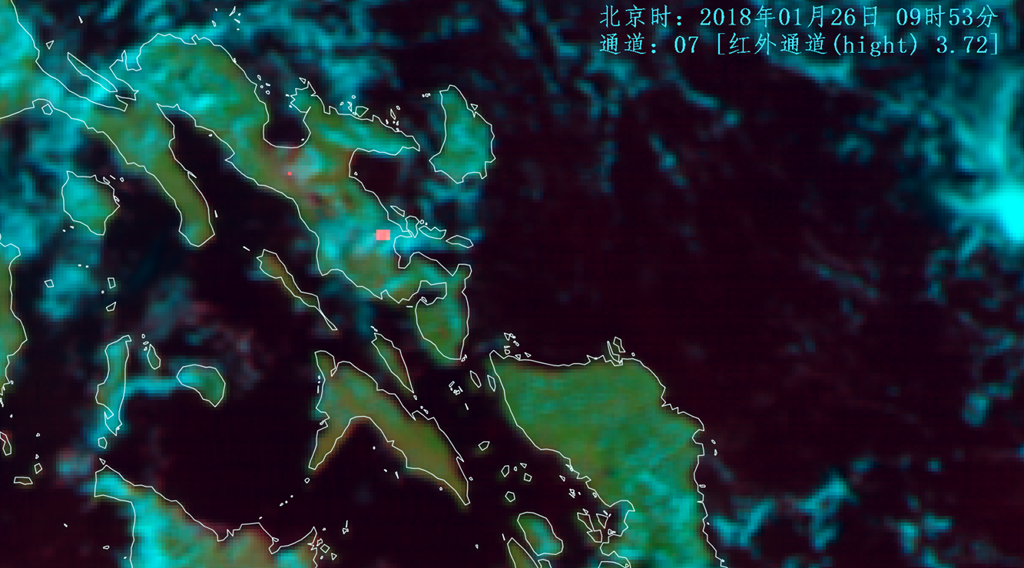
FY-3C
FY-3D
FY-3D
Kilauea, Hawaii
Krakatau, Java
Etna, Italy
FY-4A
Hot spot detection using FY3 series satellites
FY-4A/AGRI detection of Volcano eruption

Slide 16
2. Global Applications
Hot Spot
detection
Micro-physical
features
风云气象卫星
全球火山爆发监测
Ash detection

Slide 17
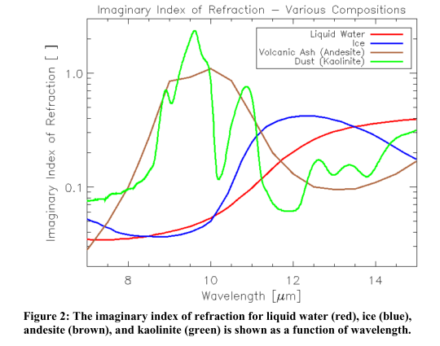
Infrared channels
SO₂
Mineral particles

Slide 18
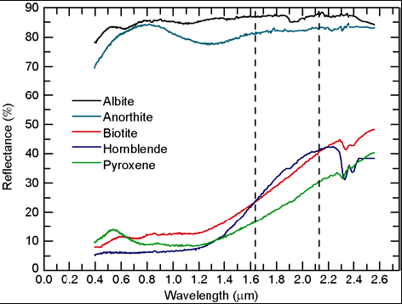
Reflective channels
In two adjacent shortwave infrared channels, dark colored minerals have different reflection characteristics from meteorological clouds.
light colored minerals
dark colored minerals
MERSI-I for volcanic cloud
Reflectance of typical minerals of volcanic ash (data are referred to USGS standard mineral spectral database).

Slide 19
  SWIR-TIR Volcanic Ash method (STVA)
A new volcanic ash cloud detection method (STVA) is developed using shortwave infrared and thermal infrared channels of MERSI and VIRR instruments onboard FY-3A. This method is also well applicable to the follow-up satellites of Fengyun-3.
SWIR-TIR Volcanic Ash method (STVA)
FY-3A-D/MERSI-I &MERSI-II
FY-3A,B/VIRR,
FY-3C,D/MERSI-II
Zhu L*., Liu J, Liu C & Wang M.2011. Satellite remote sensing of volcanic ash cloud in complicated meteorological conditions. Sci China Earth Sci(IF：3.24), 54：1789-1795. doi:10.1007/s11430-011-4265-3

Slide 20
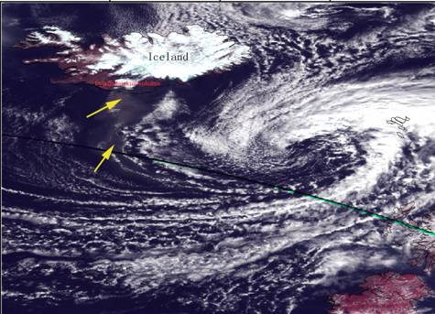
Application of STVA method during Eyjafjallajokull volcano eruption

Slide 21
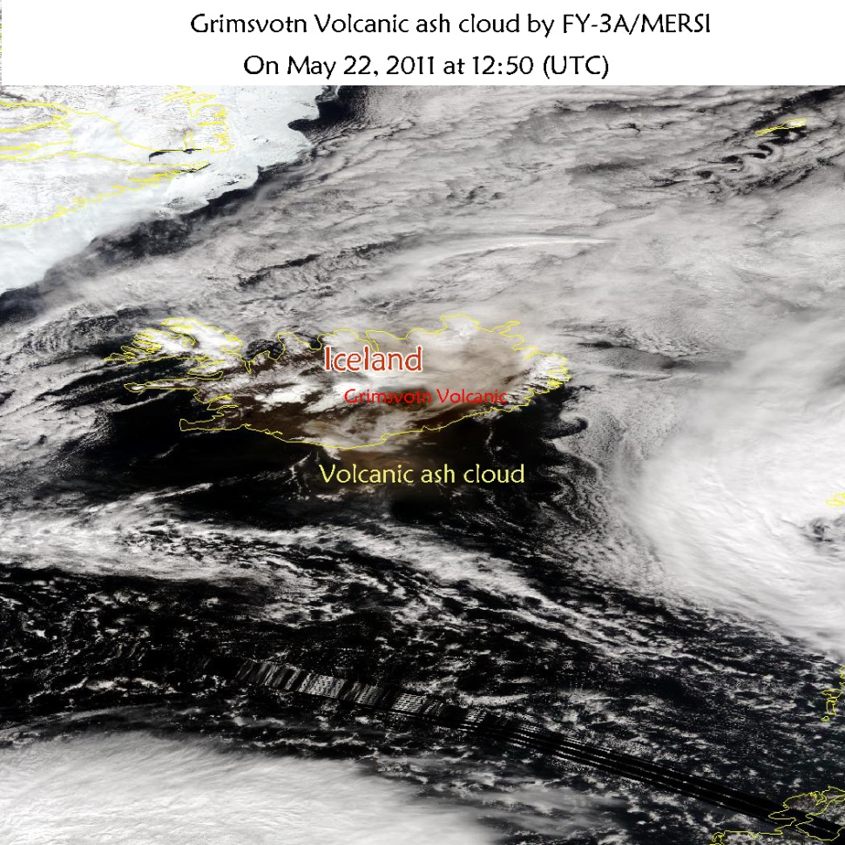
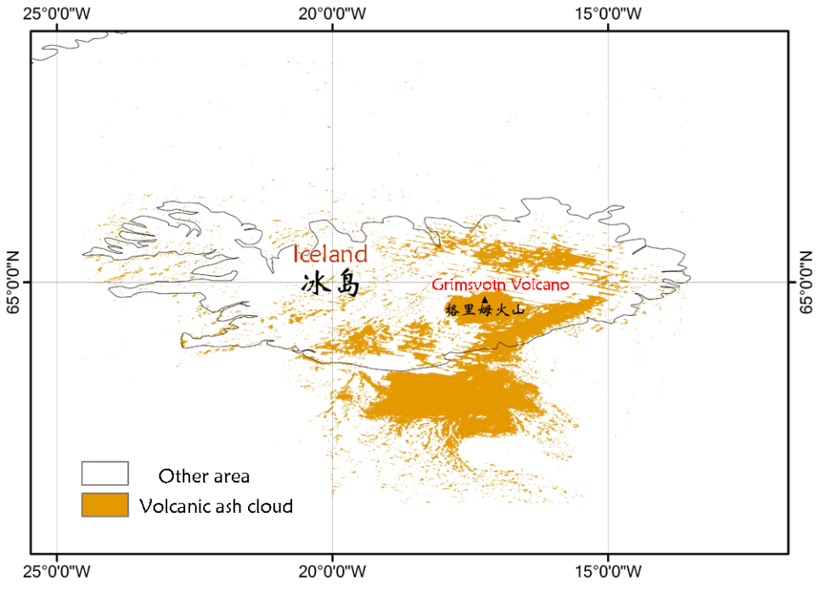
Application of STVA method during Grimsvotn volcano eruption
STVA method
Grimsvotn volcano erupted on March 20, 2010 at 11:30 UTC.
Volcanic ash is mainly distributed in the south and east of Iceland.

Slide 22
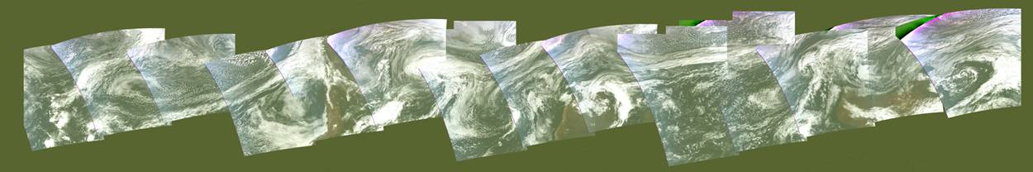
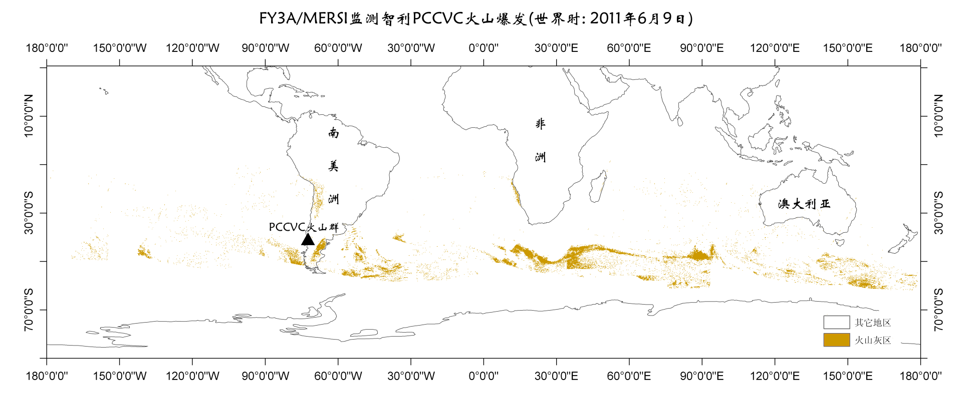
Puyehue-Cordón Caulle volcanic complex (PCCVC) in the Chilean Andes
Volcanic ash cloud transport
Up to June 9, PCCVC continues to have briefer eruptions every now and then . Volcanic ash cloud has surrounded over the southern hemisphere.

Slide 23
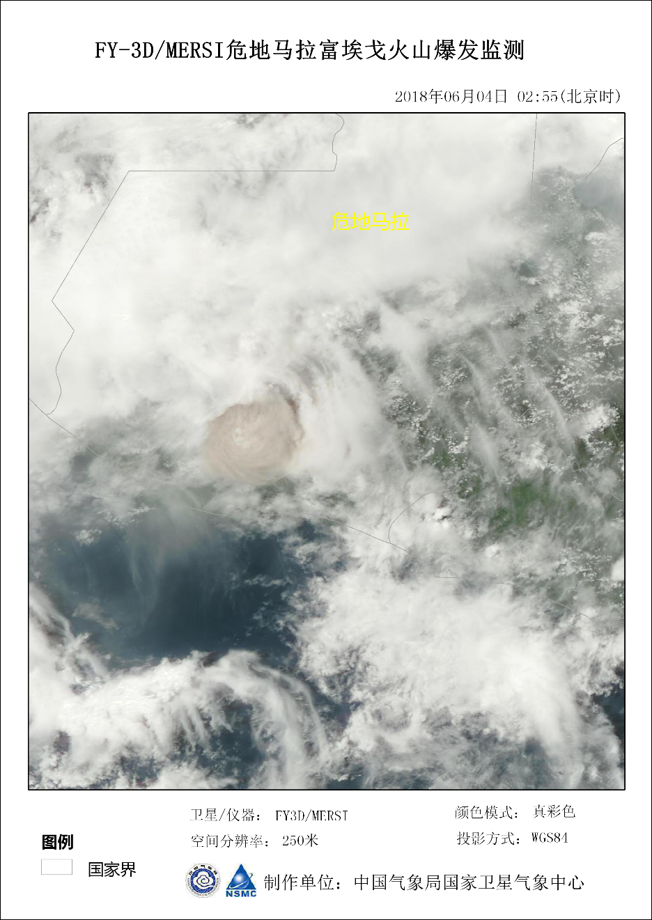
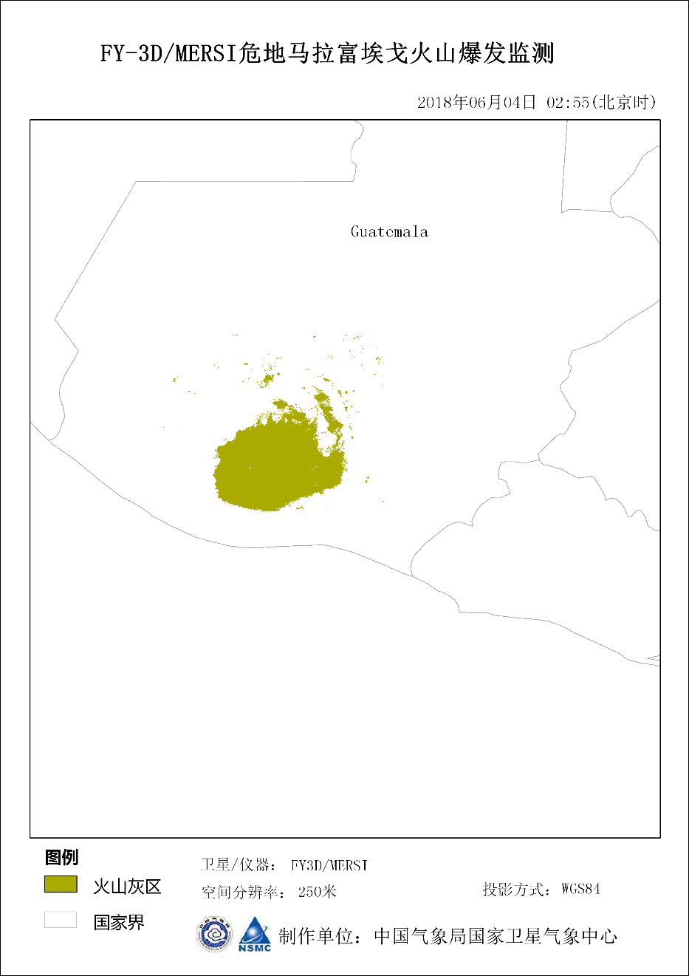
Detection result of Fuego eruption in Guatemala
Volcanic ash

Slide 24
2. Global Applications
Hot Spot
detection
Micro-physical
features
风云气象卫星
全球火山爆发监测
Ash detection

Slide 25
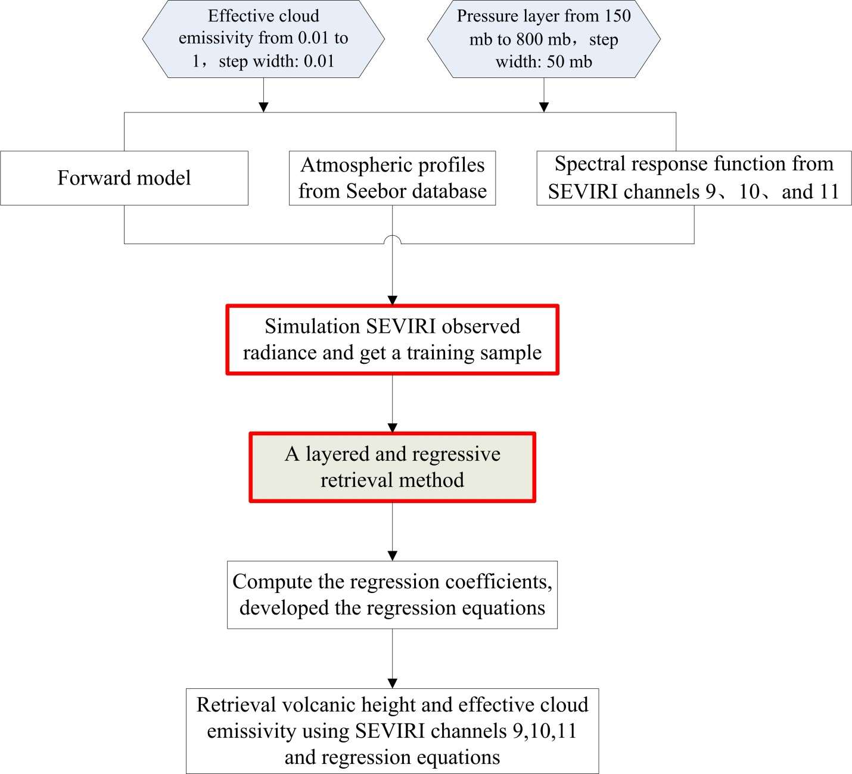
A linear regression method for Volcanic ash top height retrieval
Forward Radiative Transfer Model
Use a layered and regressive statistical methods to simulate the relationship between satellite observation signals and volcanic ash cloud height.
Zhu L.,Jun Li.,Zhao Y.Y., et al., 2017. Retrieval of volcanic ash height from satellite-based infrared measurements, Journal of Geophysical Research: Atmospheres, 122(10): 5364-5379

Slide 26
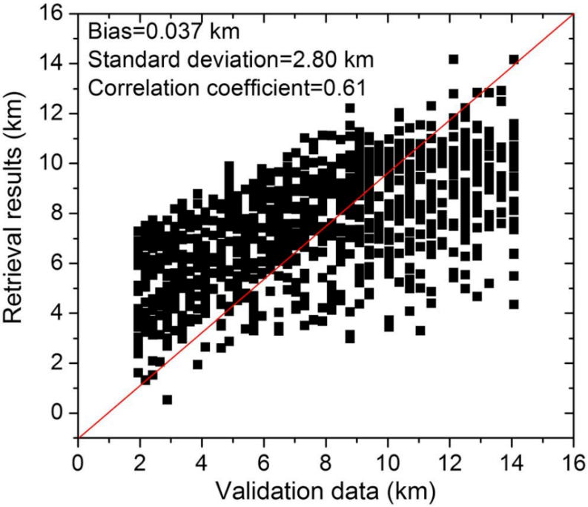
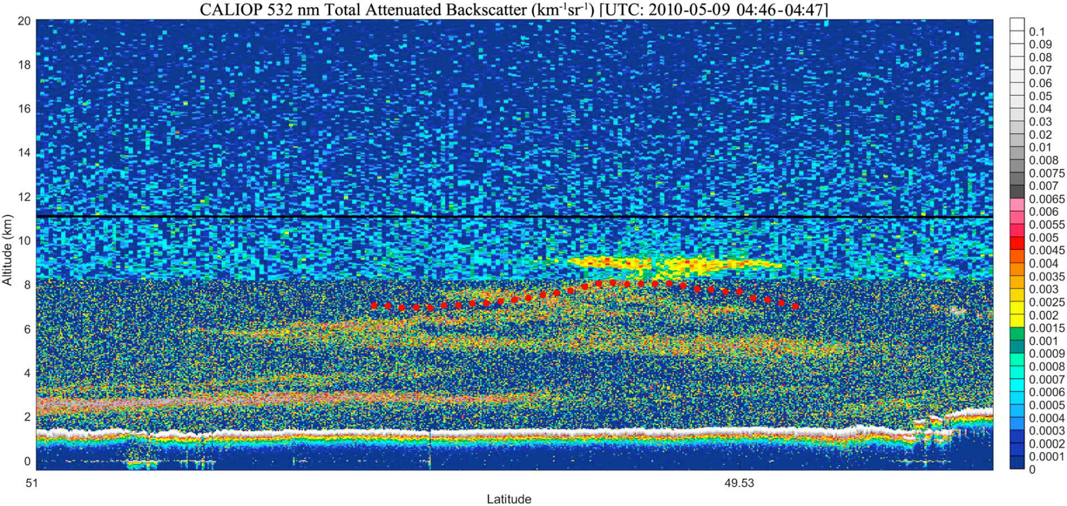
1. Generally demonstrate the linear variation
2. Best estimate at about 7-8 km
3. Advantage: Without inputting extra ancillary data such as atmospheric reanalysis data.

Slide 27
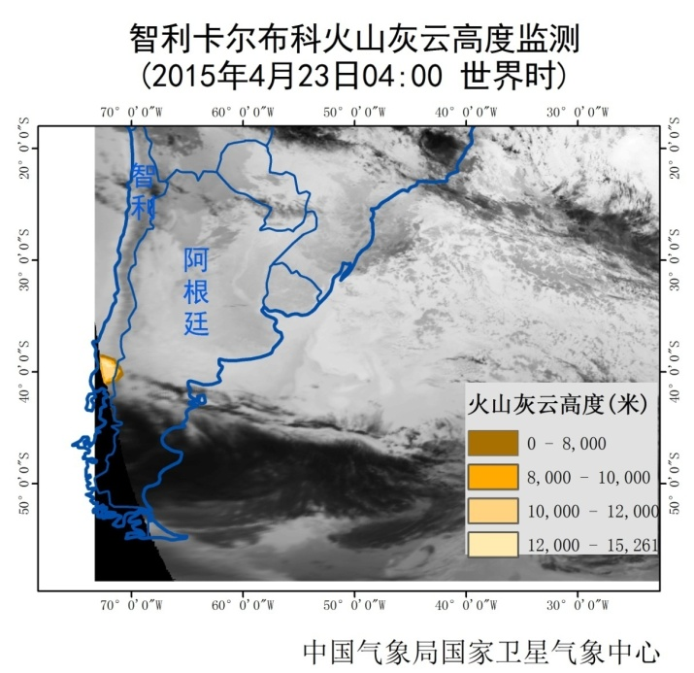
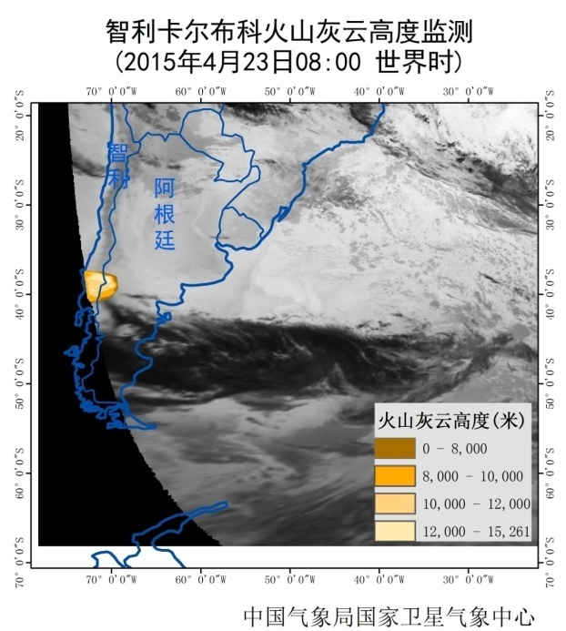
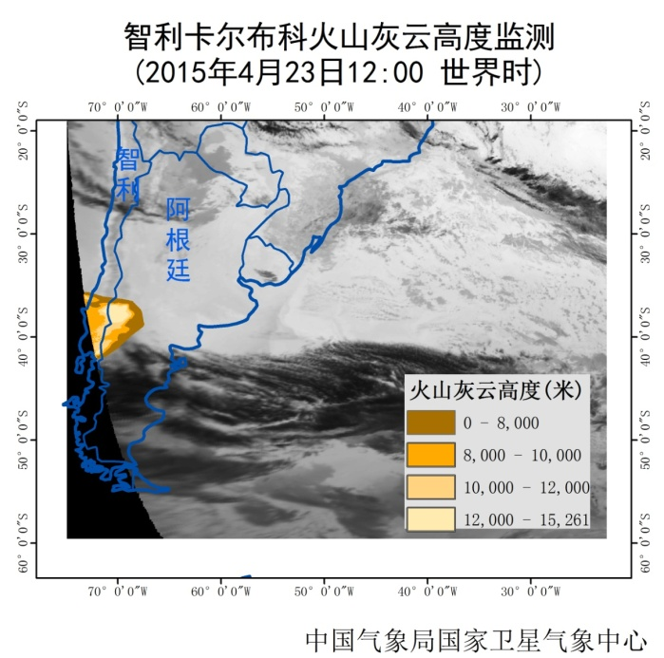
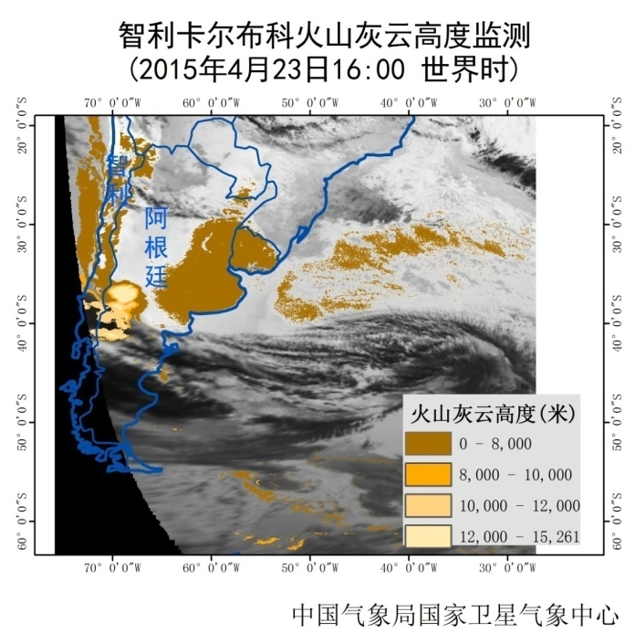
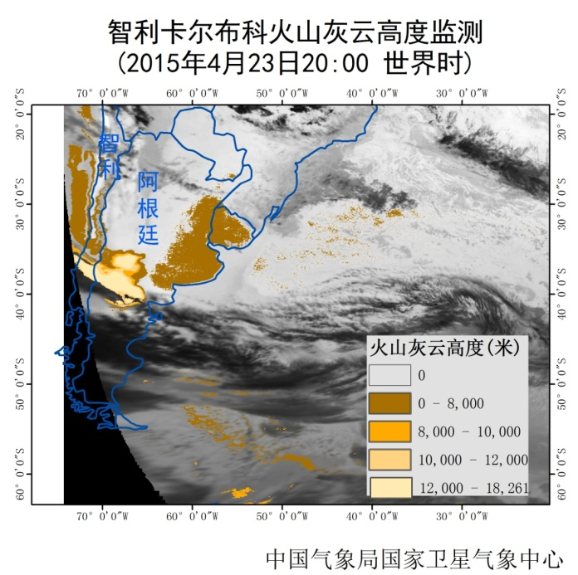
Dynamic change of volcanic ash height estimation for Chile’s Calbuco volcano
Volcanic ash was spreading to the north east of Chile and gradually had influence to tis neighbour country and the Atlantic.
圣马丁

Slide 28
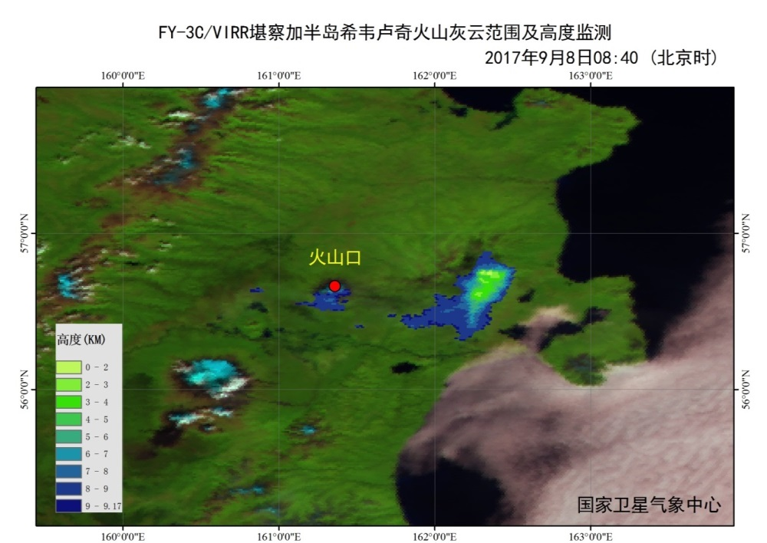
Siveluchi Volcano, Kamchatka Peninsula

Slide 29
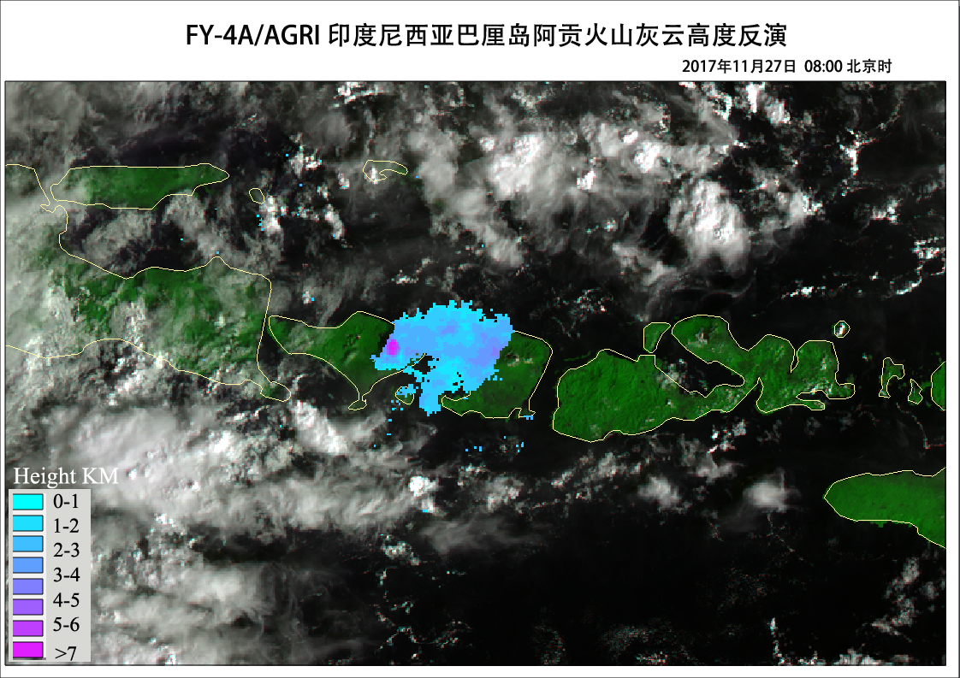
Agung, Indonesia

Slide 30
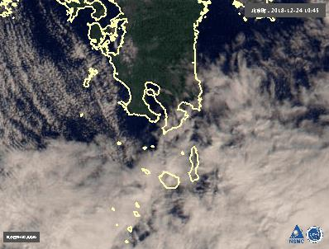
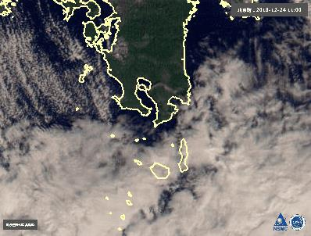
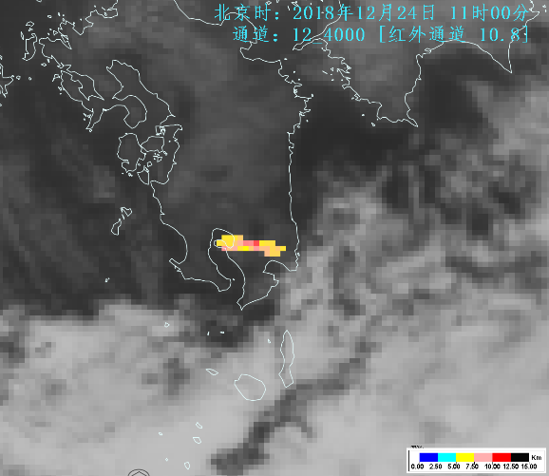


Sakura-jima volcano in Kagoshima, Japan
December 24, 2018, 10:45-11:30 (Beijing time)

Slide 31



Taal volcano, Philippines, Jan 12, 2020
FY-4A
FY-3B
FY-4A

Slide 32



Raikoke volcanic eruption, Kuril Islands, June 22, 2019
FY-4A
FY-3D
FY-4A

Slide 33


FY-3D
Saint Vincent, Caribbean Sea
Caribbean volcano saint vincent
FY-3D

Slide 34
Outline:
1. FengYun satellites
2. Global Applications
3. Recent research
4. Summary and future work

Slide 35




  （1）Automated volcanic hot-spot detection based on FY-4A/AGRI infrared data （FYVOLC）
NBTDI to reduce the influence of ‘cold’ cloud.
A mid-infrared brightness temperature criterion to identify volcanic hot spots by making calculations based on the image itself without artificially determining any parameters.
S. S. Chu, L. Zhu, H. F. Sun, Q. W. Li, X. R. Zhang, T. T. Chen, L. Qiao, W. R. Zhu, D. X. Zhao & Y. H. Zhang (2019): Automated volcanic hot-spot detection based on FY-4A/AGRI infrared data, International Journal of Remote Sensing, DOI: 10.1080/01431161.2019.1688887

Slide 36

Early-warning systems based on FY-4 data
Preliminary verification shows the total Accuracy >89%

Slide 37



  （2）Retrieving Volcanic Ash Top Height through
  Combined Active and Passive Remote Sensing Data
There is often a complex nonlinear relationship between the optical and physical properties of volcanic ash clouds and the satellite observation.
A deep-learning-based algorithm (SDA+GA+LSSVR)
Atmosphere profile
ERA-interm：（ECMWF）
Active
Passive
CALIOP：Cloud-Aerosol Lidar with Orthogonal Polarization
SEVIRI：Spinning Enhanced Visible and Infrared Imager
(Zhu et al., Remote Sensing, 2020,Vol 12)

Slide 38







Eyjafjallajökull case
Puyehue-Cordón Caulle cases
This method
This method
GOES-R method
GOES-R method
This method can achieve the more accurate results with the lower error and highest correlation with “true data”.
The complex nonlinear relationship between the VTH and the remote sensing thermal infrared channels can be simulated accurately, multi-layer clouds condition.
Notes:
it not only performs well under a relatively simple meteorological background but also is robust under more complex meteorological conditions.

Slide 39
Summary and future work:
From monitoring to forecast!
Ash dispersion
Ash height mass loading
Forecast
Ash height mass loading
Combined vertical information
Quantitatively retrieval
Future
Hot spot & ash
2017-2021
Detection
2015-2017
Deep learning method
2009-2015
Radiative transfer model

Slide 40
Reference:
Zhu L, Liu J, Liu C, et al. 2011, Satellite remote sensing of volcanic ash cloud in complicated meteorological conditions. Sci China Earth Sci, 154(11): 1789-1795. (Ash detection)
Zhu L*.,Jun Li.,Zhao Y.Y., et al., 2017. Retrieval of volcanic ash height from satellite-based infrared measurements, Journal of Geophysical Research: Atmospheres(IF：4.509), 122(10): 5364-5379 (Ash retrieval)
Zhang P.,Zhu L*.,Tang S H, et al.,2019.General Comparison of FY-4A/AGRI with Other GEO/LEO Instruments and Its Potential and Challenges in Non-meteorological Applications, Frontiers in Earth Science(IF：2.689), 2019.6,224,doi: 10.3389/feart.2018.00224 (Ash retrieval)
S. S. Chu, L. Zhu, H. F. Sun, Q. W. Li, X. R. Zhang, T. T. Chen, L. Qiao, W. R. Zhu, D. X. Zhao & Y. H. Zhang (2019): Automated volcanic hot-spot detection based on FY-4A/AGRI infrared data, International Journal of Remote Sensing, DOI: 10.1080/01431161.2019.1688887 (hot spot detection)
Zhu W., Zhu L*., Li J., Sun H.,2020. Retrieving Volcanic Ash Top Height through Combined Polar Orbit Active and Geostationary Passive Remote Sensing Data, Remote Sensing(IF：4.51), 12, 953; doi:10.3390/rs12060953 (Ash retrieval)

Slide 41
Thanks for your attention!
Any questions?

