Slide 1



AN ASSESSMENT OF CLIMATE PREDICTION AND ITS IMPACT ON SELECTED URBAN CITIES OF SINDH USING GEO-SPATIAL TECHNIQUES
Presented By:
Jan Muhammad
Aviation Meteorologist
Pakistan Meteorological Department
Jansolangi.met2009@gmail.com

Slide 2
OVERVIEW
Introduction
Literature Review
Study Area
Objectives
Research Data
Research Methodology
Results and Discussion
Summary
Recommendations

Slide 3
INTRODUCTION
Climate Predictions are the hot issue of every country
Based on the variation in meteorological events and also based on a change of situations, models and recreations which contain the bundle of assumptions
Projection of Climate and its effects on whole atmosphere including earth.
The climate predictions are a basic tool for strategy making, monetary movement, and resource management

Slide 4
INTRODUCTION
Climate change as a global issue for public policy and decision-making
The future scenarios of climate predictions and its variation are helped to detect the potential impact of climate change on Selected Urban Cities of Sindh.
The climate changes highly impacts on water assets, energy, health, agriculture, economic, industrial and private sectors
Highly unexpected meteorological events are the alarming situation of climate change and its impact on study areas

Slide 5
LITERATURE REVIEW
Pakistan owing to its warm climate is especially vulnerable to climate change. (Rasul, G., Afzal, M., Zahid, M., & Ali Bukhari, S. A., 2012)
The extreme climatic events are fully depended on the various climatic indicators that could be used during processing of the data of climate models for the prediction of incoming scenarios related with meteorology and climate. (P. Frich, L. V. Alexander, P. Della-Marta, B. Gleason, M. Haylock, A. M. G. Klein Tank, T. Peterson., (2002))
The variation in anthropogenic activities causes to reduce of natural resource and it’s highly impact regional and local meteorological events and also on the natural land use and land covers. (H.U. ABBASI, A. S. SOOMRO A. MEMON, S. R. SAMO, I. R. KARAS, 2012)

Slide 6
LITERATURE REVIEW
The steady and irreversible change in long term statistics of meteorological parameters impact on the climate in that may be in a definite district or over the whole globe is called climate change. (Ikram, F., Afzal, M., Bukhari, S. A. A., & Ahmed, B. (2016))
The world-wide average temperature has risen by 0.6°C, over southern east and central parts of United States while an increase of 1.5°C is reported on south Asia.(Zaitao, P., L. Xiaodong, K. Sanjiv, G.Zhiqiu, K. James, 2013)
The onset of climate change is indicated by mean temperature. (Iqbal, W., M.Zahid,2014)

Slide 7
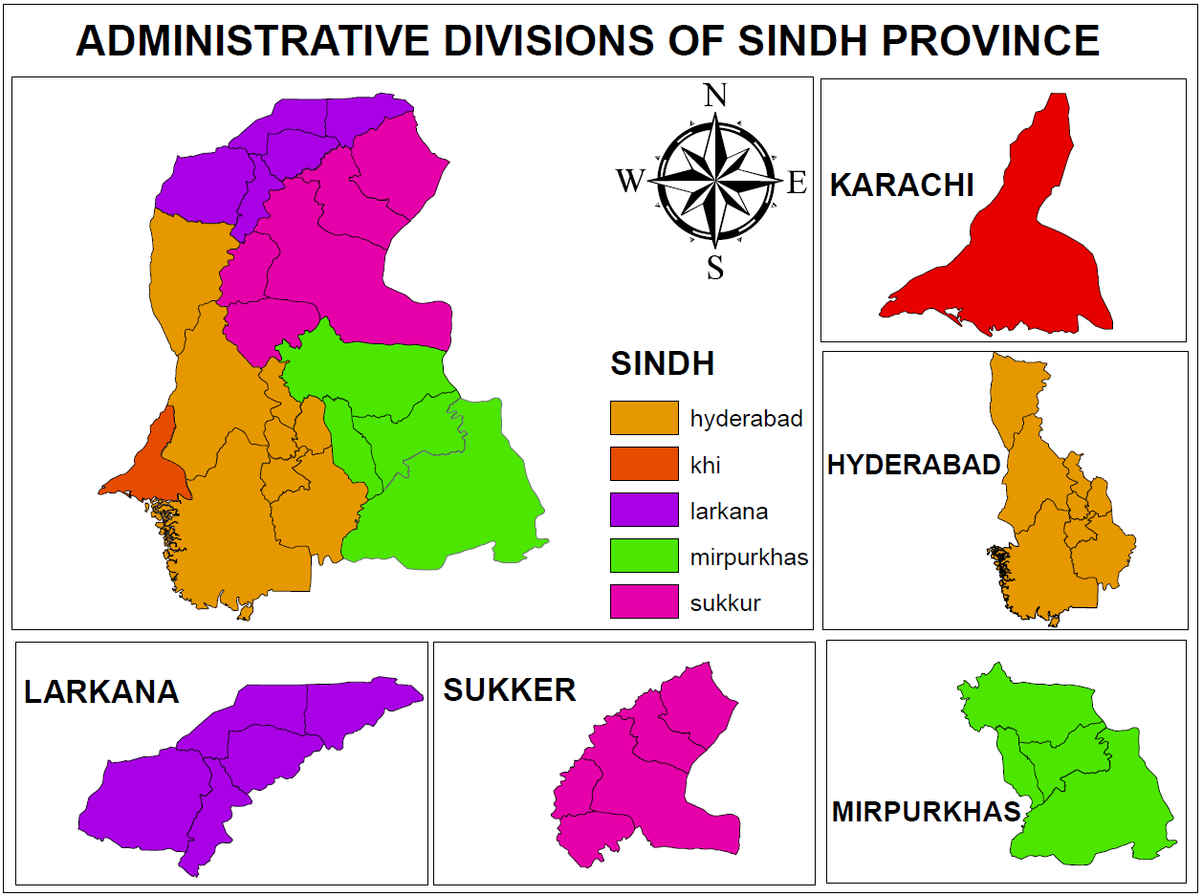
STUDY AREA
Past Climatic Condition
Present Climatic Condition (Actual)
Future Climatic Condition (Predicted)

Slide 8
OBJECTIVES
The main study area is focused on the major cities of South Asia but due to lack of resources and accuracy of results, it is started from selected urban cities of Sindh
To analysis climate prediction of study areas
To asses & determine climatic impact areas under high risk of study areas
To assess and predict meteorological disasters due to climate effect till the end of 2099

Slide 9
RESEARCH DATA
Ground Based Weather Data (Pakistan Meteorological Department)-1961-2018
GIS Data (GIS Shapefile of Study Area)
Population Data of Study Area (1951-2017)- Used to identify anthropogenic activities.
Climate Data (Past, Present & Future Data) on the based of models
Satellite Data- (National Center of Environmental Prediction (NCEP) Data) (1979-2014), LANDSAT data, MODIS Imaginary

Slide 10
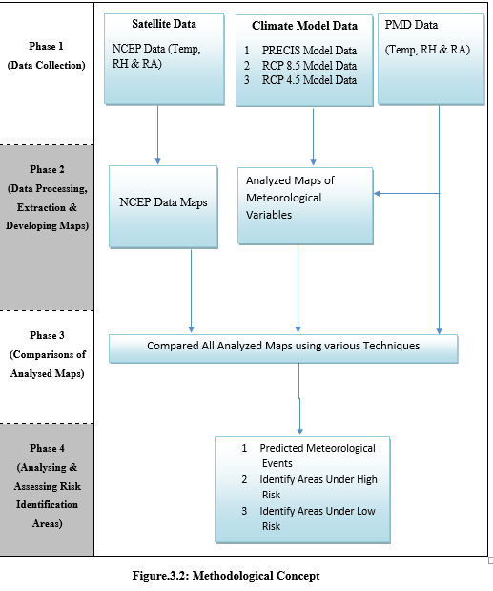

Slide 11
DATA FORMAT TYPES
Graphic Interchange Format (GIF)
Joint Photographic Experts Group (JPEG)
Portable Network Graphics (PNG)
Tagged Image File Format (TIFF)
Comma-Separated Values (CSV)

Slide 12
RESEARCH METHODOLOGY
Various climate models data and PMD data used for processing with help of the different tools such that Geo-referencing of data, Extraction by the Mask, the Geo-statistical Analytical Tools and Geo-Spatial Interpolation Techniques
Number of Interpolation Techniques using ArcGIS software applied to analysis/assess the future meteorological events such that IDW, GPI, RBF, LPI, Ordinary Kriging & Empirical Bayesian Kriging
The kriging techniques are more useful for this study area as compared other techniques as mentioned below
Selected data points of climate models to verify which Geo-Statistical analytical techniques are the best and accurate to assess the climate prediction of study area

Slide 13
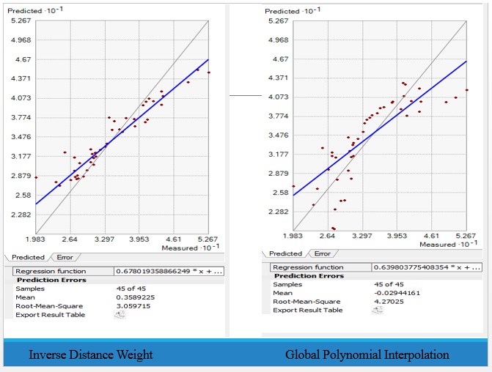
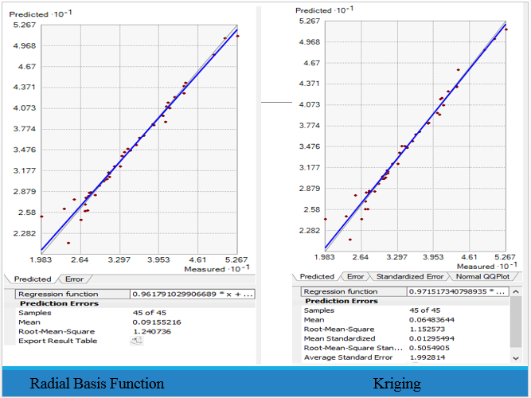

Slide 14
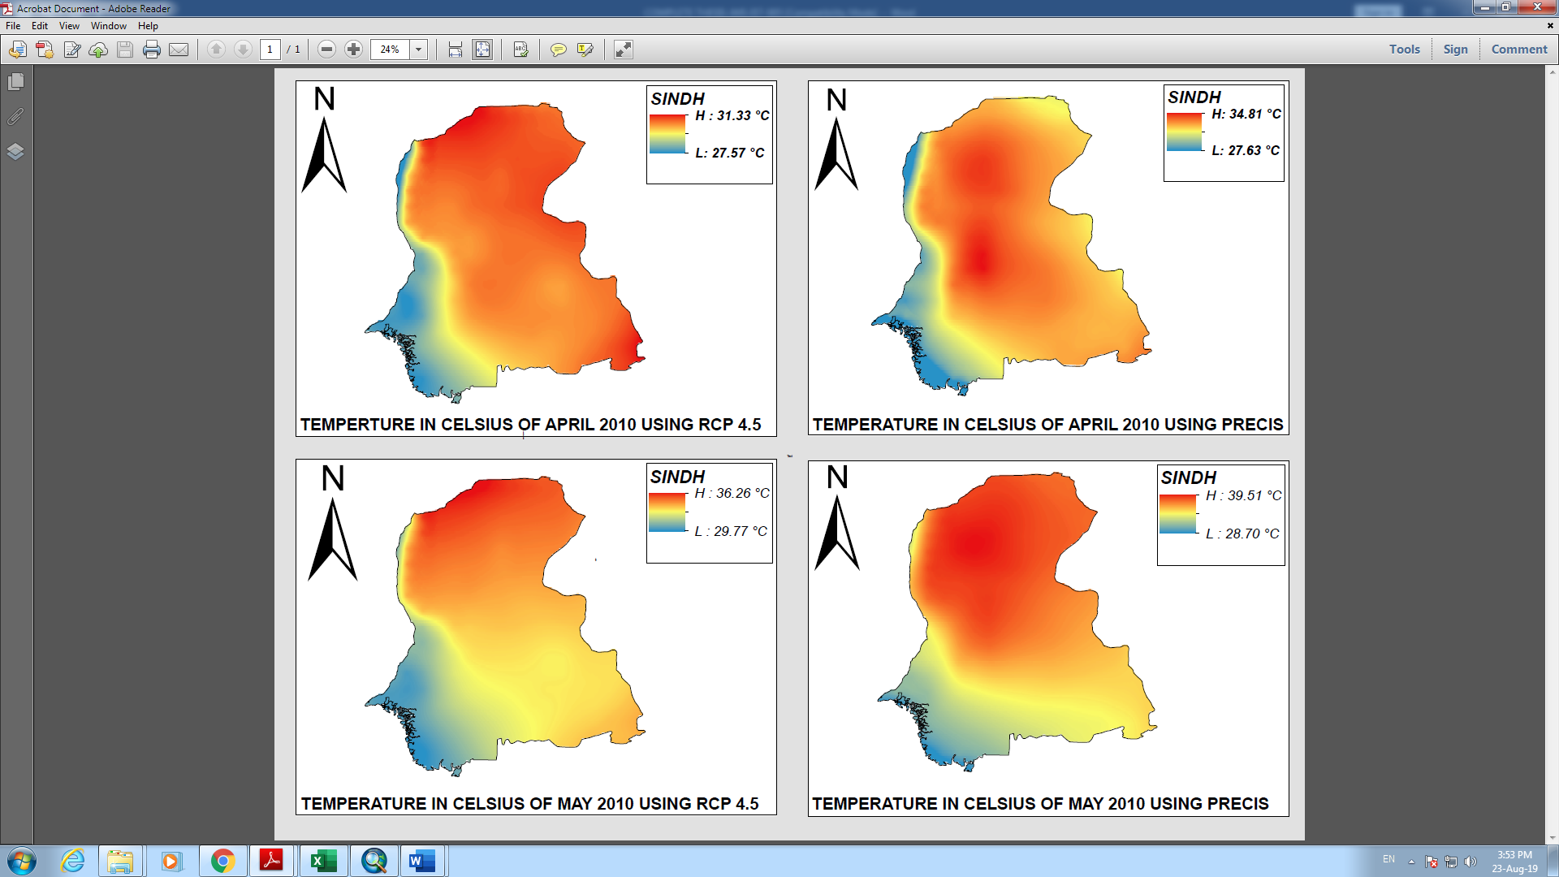
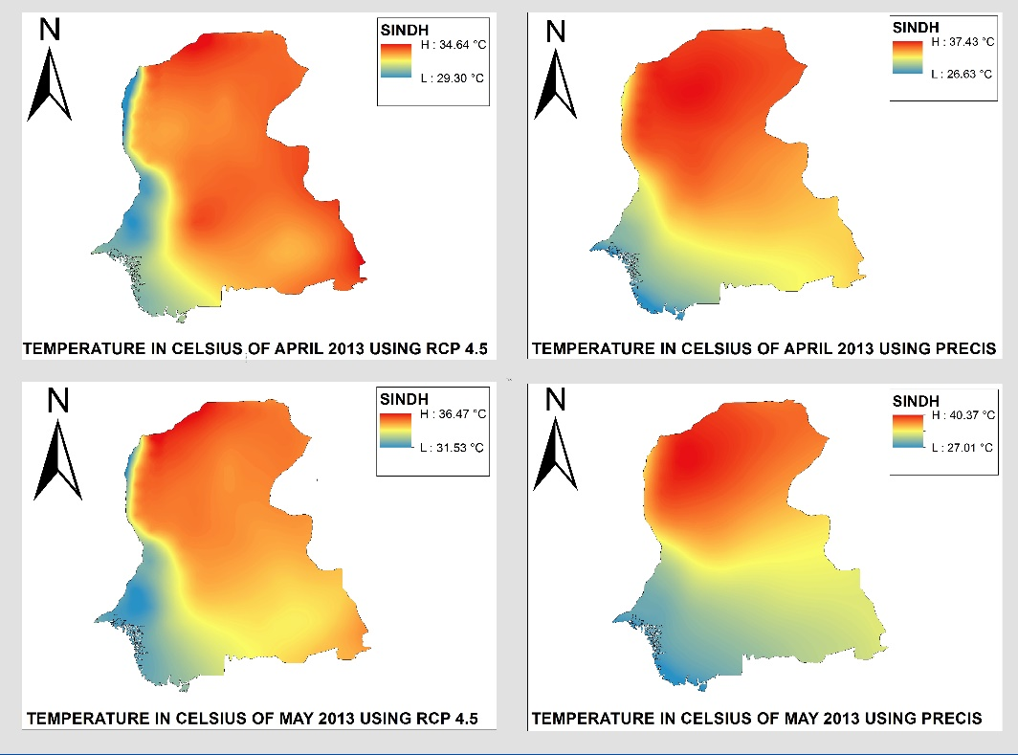

Slide 15
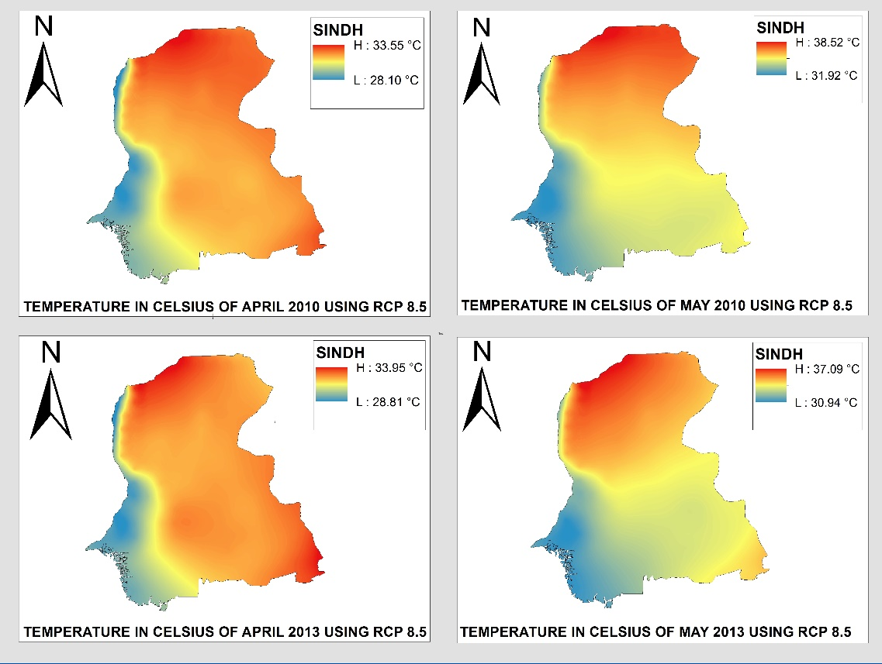
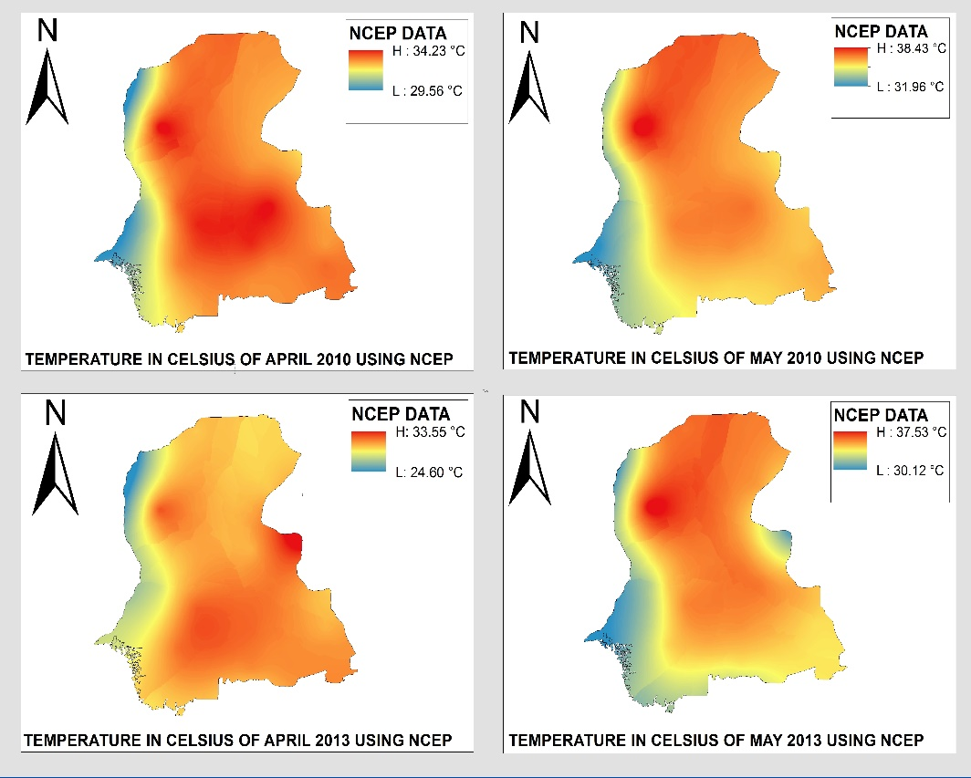

Slide 16
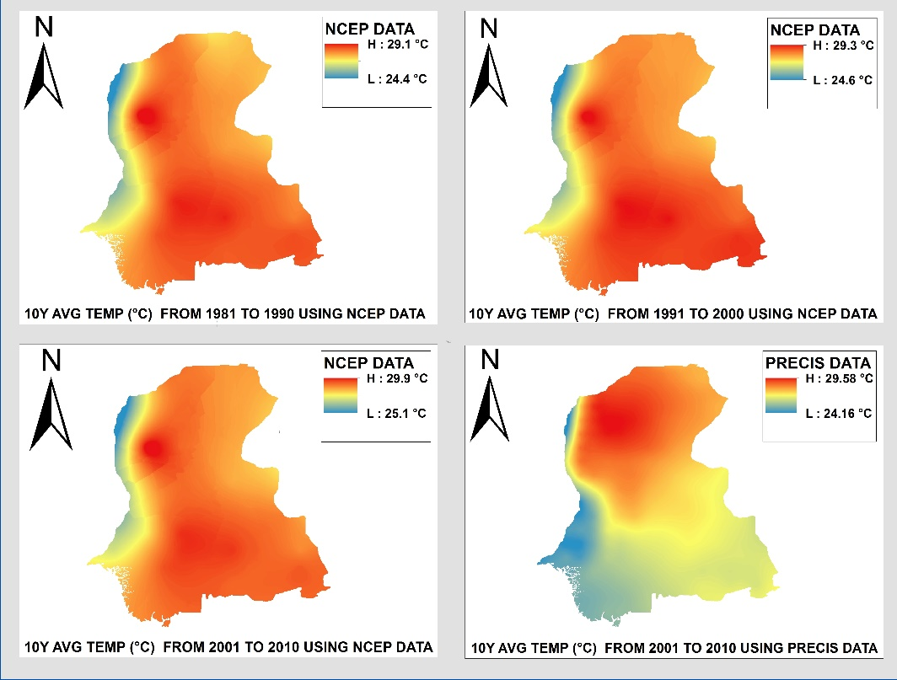

Slide 18
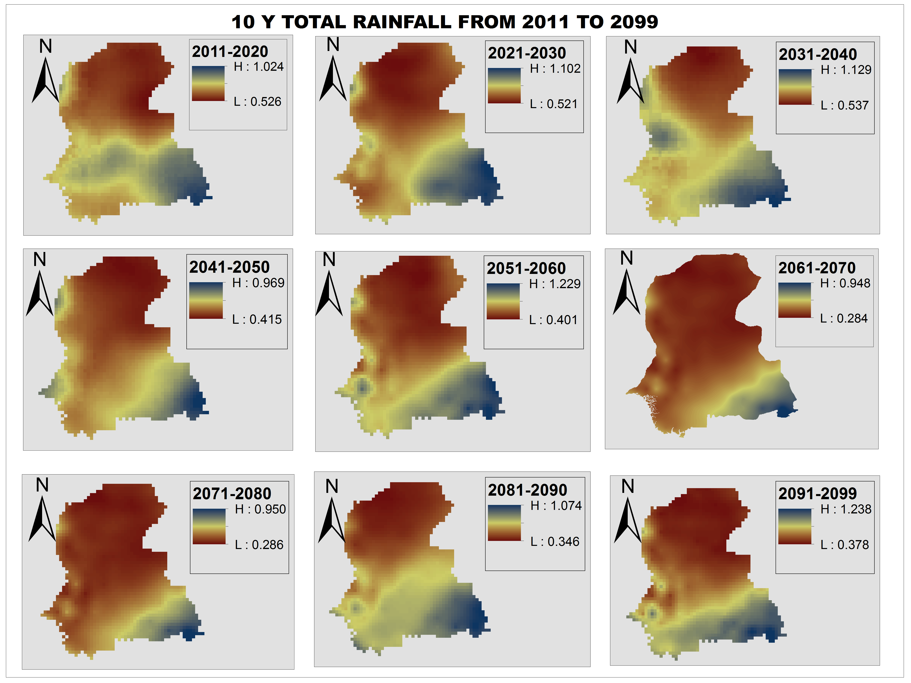
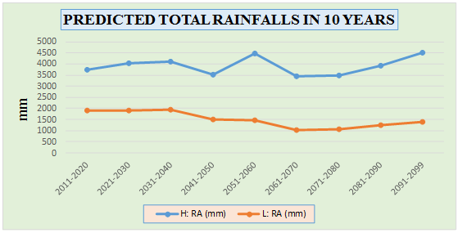

Slide 19
RESULTS AND DISCUSSIONS
Meteorological parameters are selected in this research are average temperatures, maximum and minimum temperatures, rainfall, and humidity
Meteorological events such that heavy rain with thunder, extreme snow fall, flooding with torrential rainfall, highly increase ratio of heat waves, drought condition, continuously hitting tropical cyclonic activities, earthquake, land sliding etc., are the major source of changing the meteorological parameters like as temperature, relative humidity, pressure and wind patterns
These events will be had huge impacts on the Climate of selected Urban Cities of Sindh

Slide 20
SUMMARY
Three meteorological parameters such that temperature, rainfall and humidity are simply the backbone of this study because these parameters are the basic key components to analysis the climate prediction and its impact on study area
Selected urban cities as compared other rural areas are highly under risk because the anthropogenic activities are under uncontrolled rate with addition of global warming
Major issues of the high heat waves will mostly impact on selected urban cities
Ground water level will also decreases gradually of urban cities of Sindh
The feeling temperature of these urban cities may be exceeded above 50°C during the summer season with lack of precipitation and high relative humidity
Shifting of rainfall events of these areas towards Arabian Sea and eastern sector of Sindh
Water migration is the major issue due to lack precipitation because of highly climate impacts on urban cities od Sindh Province

Slide 21
RECOMMENDATION
Urban areas of Sindh, where high anthrophonic activities with extraordinary usage of resource and lack of vegetation causes to damage the total structure of that areas
The responsible authorities to play the vital role for developing the friendly environment and rapidly control the rate of increasing ratio of high anthrophonic activities
The authorities should develop the green belt in the urban cities on immediate base
Provided source of water on immediate bases to all people who are interested to develop greenery

Slide 22
RECOMMENDATION
Save agricultural land areas and provided all basic sources to cultivate their lands
Develop new forest and control the rate of deforestation. Control increasing ration of transportation
Densely populated and heavily built areas are also vulnerable ones since they play the vital role to disturb the climate due to lack of resources
The responsible authorities to play the vital role for developing the friendly environment and rapidly control the rate of increasing ratio of high anthrophonic activities

Slide 23



