Slide 1
A histogram matching method for GSMaP improvement in geostationary meteorological satellite observing areas
Hitoshi Hirose, Tomoko Tashima, Takuji Kubota
Japan Aerospace Exploration Agency
Tomoaki Mega, Tomoo Ushio
Department of Engineering, Osaka University

Slide 2
GSMaP major algorithm update
Global Satellite Mapping of Precipitation（GSMaP）
Passive Microwave (PMW) sensor onboard
low-orbit satellites
Infrared (IR) radiometer onboard geostationary meteorological satellites
(GEOs)
・The update to GSMaP algorithm v8 will add numerous improvements
・A histogram matching method is introduced into the
PMW + IR combined (CMB) algorithm
High frequency
global precipitation estimation

Slide 3
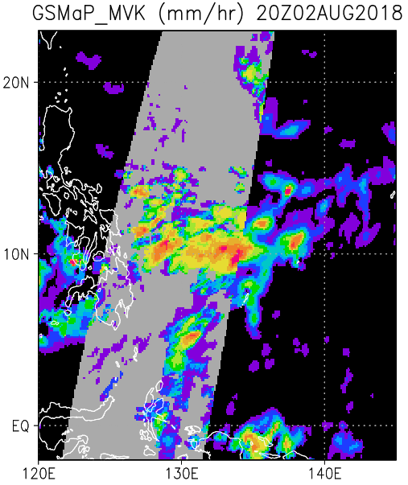
Research Objective
The black shaded area indicates rain rate observed by PMW sensors.
The gray shaded area indicates rain rate complemented by CMB algorithm
The interpolation product using GEO IR tends to overestimates rain rate compared to PMW observations
This has caused a gap in the rain rate at the boundary between the PMW and GEO IR observing areas.
To reduce the accuracy difference
between the PMW and CMB products

Slide 4
MVK algorithm flowchart
If PMW observation is not available, the GSMaP calculates a cloud moving vector
Furthermore, a Kalman filter is used to correct the rain rate
To reduce the accuracy difference between the CMB and PMW algorithms, the histogram matching method is introduced.
Histogram matching is applied only to CMB product and does not change the observed value of PMW

Slide 5
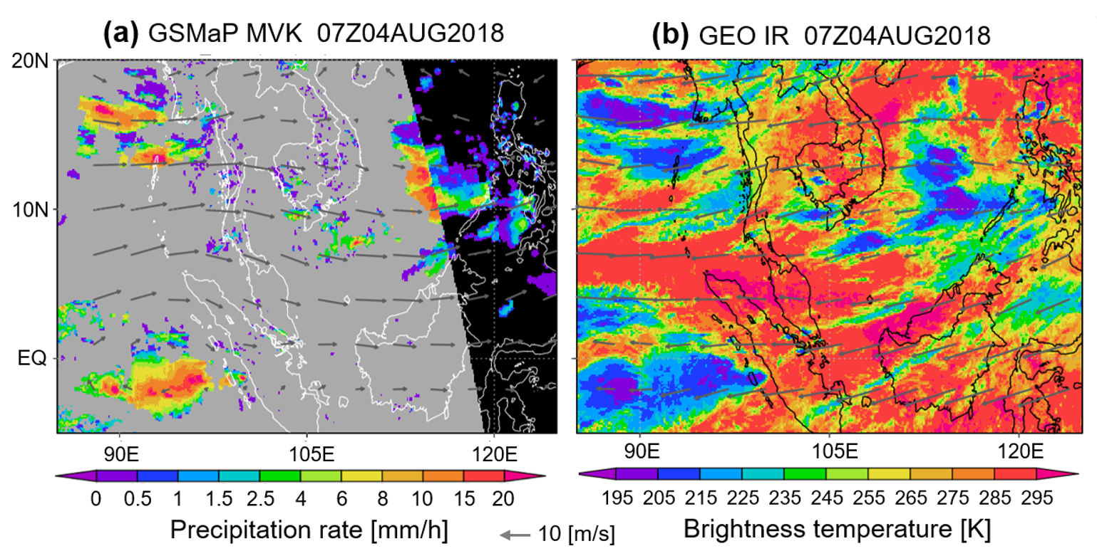
Case Analysis: A cause of rain overestimation
GSMaP calculates the cloud moving vector (MV) by using GEO IR
The MV is used to estimate destination of rainy clouds observed by PMW
The Kalman filter is used to correct rain rate correspond to IR TB
MVK algorithm may incorrectly estimate the destination of rainy clouds under vertical wind shear

Slide 6
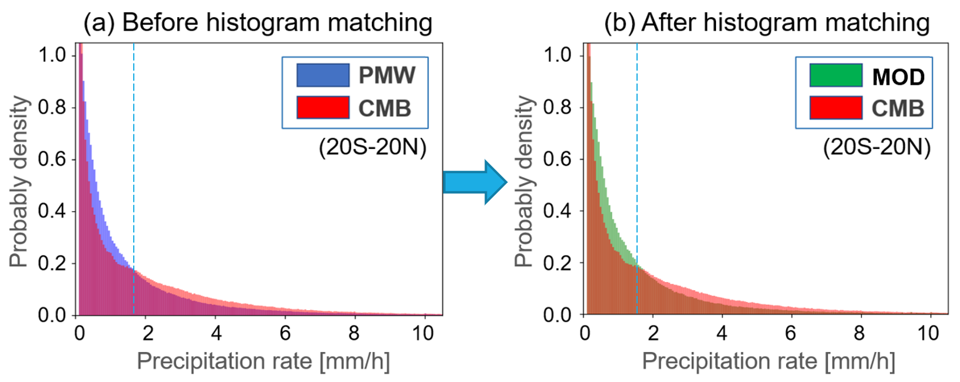
Histogram matching method
・M and N indicate the number of PMW and CMB precipitation samples respectively
・The CMB product has less rain samples below 1.8 mm/h as compared to the PMW observation
・MOD indicates the corrected CMB rain rate and is in good agreement with the PMW observation

Slide 7
Zoning of the area for histogram matching
As shown in the right figure, the area is divided into the regions by a latitude-longitude orthogonal grid considering the continental width, and the samples are collected separately over the sea and land.
Rain rate samples are collected for previous six hours
The histogram matching is done hourly for each region

Slide 8
Improvement by histogram matching
(a) Before histogram matching
(b) After histogram matching

Slide 9
Improvement for zonal mean rain amount

Slide 10
Use of the ISCCP cloud classification data
The ISCCP classifies clouds into nine types based on cloud top pressure and cloud optical thickness
The right figure shows deep convective and cirrostratus derived from it
ISCCP:
International Satellite Cloud Climatology Project
(https://isccp.giss.nasa.gov)

Slide 11
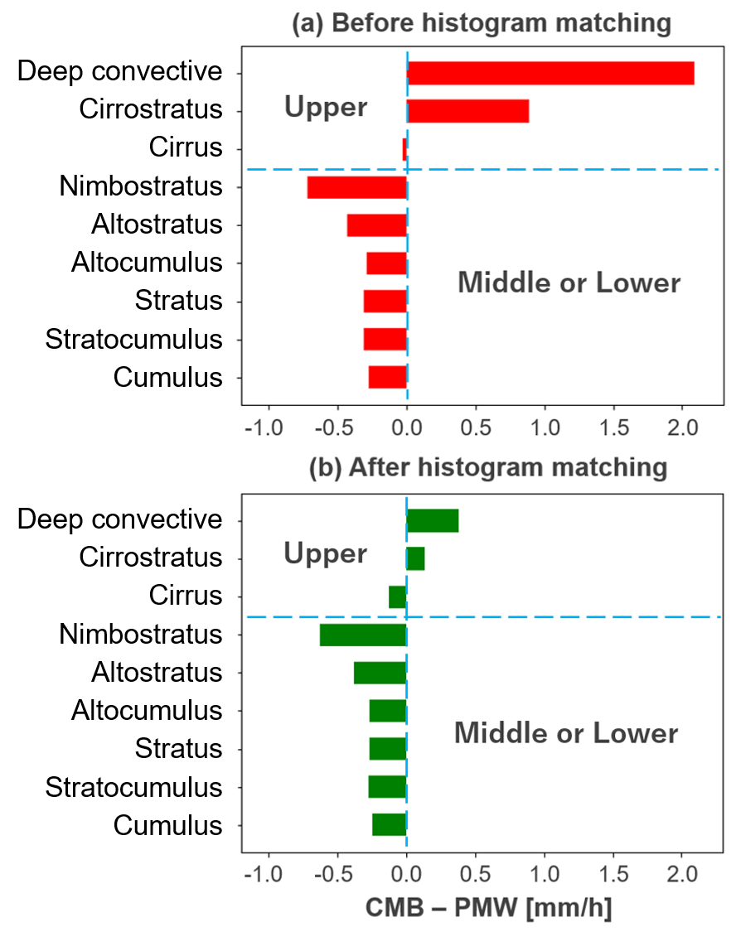
Analysis by cloud type
Figure (a) shows that very large overestimations are occurring in the deep convective and cirrostratus among the upper clouds
Figure (b) shows the result after applying histogram matching and the rain overestimation for such upper clouds has been greatly reduced
Nimbostratus showed a large underestimation tendency even after correction, which is an issue to be addressed in the future

Slide 12
Summary
The GSMaP CMB product tended to overestimate rain rate in the tropics compared to the PMW product
The histogram matching method was applied to modify the CMB product correspond to the PMW product
Rain rate overestimation is greatly reduced after applying histogram matching
This histogram matching method and another smoothing method will be introduced in the GSMaP algorithm major update to algorithm version 8 between the PMW and CMB products
These two updates are expected to allow us to utilize more homogeneous GSMaP products

