Slide 1

The ability of China's Satellite X-ray payload to warn of solar radio bursts interfering navigation communication events from the Event of September 6, 2017
Dong Liang
Yunnan Astronomy Observatory, Chinese Academy of Sciences, Kunming, Yunnan 650216
Yan Xiaojuan, Yu Chao
National Satellite Meteorological Centre/National Space Weather Monitoring and Early Warning Centre，Beijing, 100081
Notes:
P1: Hi everyone: My name is Dongliang coming from Yunnan Observatory Chinese Academy of Sciences.
My report’s title is “The ability of China's Satellite X-ray payload to warn of solar radio bursts interfering navigation communication events from the Event of September 6, 2017”
I will introduce our research results about how to pre-warning the solar radio bursts interfering navigation communication events based on China's Fengyun(FY) Satellite X-ray payload

Slide 2
Index
1. Back ground
2. Introduce 2017-9-7event and Data analyzing and comparing
3. Future plan
Notes:
in my report, at first, I will introduce this special space weather event;
the second, I will introduce 2017-9-7event and the physical mechanism of our method why we can get the pre-warning information based on solar X-ray observation data ; and then I will exhibit the data from GOES and FY-II C to you.
The last, I will discuss with you how to build a high performance pre-warning system with ground and space solar-monitoring instruments for this kind of space weather events.

Slide 3
1. Back ground

Slide 4
1. Back ground
1. Solar radio burst events
Very strong radio Emissions
2. Satellite communications
Long distances , more than 500km at least.
Different spectrum structures, such as :spike, wide band, narrow band…
Very weak signals
Notes:
in the beginning of my report, there is a question: why do we need to monitor the L band solar radio flux?
At first, the L band solar radio bursts with very strong flux are always a potential threat to navigation communication signal which also works in L band.
This is a kind of special space weather events which may affect millions of navigation users.
And the second, there are many different types of bursts with SRB emissions’ spectrums. So we have to face many different interfering presentations.
And then, I will show you some famous events.

Slide 5
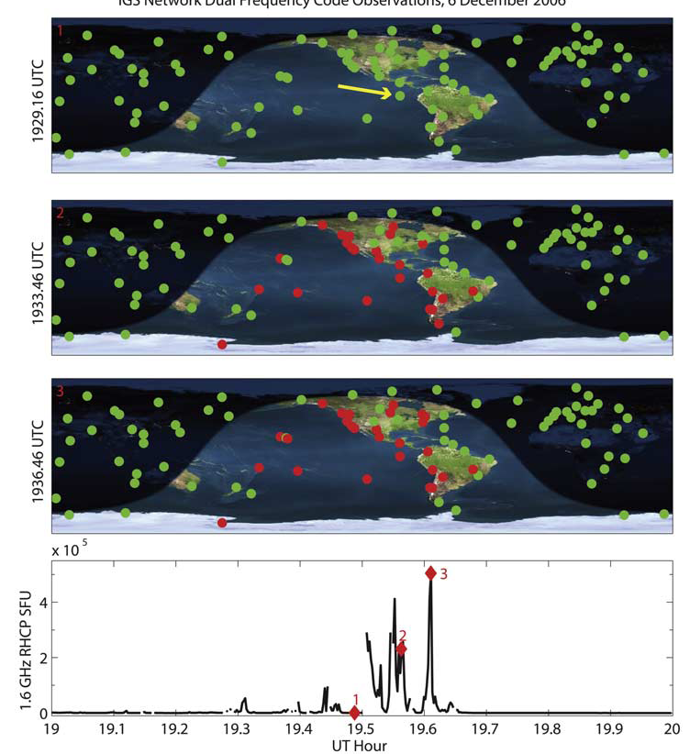
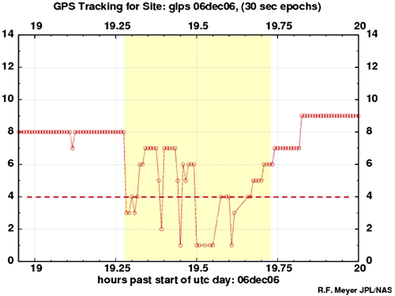
The SRB events interfering wireless communication system
2006-12-6 event
Notes:
During this event, many GNSS ground stations were loss of locked, during the worse period, some ground stations could get signal from only one satellite what could not get the position information.

Slide 6
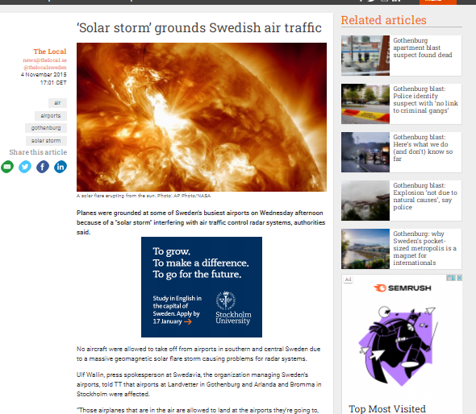
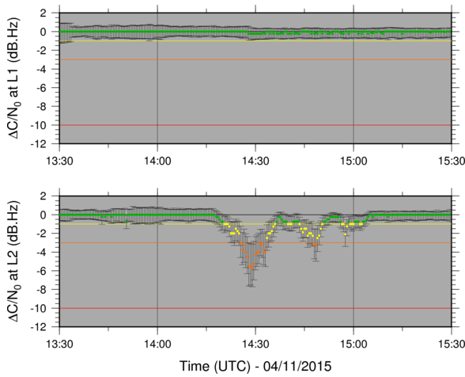
The SRB events interfering wireless communication system
2015-11-4 event
Notes:
This was a famous event. The SRB strong emission noise not only inferred the GPS signal, but some radar system for air traffic

Slide 7
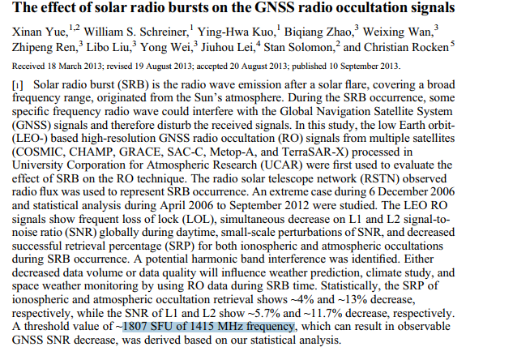
The SRB events interfering wireless communication system
Prof. Yue found that the 1807SFU may be a threshold for SRB interfering the GNSS position function.
YUE X A, Schreiner W S, Kuo Y H, et al. The effect of solar radio bursts on the GNSS radio occultation signals[J]. Geophysics Research Space Physics, 2013,118(9): 5906–5918
Notes:
P11: Prof. Yue found that the 1807SFU may be a threshold for SRB interfering the GNSS position function.

Slide 8
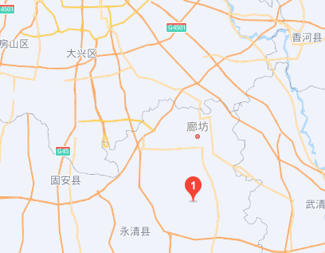
The solar radio telescope for L/S band
Antenna
4.5 m
L/S band
Receiver
18 channels, 9 monitoring band, two polarizations
Power detecting and synchronous sampling
software:
Data processing and monitoring in real time
Trace solar based on real-time computing program
Notes:
So we build a multi-channel solar radio telescope system
What we can do: A precision solar flux monitoring telescope in L band and get flux for publishing the pre-warning information before it reaching threshold in real time.
It also needs unattended operation, including tracing solar, signal sampling, data processing and so on .
The first, the antenna’s diameter is 4.5 meter, and works at 1-3GHz;
The second, the receiver has 18 observation Channels, including 9 monitoring band, two polarizations. It can detect the channel power and sampling the power data in real time.
The third software:
It can process and monitor Data in real time. It also can drive the antenna to trace solar based on real-time through computing program

Slide 9
But not enough!
Fast transmission: Light speed
Flux will exceed threshold quickly
Some strong RFI signals may trigger pre-warning
Notes:
but it is not enough
At first, the radio emissions transmit with Light speed, these may be the fastest space weather event, sometimes, when the radio telescopes received the emission, the interfering is coming;
The second, the radio Flux upsoar and exceed threshold quickly, and the data process of radio telescope need time. So, we have little time to send pre-warning information to USERs;
The third, there are so many RFIs which may trigger pre-warning.
So, we need to find some new observation data for improving the pre-warning effects.

Slide 10
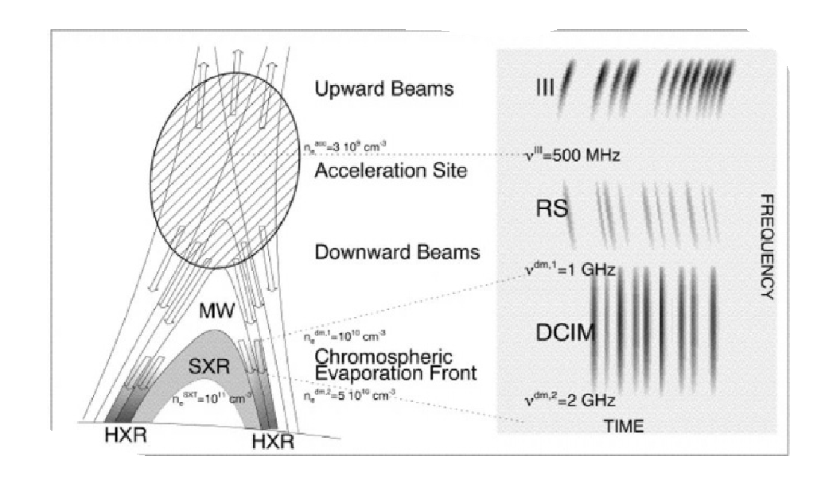
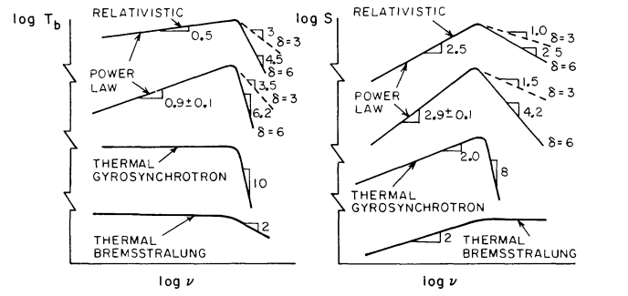
X-ray and SRB events
From the same active area
Different positions of the flares
Intensive SRB events
Intensive SRB emissions are produced by nonthermal electrons
Nonthermal electrons always produce X-ray emissions in the same time
Notes:
X-ray may be a good choice
At first, the X-ray and SRB emission always come from same active area only with different positions of one flare.
And furthermore, the X-ray payload cannot be interfered which work in the space.
The second, for intensive radio emissions with more than several thousand Kelvin brightness temperature are always produced by the non-thermal electrons which are also the source of X-ray.
So, the X-ray and SRB events always happen in same time.

Slide 11
X-ray and SRB events
So we can get a The flux variation of X-ray and solar radio during solar radio burst events
Notes:
we can get the flux variation of X-ray and SRB during solar radio burst events.
The first, when a flare is forming, the magnetic field is very weak. And then, with magnetic evolving, some hot electron generates, and they can produce Soft X-ray and weak radio emissions.
At this time, the flux of solar radio does not exceed threshold,
The second, with flare evolving and magnetic enhancing, there are some non-hot electron generating, the Soft X-ray is converting to Hard X-ray and radio emission is enhancing in the same time.
And then, the flux of SRB exceeds threshold and interferes wireless signals.
Above all ,the beginning of Soft X-ray may be as a pre-warning information.

Slide 12
2. Introduce 2017-9-6 event and Data analyzing，comparing

Slide 13
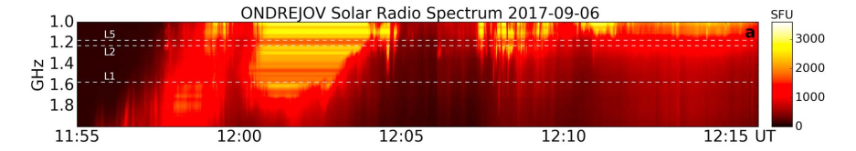
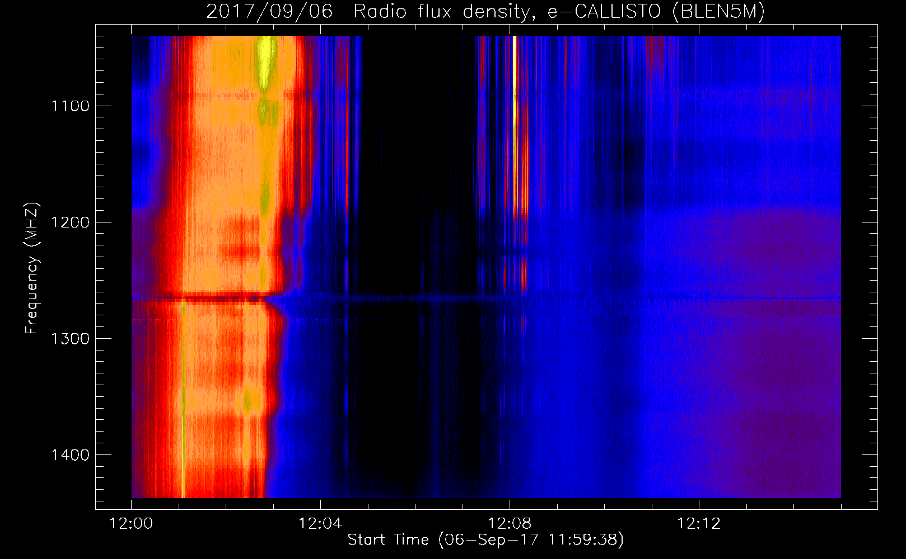
Introduce 2017-9-6 event
Notes:
the latest event, during this event, all the GNSS system were interfered.

Slide 14
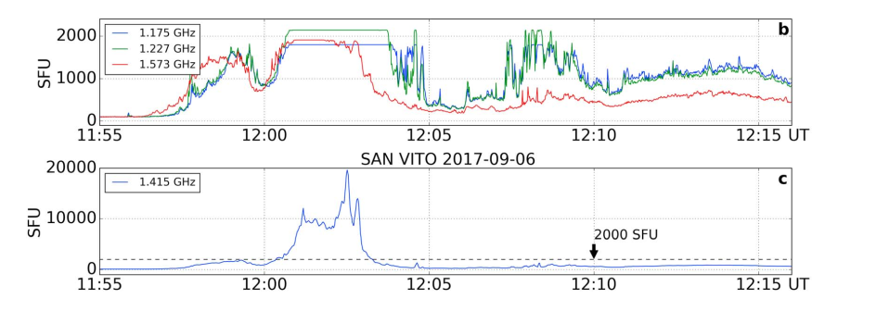
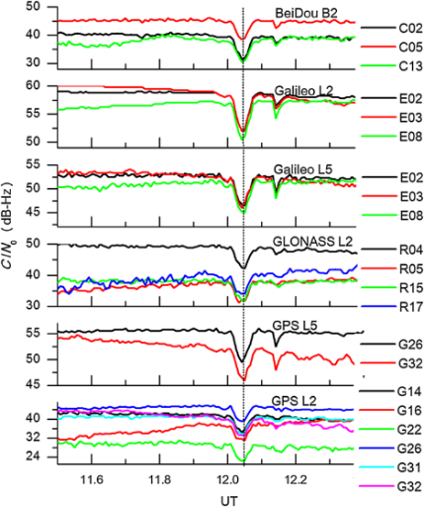
The flux of solar radio in L band
The flux exceeded threshold at 11:59 UTC
GNSS C/N0 decrease @ 12:00 UTC
Notes:
in this event
The flux of 1415 MHz exceeded threshold (1807S.F.U) at 11:59 UTC.
And the signal to noise ratio decreased for 12:00 UTC.

Slide 15
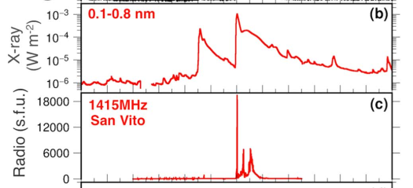
the X-ray and 1415MHz solar radio flux
There is more than 5minutes in advanced for the beginning of X-ray raising to interfering event.
Notes:
during this event, there is more than at least 5 minutes in advanced for the beginning of X-ray raising to interference event.

Slide 16
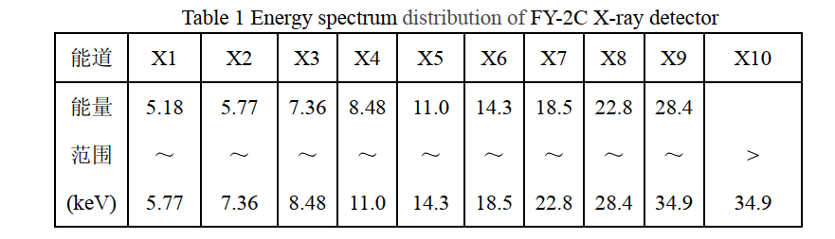
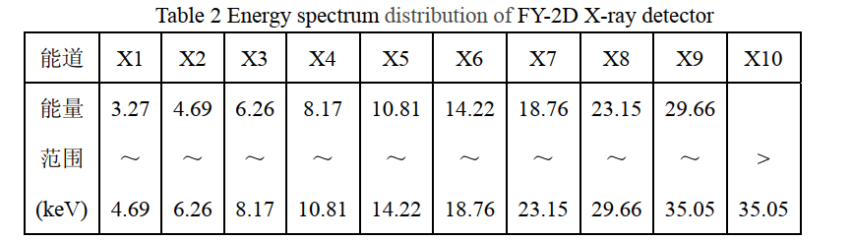
The X-ray detector in FY satellite
YU C., LI J W, ZHANG X X. et al. Cross comparison of solar X-ray data between FY-2C/D satellite and GOES satellite[J] Journal of Geophysics (in Chinese). 2012. 55(9):2835-2842
Notes:
for china, FY satellites equip some payloads for monitoring X-ray flux in real time, you can see the Energy spectrum distribution of FY-2C X-ray detector which covers the whole band of soft X-ray, the same band comparing to GOSE satellite soft X-ray payload.

Slide 17
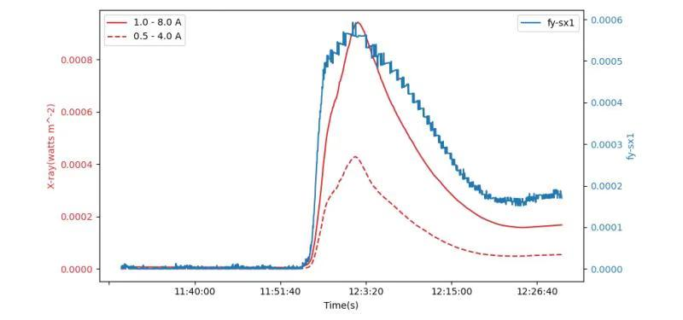
2017-9-6 event FY vs GOSE
Notes:
for the 2017 sep-6th event, you can see from this picture.
At first, FY-C X-ray detector got nearly the same observation results.
The second, you can see the raising time of Soft X-ray was 11:51 UTC which was 10 minutes earlier than the SRB interfering Navigation event.
So, this result may be a good pre-warning information.

Slide 18
3. Future plan

Slide 19
Future plan
1. We need some faster pre-warning channels
Some Nano satellites need to monitor soft X-ray in real time
2. Space and ground data combining
The space(X-ray) data is pre-warning
BD short message may be a good choice to transmit information
The ground (radio) data is real time warning
We will both data to verify an interference event

Slide 20
Thank you !
Contract us: dongliang@ynao.ac.cn

