Slide 1

Atmospheric escape on Earth and beyond: Space weather as a driving force
Jun Cui
School of Atmospheric Sciences, Sun Yat-Sen University

Slide 2
Outline
Background
Space weather and terrestrial atmospheric escape
Space weather and planetary atmospheric escape
Conclusion

Slide 3
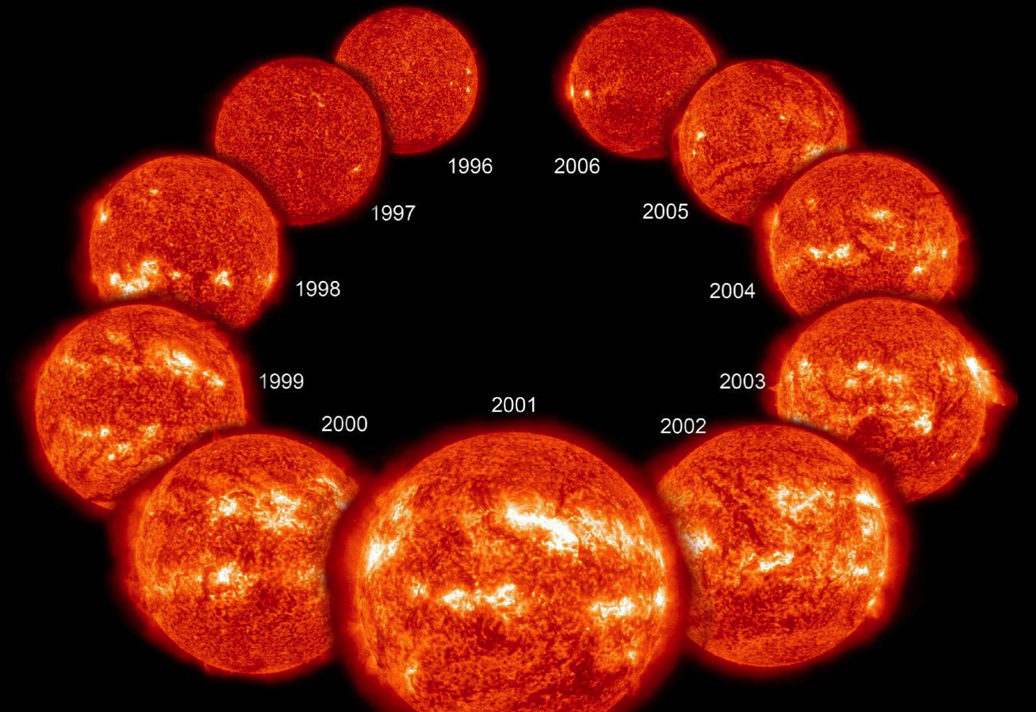
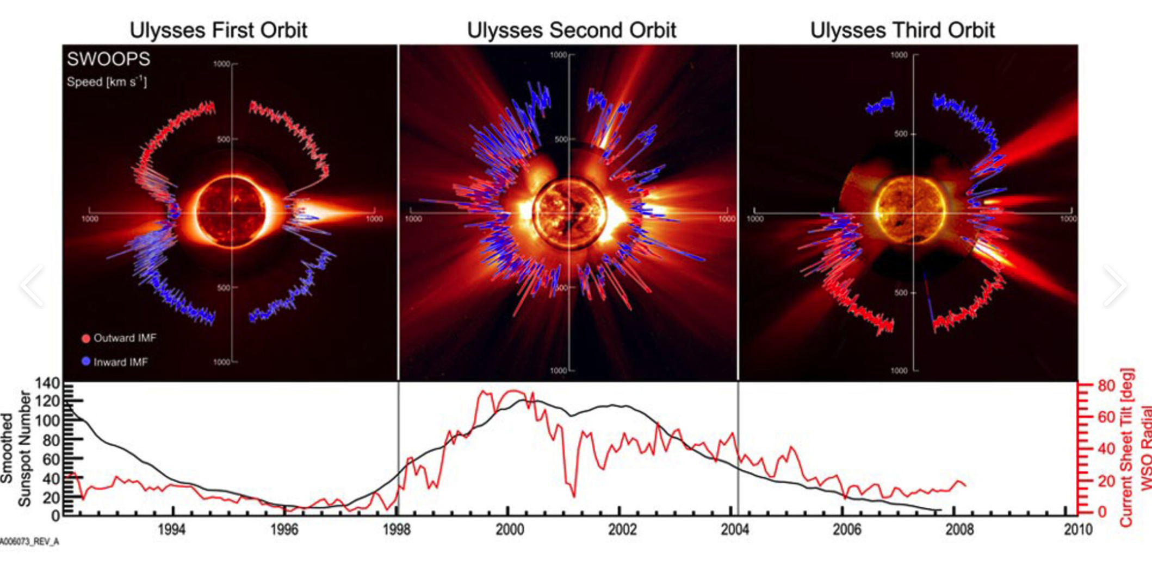
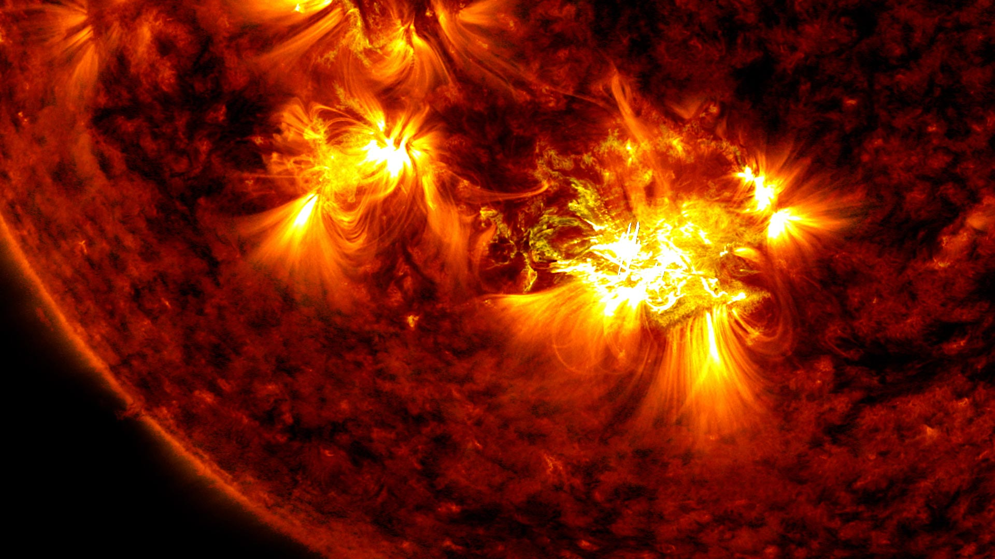
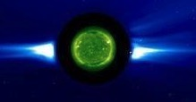
Fundamental atmospheric escape process
Atmospheric escape
Long-term solar variations
Neutral
Ion
Thremal
Nonthermal
Nonthermal
Short-term solar variations
Jeans escape
Hydrodynamic escape
Sputtering
Chemical escape
Ion pick up
Ion bulk outflow
……
SF
ICME

Slide 4
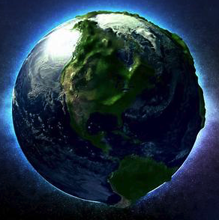
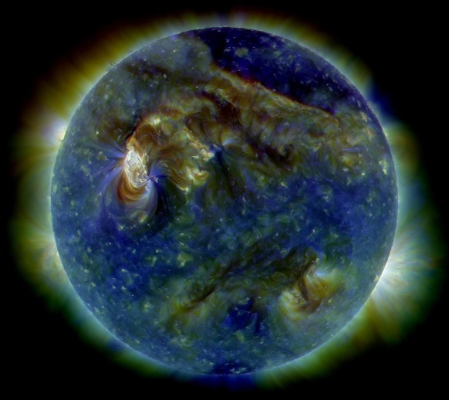
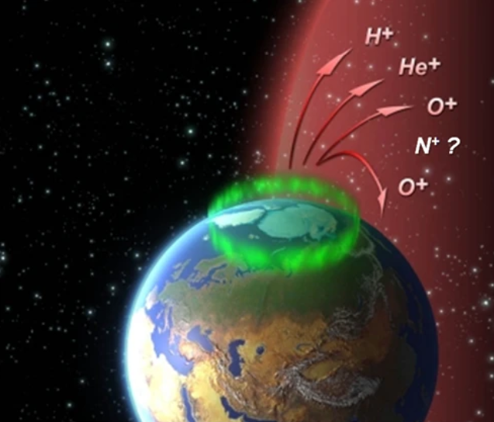
Two main energy sources for ion outflow from the Earth’s polar regions
Solar irradiation
Solar irradiation and solar wind energy input are considered the main drivers of ion outflow from the Earth’s polar regions.
Solar wind energy input
Solar Illumination
Solar Wind Energy
Ion Outflow
Topside Ionosphere
EUV
Electromagnetic Energy
(AC and DC Poynting Fluxes)
Particle Precipitation
Atmosphere
Heating
Ion Production
Notes:
能量来源：太阳辐射和太阳风能量注入。这两者都能提供离子源和逃逸能量。由于质量不同，重离子和轻离子的逃逸区域和逃逸路径也有所不同。在极区，离子逃逸的源区按能量获得来源分为极盖区（即开放磁力线区域，由于电离层加热，电子和离子特征高度的不同而导致的加速电场加速轻离子而逃逸，蓝色虚线）、极隙极尖和极光区（粒子沉降和波粒相互作用使包括重离子在内的离子获得能量而逃逸，红色虚线）。

Slide 5
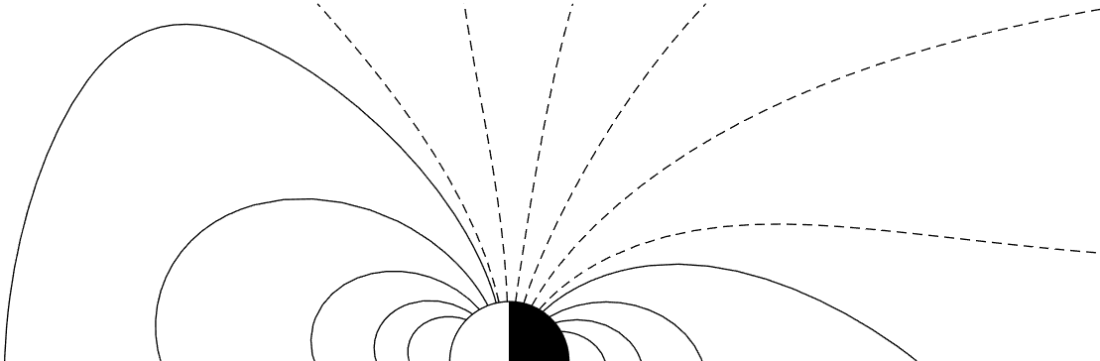
Three high-latitude outflow regions with different ion energization processes
Polar cap regions – no significant particle precipitation
Cusp regions – the solar wind can directly access the ionosphere
Auroral regions – particles precipitate from the nightside reconnection sites
Ion outflow from the polar cap, known as the polar wind, contributes the most to the magnetospheric ion population.
Solar wind particle precipitation
Convection of magnetic field lines
Particle precipitation in the auroral regions
Routes of ion escape from the cusp and auroral regions
Route of ion escape from the polar cap regions
Outflow regions | Species | Energies | Outflow rates
Polar cap | Mainly H⁺ | <100 eV (Cold ions) | more than 10²⁵/s, with the order of 10²⁶/s maximum
Cusp and auroral regions | a large amount of heavy ions (O⁺) | >100 eV | about 10²⁴/s

Slide 6
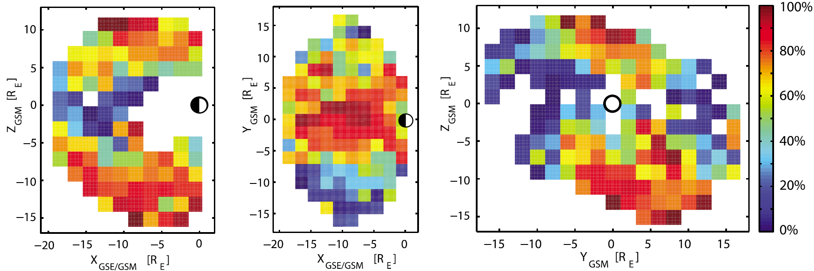
The mechanism of the polar wind
Electrons
-
-
-
-
-
Centrifugal Acceleration
E||
-
-
Cold Ions
+
+
+
+
Cold Ions Dominate the Ion Population in the Magnetosphere
[Engwall et al., 2009, AG]
Detection Probability

Slide 7
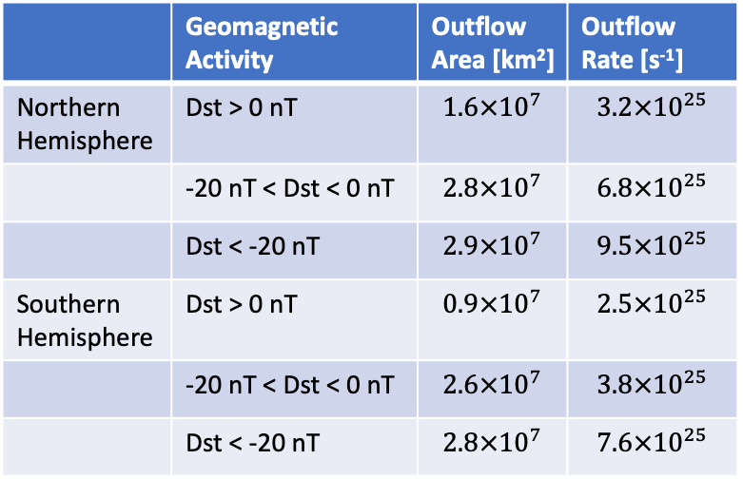
Solar wind energy input as a driver of the polar ion outflow
 | Geomagnetic Activity | Outflow Area [km²] | Outflow Rate [s⁻¹]
Northern Hemisphere | Dst > 0 nT | $$1.6×{10}^{7}$$ | $$3.2×{10}^{25}$$
 | -20 nT < Dst < 0 nT | $$2.8×{10}^{7}$$ | $$6.8×{10}^{25}$$
 | Dst < -20 nT | $$2.9×{10}^{7}$$ | $$9.5×{10}^{25}$$
Southern Hemisphere | Dst > 0 nT | $$0.9×{10}^{7}$$ | $$2.5×{10}^{25}$$
 | -20 nT < Dst < 0 nT | $$2.6×{10}^{7}$$ | $$3.8×{10}^{25}$$
 | Dst < -20 nT | $$2.8×{10}^{7}$$ | $$7.6×{10}^{25}$$
Maps of the source regions for cold ion outflow [Li et al., 2012]
The Dst index is used as a proxy of solar wind energy input.
Notes:
With solar wind energy input increases, both the outflow area and the outflow flux increase. This fact results in an increase in the outflow rate during disturbed by about a factor of 3 compared with that during geomagnetically quiet times.

Slide 8
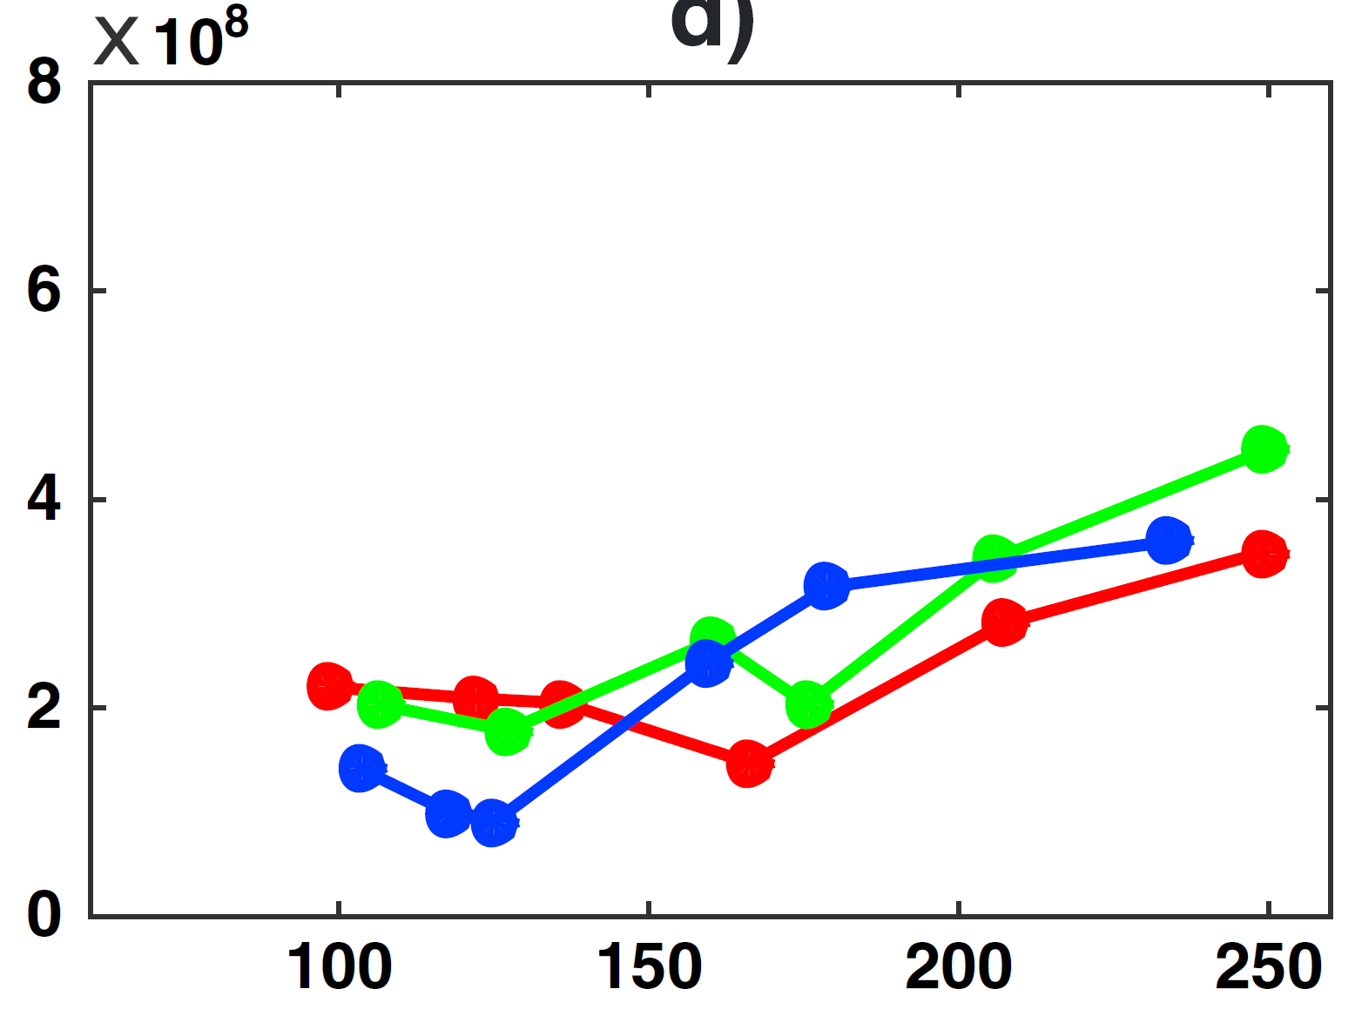
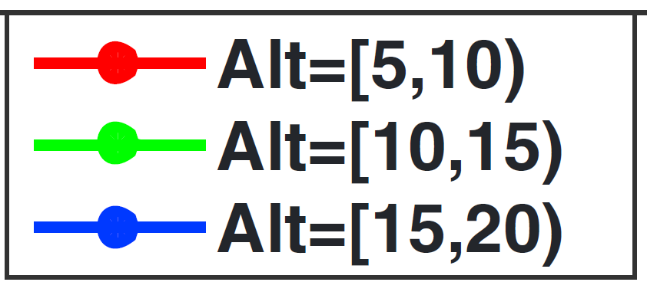
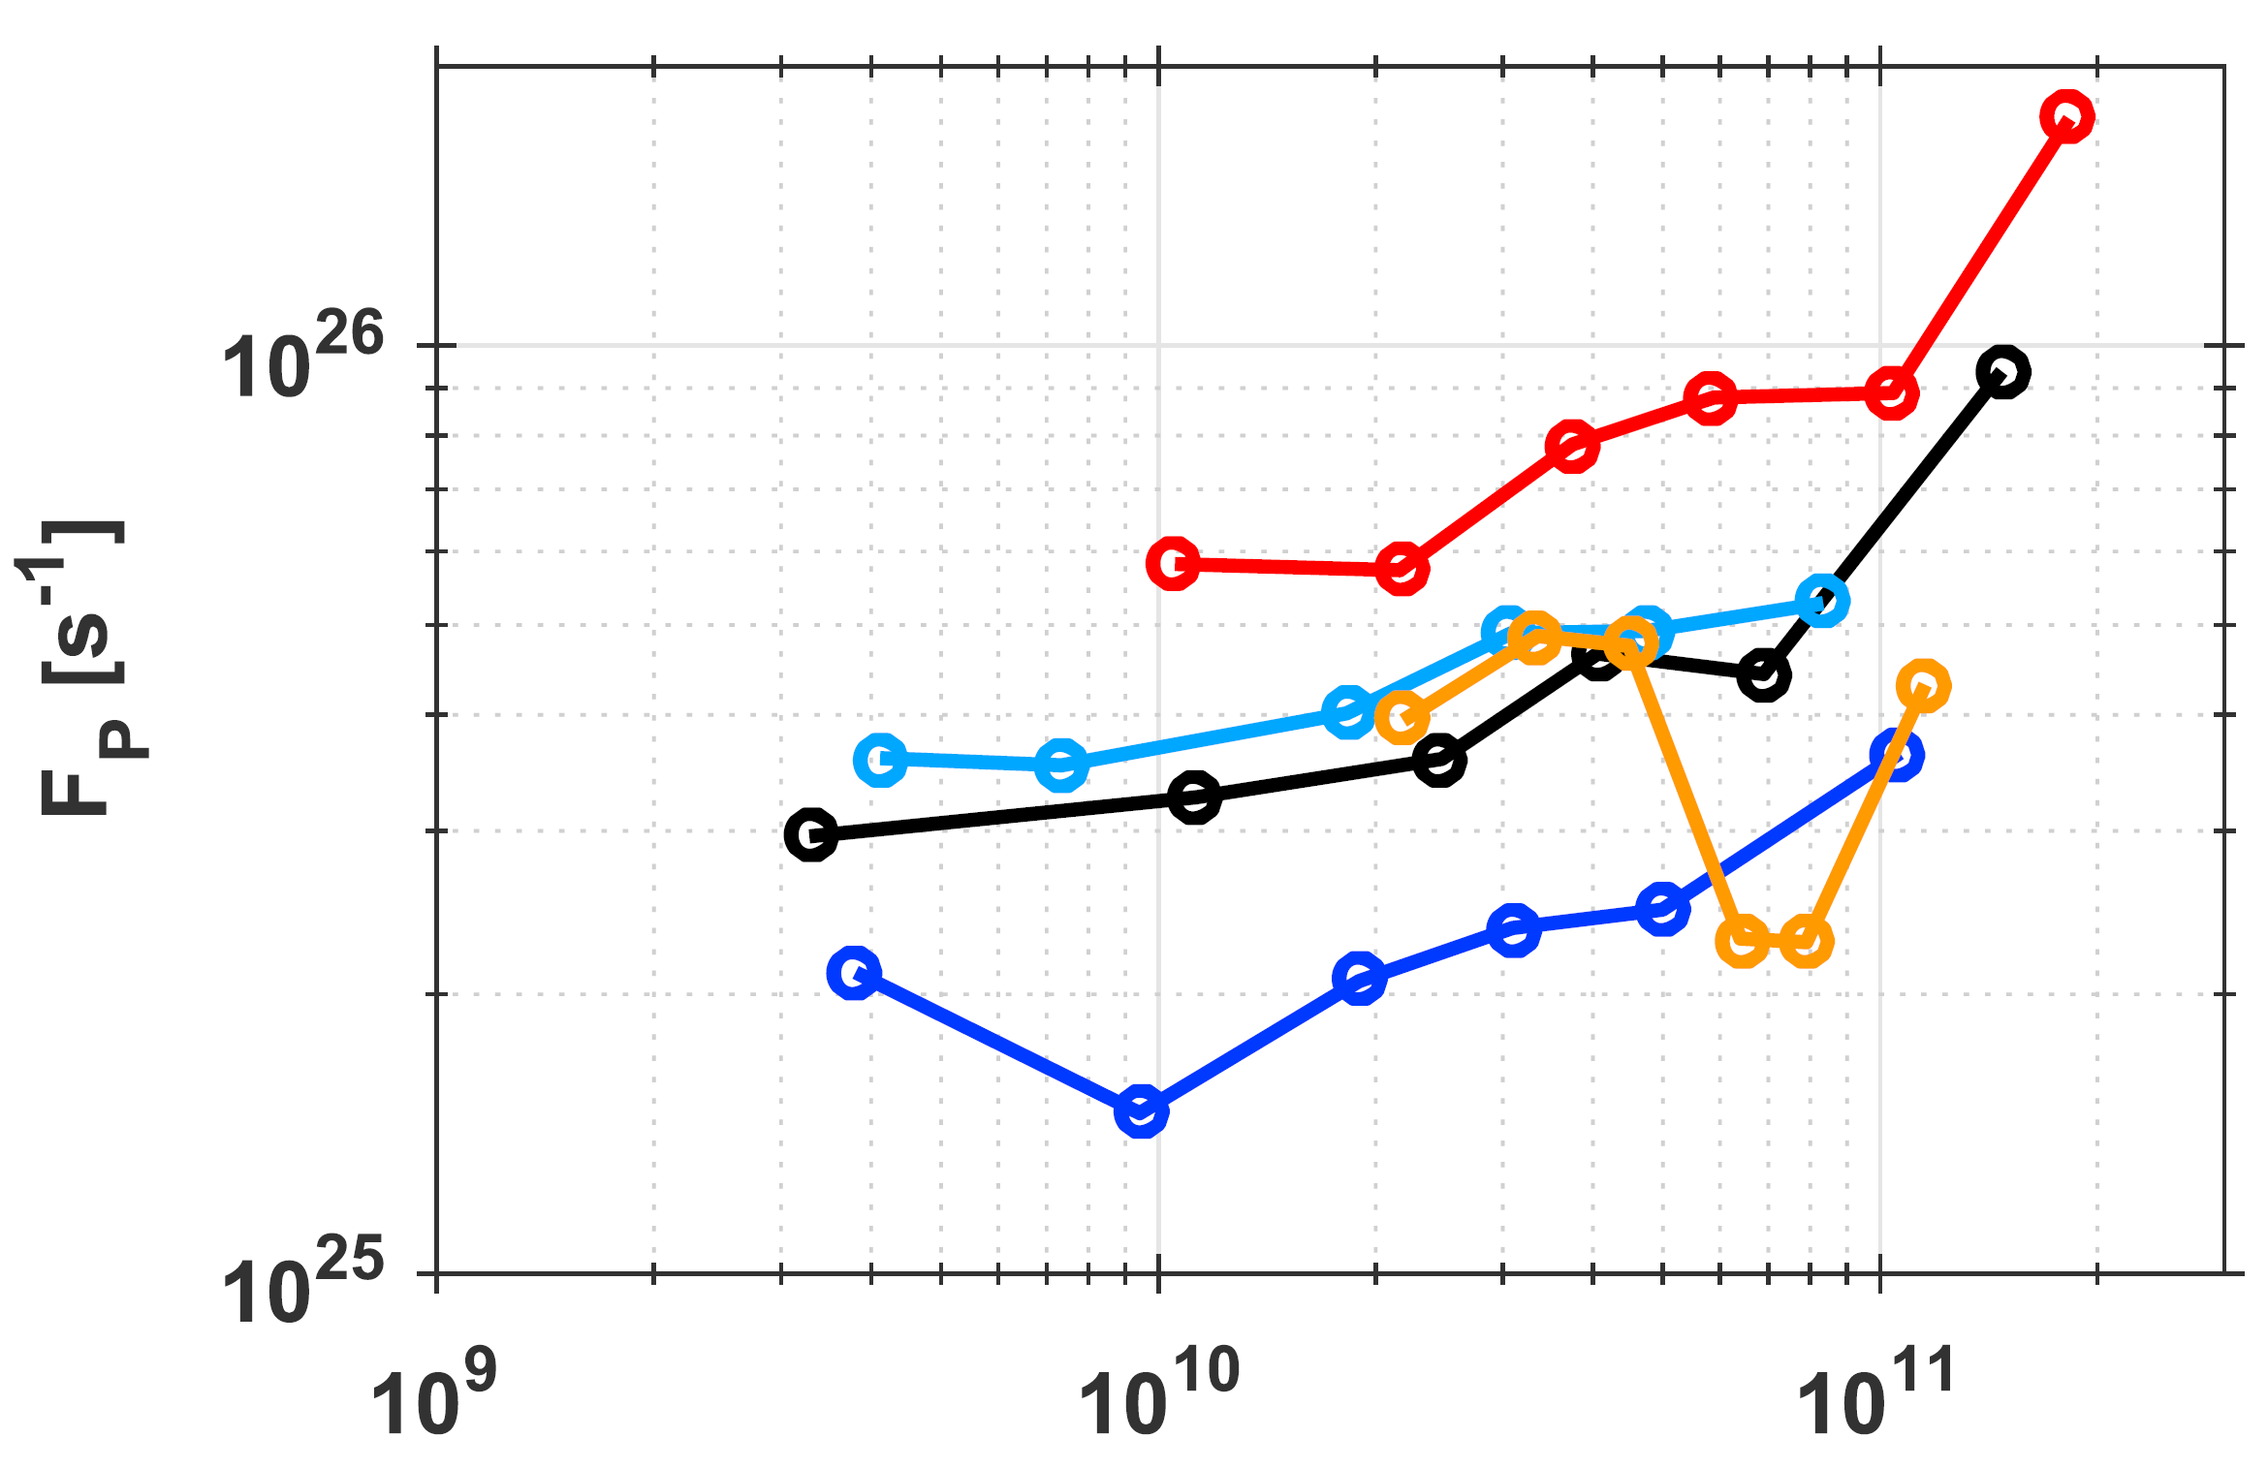
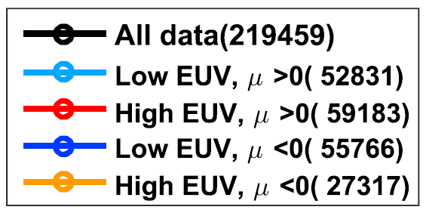
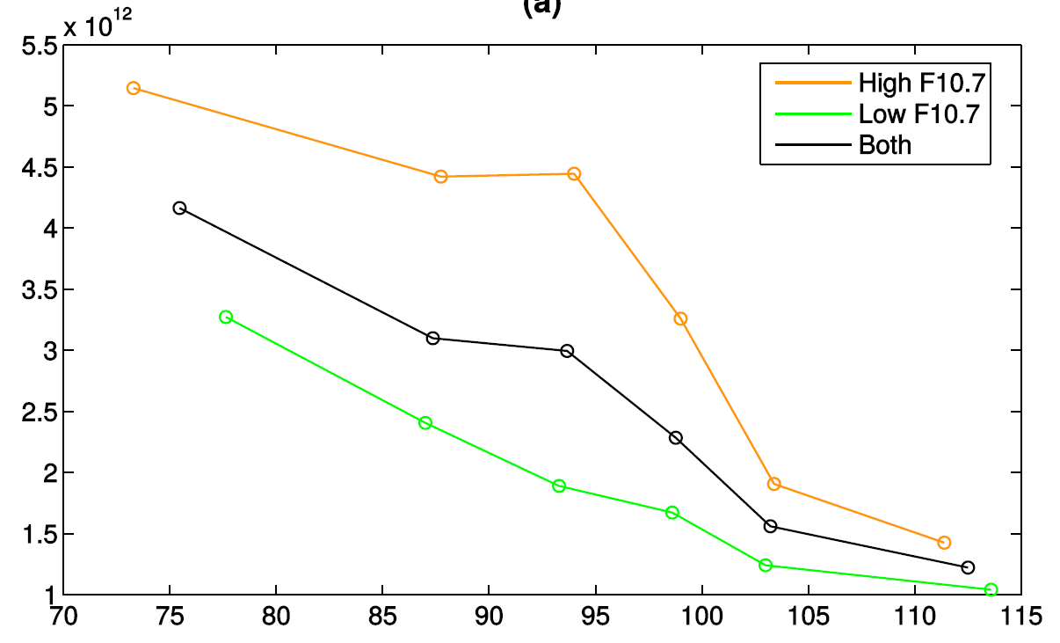
Solar irradiation as a driver of the polar ion outflow
Outflow rate as a function of solar irradiation and solar energy input
[André et al., 2015]
Outflow flux [cm⁻² s⁻¹]
Outflow rate from one hemisphere [ions/s]
F10.7 [10⁻²² W m⁻² Hz⁻¹]
[Li et al., 2017]
Solar wind energy input rate [W]
Outflow flux [m⁻² s⁻¹]
Solar irradiation is estimated from the F10.7 index (EUV intensity)
Solar wind energy input is estimated from the electromagnetic field DC Poynting flux that enters the magnetosphere
[Maes et al., 2017]
Solar zenith angle [deg]

Slide 9
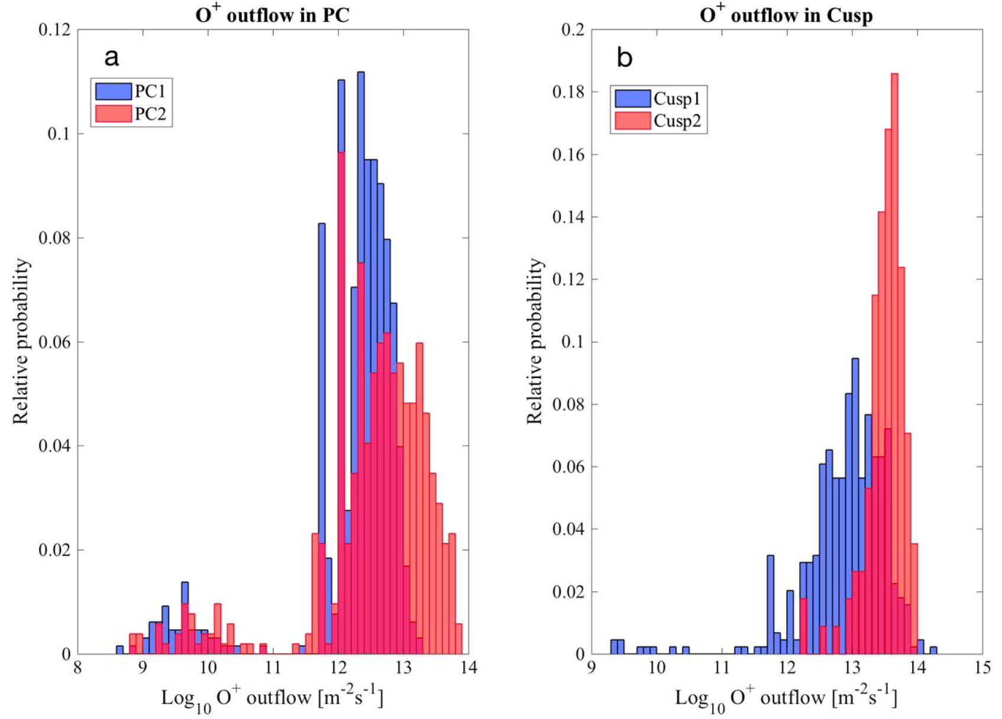
Outflow in an extreme space weather event — outflow increased by high solar irradiation and further increased by high solar wind energy input
During a geomagnetic storm, the low-energy ions turn into relatively high-energy ions. The outflow can be dominated by O⁺.
Normally, the O⁺ outflow flux in the cusp is about 10⁹ cm⁻² s⁻¹.
In the extreme event from 7 Sep 22:11- 8 Sep 00:33, 2017 (minimal Dst = -142 nT), the O⁺ ions were pre-heated by multiple solar flare, the outflow flux of O⁺ from the cusp and the polar cap (in the vicinity of the cusp) further increased by about one order of magnitude (being 10¹³ m² s⁻¹ for the cusp region, see figure).
Cusp 1 and PC1 represent the parameters measured in the cusp and the polar cap before the storm, respectively.
Cusp 2 and PC2 are those measured after.
[Schillings et al., 2018]

Slide 10
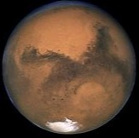
H Jeans escape on Mars
Qin 2021

Slide 11
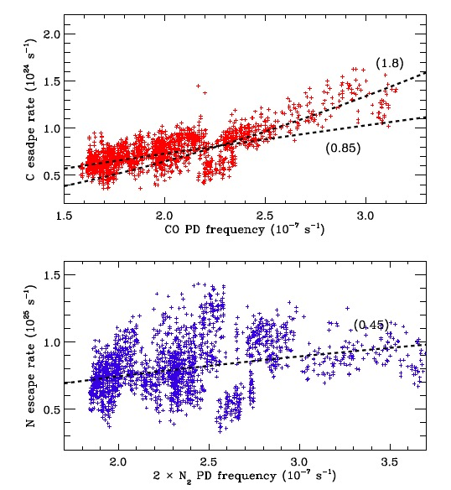
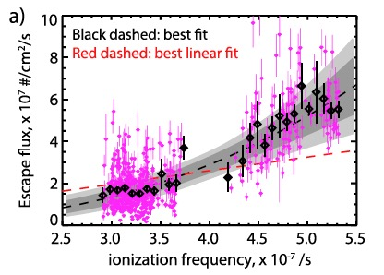
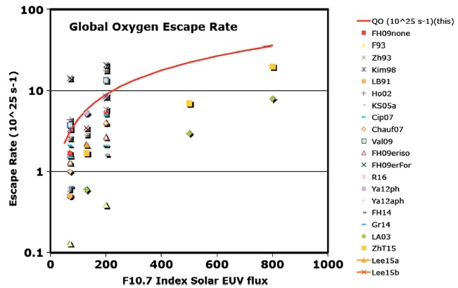



Photochemical escape of O, C, and N on Mars
Cui et al. 2019
$$CO+hν→C+O$$
$$O_{2}^{+}+e→O+O$$
Lillis et al. 2017
$$N_{2}+hν→N+O$$
Cravens et al. 2017

Slide 12
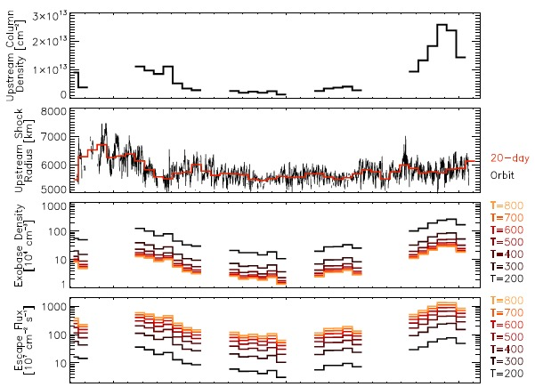
Solar wind control of neutral escape on Mars
Halekas et al. (2018)

Slide 13
Atomic O escape on Mars during a solar flare event
Lee et al. (2018)

Slide 14
Conclusions
 |  | Long-term variations |  | Short-term variations
Space weather |  | Solar radiation | Solar wind | Solar Flare | ICME
Ion escape on the Earth (H⁺ polar wind) |  | Positive correlation | Positive correlation | Positive correlation | Positive correlation
Neutral escape on Mars | Jeans escape (atomic H) | Positive correlation | Positive correlation | Positive correlation | ?
 | Chemical escape (atomic O, C, N) | Positive correlation | ? | Positive correlation | ?
 | Sputtering (heavier species) | ? | ? | ? | ?

