Slide 1

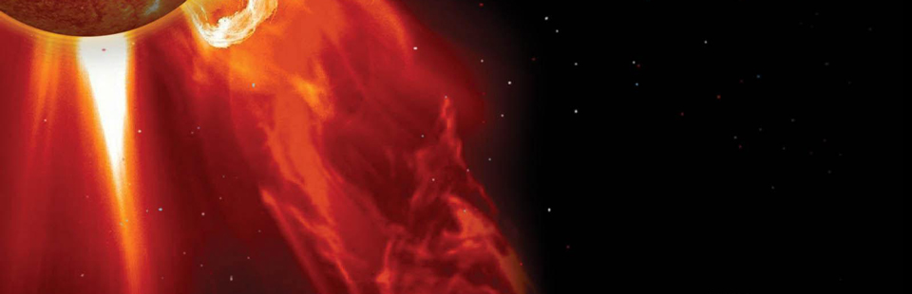

Introduction on the Chinese Meridian Project (CMP)
[Space Environment Ground Based Comprehensive Monitoring Network]
Jiyao Xu
(on behalf of the project team)
Key Laboratory for Space Weather, The Chinese Academy of Sciences, China.
04, Nov. 2021

Slide 2
Contents
Scientific objectives of the Chinese Meridian Project
Chinese Meridian Project: Phase I
Chinese Meridian Project: Phase II
Future plans
Summary

Slide 3




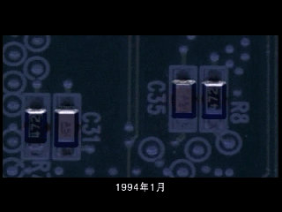
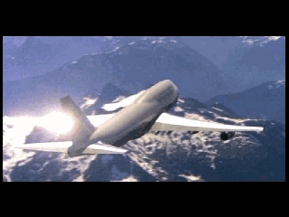
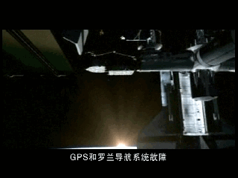
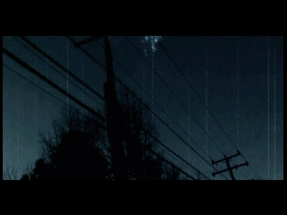
1. Scientific objectives of CMP
Disastrous space weather events
have serious impacts on modern society
Satellite
failure & loss
Communication
Interruption
Navigation
failure
Power network
accident or collapse
The only way is to improve the ability of space weather monitoring.
Ground-based monitoring network is one of the most important solutions.

Slide 4
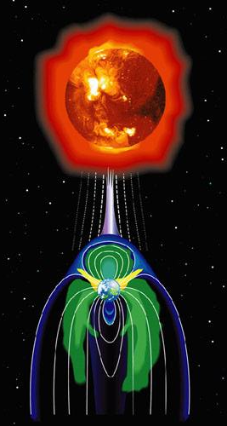
1. Scientific objectives of CMP
(1) Regional Features: To reveal the regional features of space environment above China, and their relationship to global space variations.
(2) Coupling Mechanism: To study coupling processes and mechanisms between space spheres at different heights.
(3) Propagation Characteristics: To monitor the propagation and dissipation processes of violent disturbances caused by solar activities and eruptions.

Slide 5
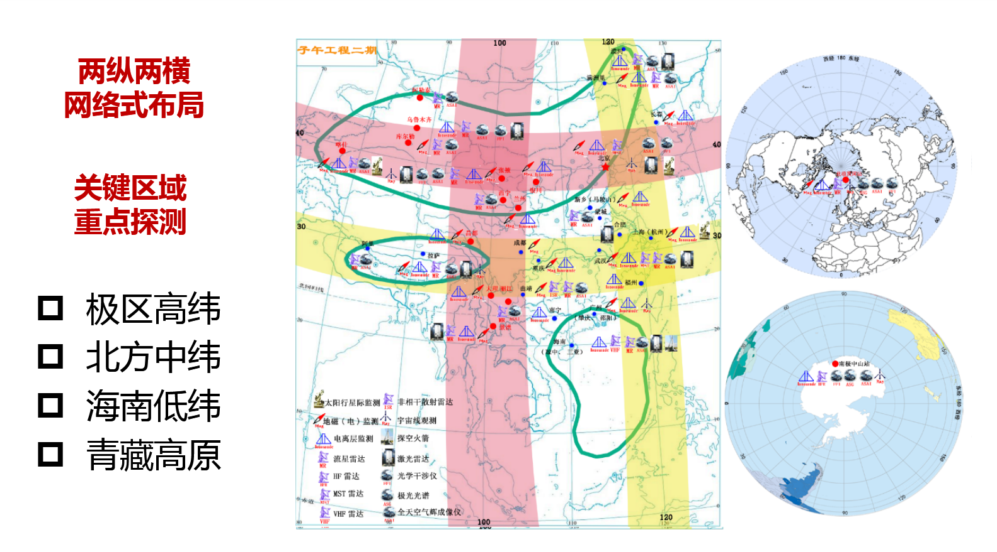
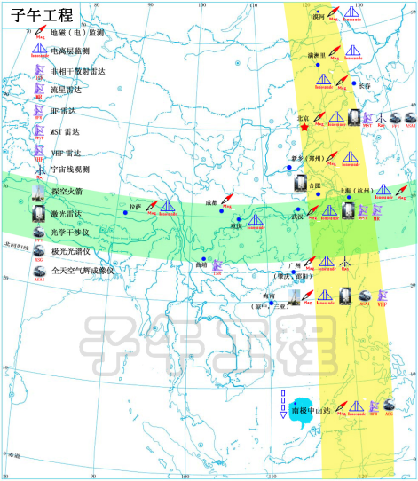
Construction Process of CMP
Tow steps of the Chinese Meridian Project construction:
CMP-phase I and CMP-phase II
CMP-phase I (0.167 billion)
CMP-phase II (1.3 billion)
2008
2012
2019
2023
Construction period (CMP-I)
Operation period (CMP-I)
Construction period (CMP-II)
Operation period of CMP
We are here now.

Slide 6
2. Overview of the CMP-Phase I
120°E
15 observation stations: along 120°E and 30°N, monitoring space environment
87 conventional automatic instruments are installed
Construction period: 2008-2012
2012-now: Operation period
4000km
30°N
3000km
Antarctic

Slide 7
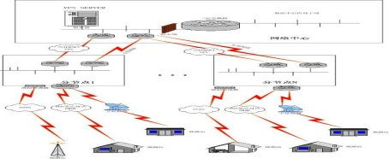
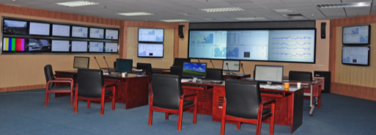
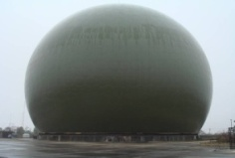

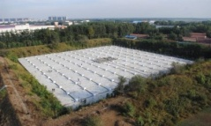
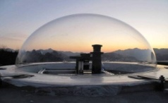
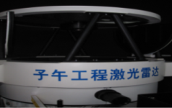
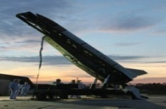
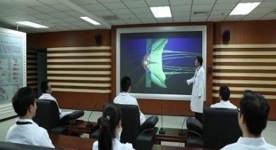
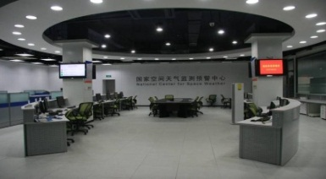
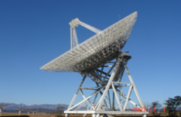
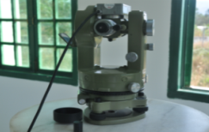
Framework & Instruments
Data and Communication System
Space Environment Monitoring System
Magnetometers,
Radio Detectors
Optical Instruments
87 instruments
Research and Forecast System
Notes:
7

Slide 8


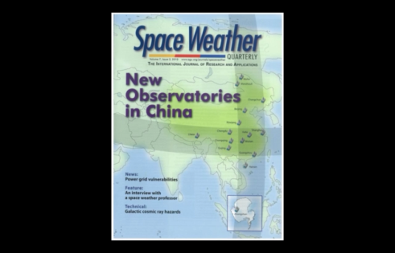
Research Progress of operation of CMP-I
From 2012 to 2021, more than 400 papers were published.
Nature Physics
Nature Communications
PNAS
JGR
GRL
Space Weather
Ann. Geophy.
Science China

Slide 9
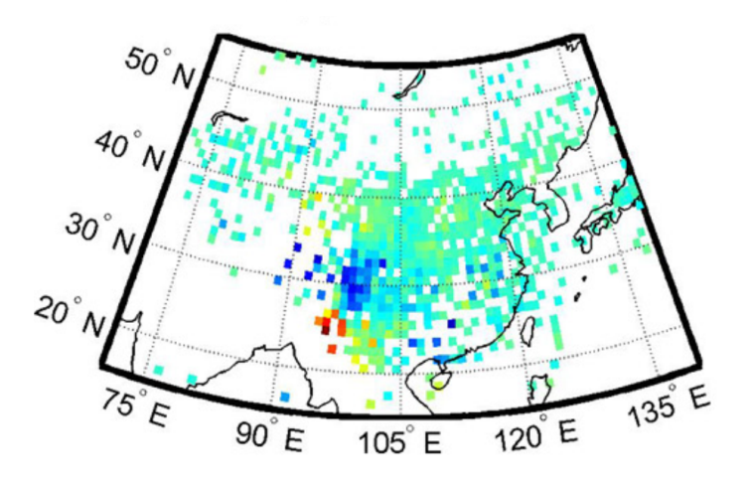
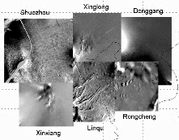
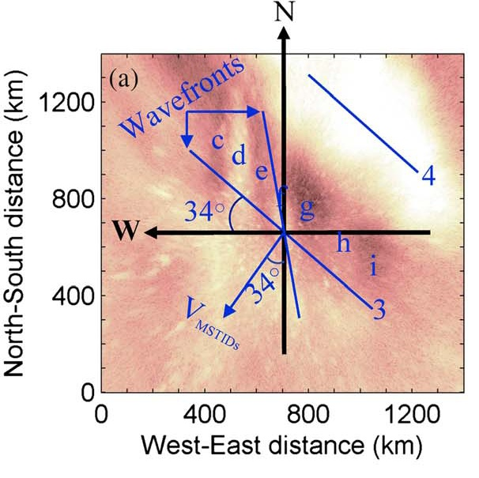
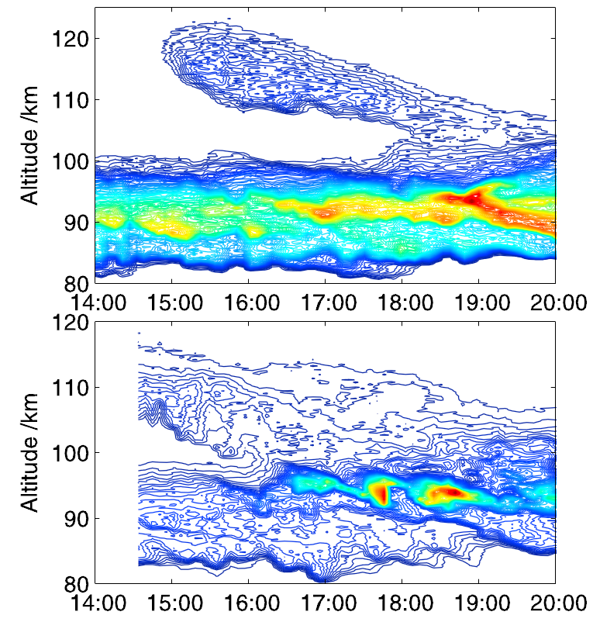
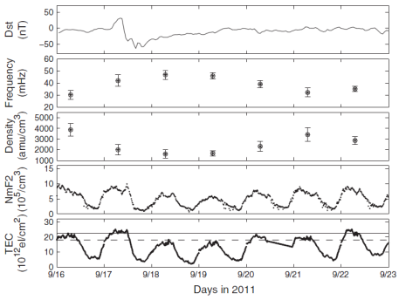
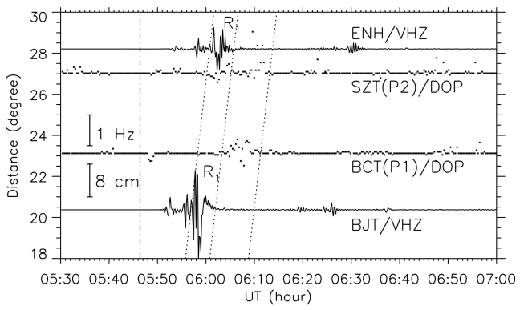
Research Progress of operation of CMP-I
Disturbance propagation and evolution
Unusual northward propagation of large-scale TID.
F. Ding, Ann. G., 2013
Long distance propagation of GW over 1000 km observed by airglow image network.
Jiyao Xu, JGR, 2015
Regional characteristics near 120°E meridian line
A sodium (Na) layer in low thermosphere observed by Lidar.
Jihong Wang, GRL, 2012
Ionosphere irregularities large than 150km observed by a airglow imager.
Longchang Sun, JGR, 2015
Coupling between different spheres
Perturbations in ionosphere over China after the earthquake of Japan in 2011.
Y. Q. Hao, JGR, 2012
Coupling between plasmasphere and ionosphere during storm.
Chi Wang, JGR, 2012

Slide 10
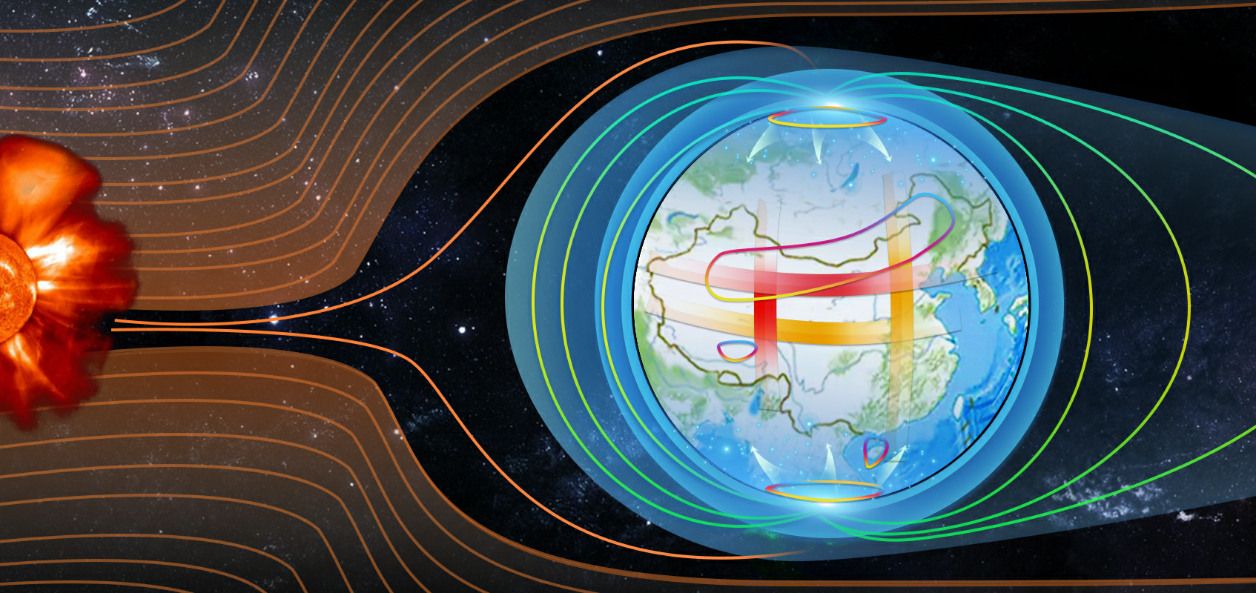
3. Overview of the CMP-Phase II
General Ideas
Magnetosphere
Solar Interplanetary Geospace
Ionosphere
Middle and upper atmosphere
A whole chain: to trace from sun to interplanetary, and to geospace.
Networks: to capture the propagation of disturbances in the geospace.
Key regions: comprehensive observation with multiple instruments .

Slide 11
Monitoring layout
One Chain:
From the Sun → Interplanetary → Geospace
Three Networks:
Upper Atmosphere + Ionosphere + Magnetosphere
Four Focuses:
High-latitude: Polar regions
Mid-latitude: North area of China
Low-latitude: South of China (Hainan)
High-land: Tibetan Plateau
Conventional automatic instruments + some international advanced equipment.

Slide 12
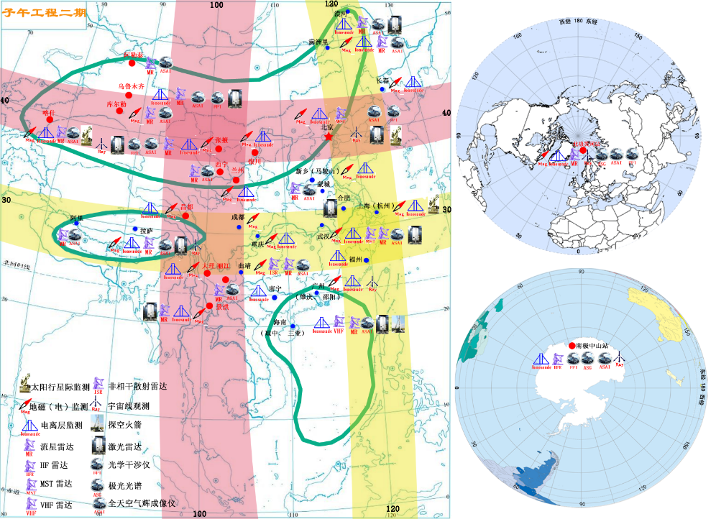
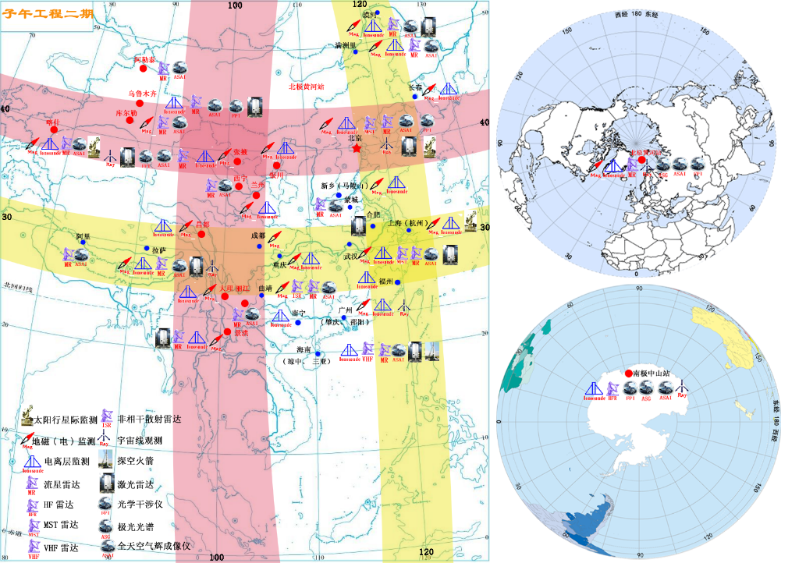
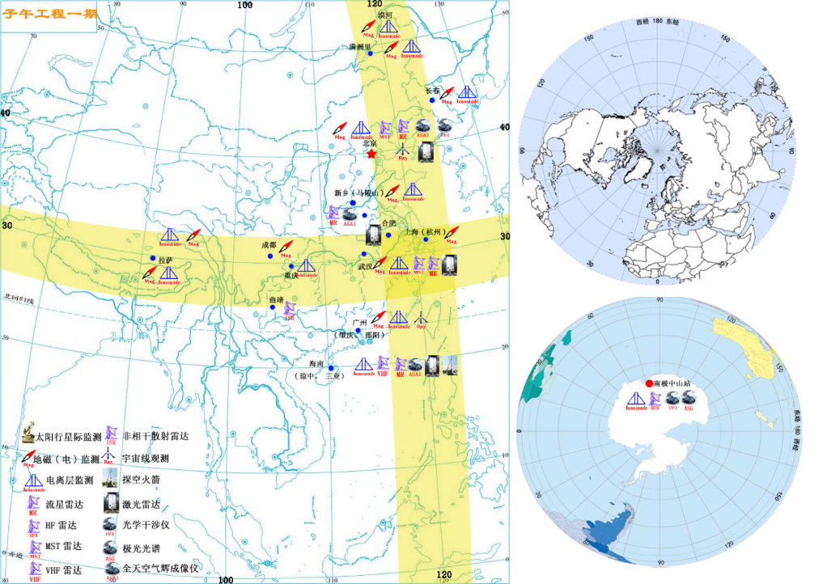
Monitoring layout
100°E
120°E
3 Networks
on
two-cross network
40°N
North of China
30°N
4 Focuses
Polar regions
North of China
South of China
Tibetan plateau
1.3 billion
Tibetan Plateau
Polar region
Low lat. Near Hainan
PPT模板下载：www.1ppt.com/moban/ 行业PPT模板：www.1ppt.com/hangye/
节日PPT模板：www.1ppt.com/jieri/ PPT素材下载：www.1ppt.com/sucai/
PPT背景图片：www.1ppt.com/beijing/ PPT图表下载：www.1ppt.com/tubiao/
优秀PPT下载：www.1ppt.com/xiazai/ PPT教程： www.1ppt.com/powerpoint/
Word教程： www.1ppt.com/word/ Excel教程：www.1ppt.com/excel/
资料下载：www.1ppt.com/ziliao/ PPT课件下载：www.1ppt.com/kejian/
范文下载：www.1ppt.com/fanwen/ 试卷下载：www.1ppt.com/shiti/
教案下载：www.1ppt.com/jiaoan/ PPT论坛：www.1ppt.cn

Slide 13
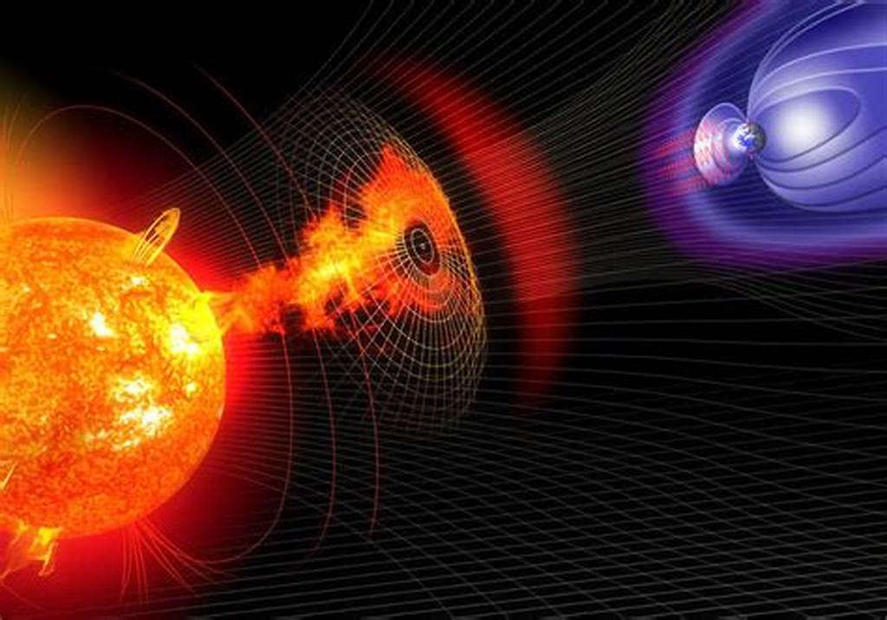
One Chain – Solar Interplanetary
Distance | Method
0Rs Solar surface | Optical
0.05 ~1.0Rs
0.3 ~ 1.5Rs | Radio
1 ~ 5Rs
20 ~ 200Rs | IPS
to ~ 215Rs | Cosmic ray
KHz
MHz
30MHz
IPS &
Cosmic ray
GHz
GHz
Radio
Optical
Instruments: Solar Magnetic Imager, Coronagraph, Radio heliographs, interplanetary scintillation (IPS) telescopes, and Cosmic ray detector.
Joining multiple methods and frequencies, form the whole observing chain.

Slide 14
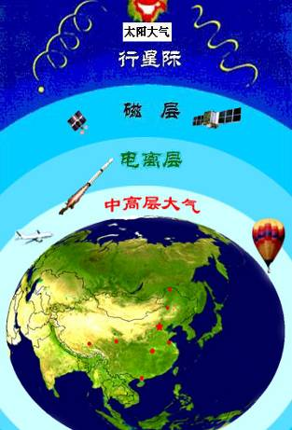

Three Networks
Whole territory
Mid to small scale
Sun
Interplanetary
Magnetosphere
MHz
Ionosphere
Atmosphere
GHz
Magnetosphere
Ionosphere
Upper atmosphere
Upper Atmosphere: Lidars, Meteor radars, MST radars, Airglow imagers
Ionosphere: Ionosondes, TEC and scintillation monitors, Doppler shift monitors.
Magnetosphere: Magnetometers, Wave monitors, Electric field monitors

Slide 15
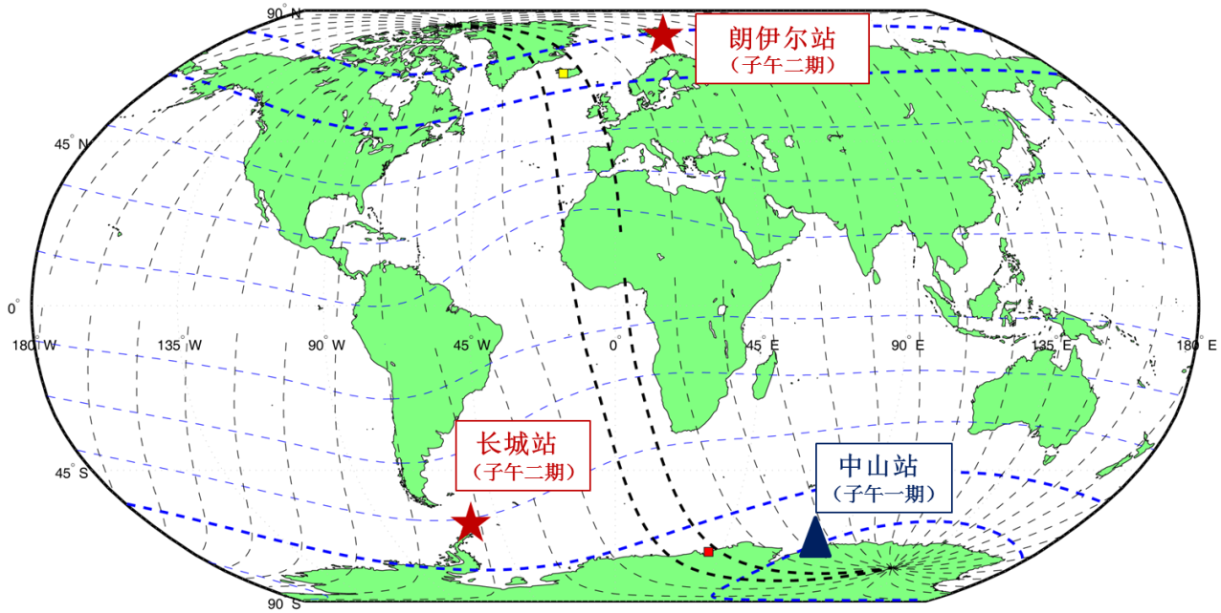
Focus 1: Polar Regions
 | Mlat. | Mlon.
Changcheng | -47.75 | 11.48
Zhongshan | -74.63 | 96.66
Yellow river | 76.30 | 110.52
Longyearbyen | 75.12 | 113.35
Longyearbyen
(Norway)
Magnetometers
Wave monitors
Ionosonde
TEC and scintillation monitor
FP interferometer
All-sky aurora imager
Changcheng
Zhongshan
Longyearbyen and Zhongshan, roughly in conjunction positions.
By adding Changcheng, polar detection is expanded to the west hemisphere.
Latitudinal propagation can be monitored by two latitudinally separated stations, Changcheng and Zhongshan.

Slide 16
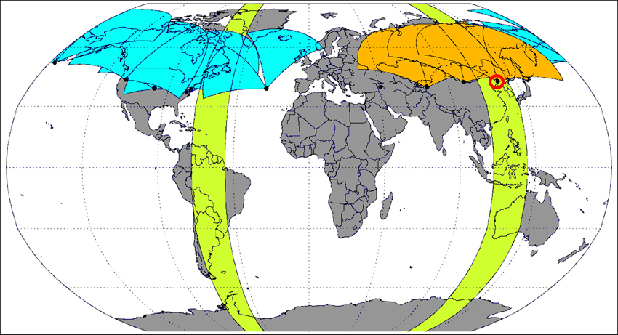
Focus 2: Mid-Lat: North of China
Xinjiang
Jilin
Inner Mongolia
Three station HF radar array: monitor irregularities for a large area at the upstream of China’s territory.
Combined with SuperDARN, mid-latitude regions is well covered.

Slide 17
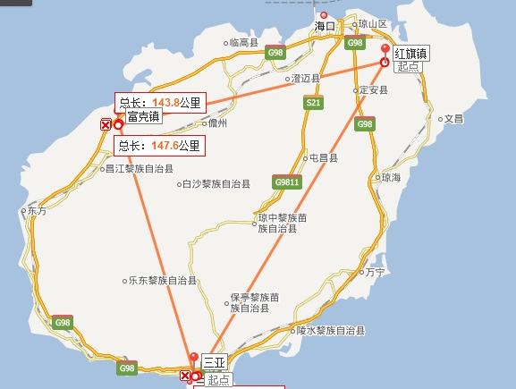
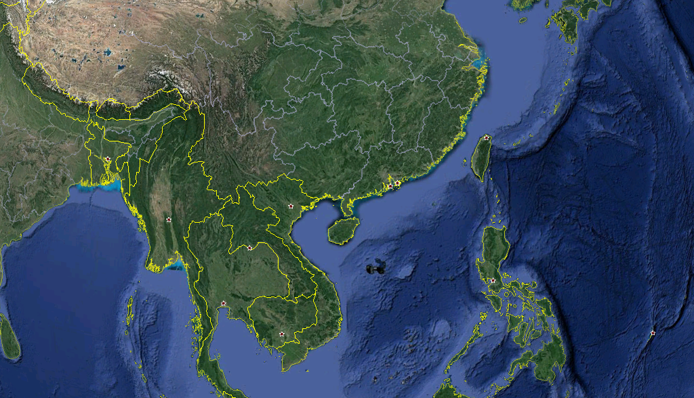
Focus 3: Low-Lat: South of China (Hainan)
Haikou
Danzhou
3-station type ISR
VHF radar
Sanya
VHF radar
HF radar
HF radar
Large aperture Lidar
Two VHF radars: to observe ionospheric irregularities.
A low-latitude HF radar: monitoring ionospheric convection
A three-station incoherent scattering radar: detects 3D plasma speed vectors and other important parameters.
A large aperture Lidar: will detect the atmosphere up to 1000km.
Sounding rockets: to carry out in-situ measurements.

Slide 18
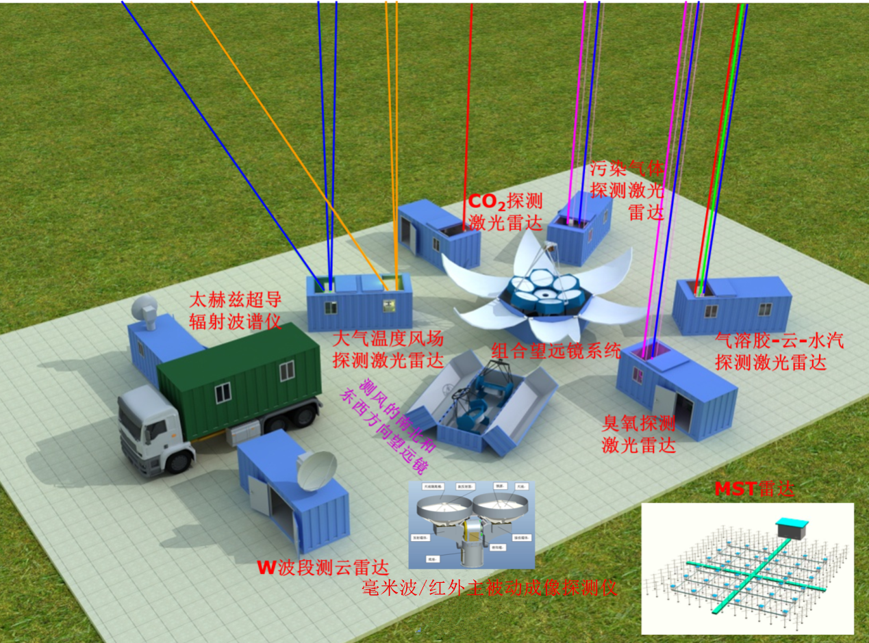
Focus 4: Highland: Tibetan Plateau
Instruments
Temperature-wind Lidar
O₃ Lidar
Pollution gas Lidar
CO₂ Lidar
Aerosol-cloud-vapor Lidar
W band cloud radar
Tera-hertz superconductive radiation spectrometer
MST radar
Millimeter wave/infrared imager
Lidar system + MST radar + Millimeter wave/Infrared imager

Slide 19
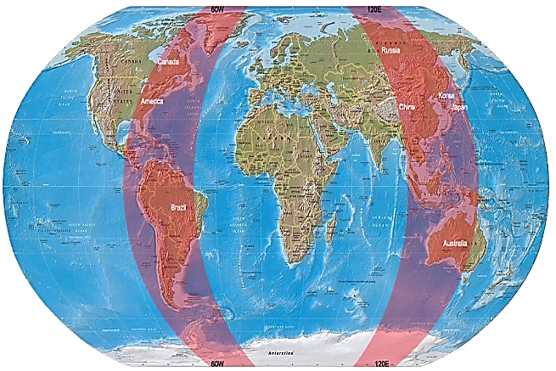
4. Future plans
Meridian Project Trilogy:
CMP-phase I CMP-phase II IMCP
国际子午圈
数据中心
西经60度
东经120度
International Meridian Circle Project
2008
2012
2019
2023
Now
Construction period (CMP-I)
Operation period (CMP-I)
Construction period (CMP-II)
Operation period of CMP

Slide 20
5. Summary
The Chinese Meridian Project phase I is currently running well, and has made important progresses in research.
The second phase of the project is during the construction period. It will be put into operation after 2023.
IMCP is very worth looking forward to.
Data of CMP phase I: http://data.meridianproject.ac.cn

Slide 21
Thanks！
International cooperation is welcome!

