Slide 1




Characteristics of lightning activity detected by FY-4A Lightning Mapping Imager (LMI)
Dongjie Cao¹, Feng Lu¹, Xiaohu Zhang¹, and Jing Yang²
1. National Satellite Meteorological Center, China Meteorological Administration (NSMC/CMA), Beijing, China
2. Institute of Atmospheric Physics, Chinese Academy of Sciences (IAP/CAS), Beijing, China
E-mail: caodj@cma.gov.cn

Slide 2
Introduction
Data and Methodology
Results
Summary

Slide 3
Introduction
Data and Methodology
Results
Summary

Slide 4
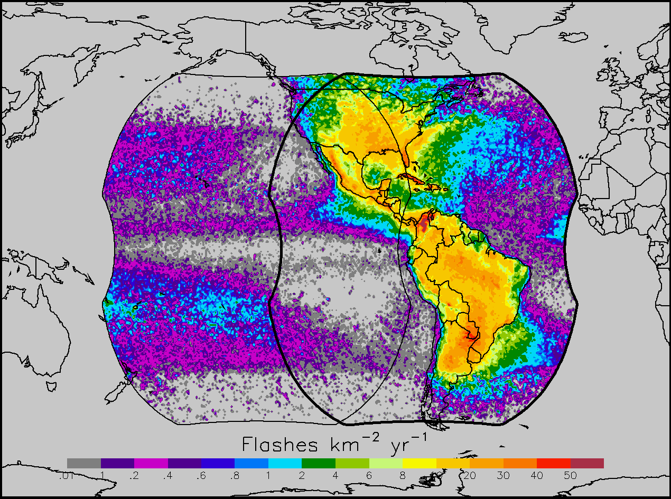
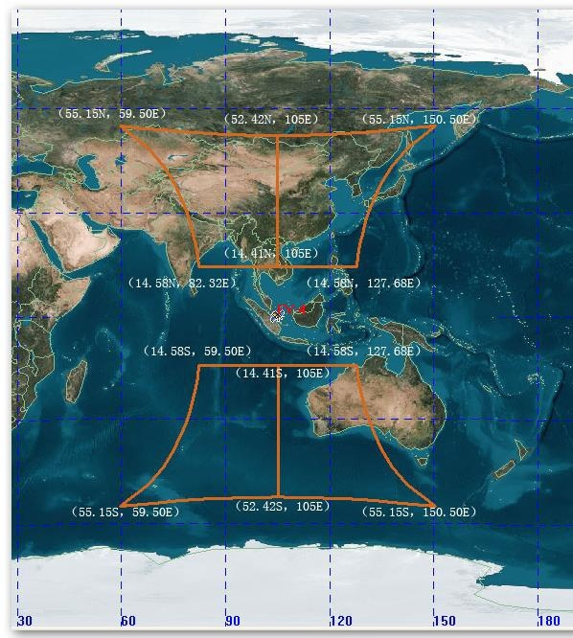
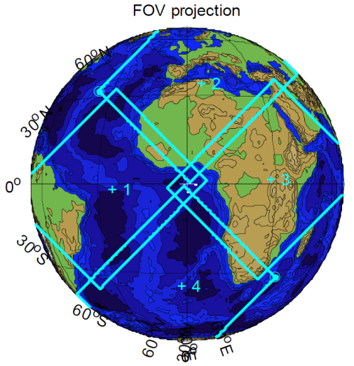
GOES-16 and GOES-17 GLM courtesy Steven J. Goodman, NOAA/NESDIS
launched on November 19, 2016 at 6:42 p.m. EST
FY-4A LMI, NSMC CMA
launched on December 11, 2016 at 00:11 p.m. Beijing Time
Goal: Globally Consistent Lightning Database
Global Circuit research
MTG LI courtesy Jochen Grandell, EUMETSAT, Scheduled to be launched in 2021

Slide 5
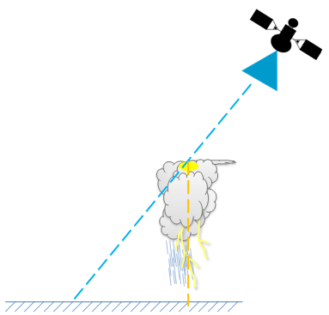
FY-4A LMI
LMI capture strongest optical emission from lightning discharge from the cloud top by detecting the neutral oxygen (OI(1) line at 777.4 nm.
LMI instrument include 400×300×2 CCD array, RTEP (On-board preprocessing and background substraction), temporal controller, image transistor and power.
As incident radiance is focused onto the pixel array, each pixel within the CCD array accumulates energy, integrating over frames of approximately 1.875 ms. Results are read out every 2 ms and passed to the RTEP.
Ground data processing
Calibration and validation, non lightning event filtering and clustering analysis, output LMI Level 2 products updated each minute.
Coverage
The FY-4A LMI could observe total flashes（include intra-cloud flash and cloud-to-ground flash）
The FY-4A LMI could monitor lightning in China and its adjacent ocean from April to September, then turn to detect lightning in Australia and east of Indian Ocean from October to March of next year.
FY-4A
Enhance Aperture
CCD Array
LMI Optics measurement system

Slide 6
FY-4A LMI Level 1 to Level 2 products (False signal filtering and Clustering analysis)
Event
Group
filtering
Flash
CG Flash
filtering
Events with false signal
Events without false signal
False signal filtering
Event
clustering
Group
clustering
Flash
Clustering analysis

Slide 7
FY-4A LMI Level 2 products (updated each minute)
Event Variable Name | Description
LON | Event Longitude
LAT | Event Latitude
EOT | Event Observe Time
ER | Event Radiance
EFP | Event Footprint
EA | Event Address
EGA | Event-Group Address
EFA | Event-Flash Address
EXP | Event X Pixel
EYP | Event Y Pixel
DQF | Lightning Event Data Quality Flag
Group Variable Name | Description
LON | Group Longitude
LAT | Group Latitude
GOT | Group Observe Time
GR | Group Radiance
GF | Group Footprint
GA | Group Address
GFA | Group Flash Address
GEA | Group Event Address
GEC | Group Event Count
DQF | Lightning Group Data Quality Flag
Flash Variable Name | Description
LON | Flash Longitude
LAT | Flash Latitude
FDT | Flash Delta Time
FOT | Flash Observe Time
FR | Flash Radiance
FF | Flash Footprint
FA | Flash Address
FGA | Flash Group Address
FGC | Flash Group Count
DQF | Lightning Flash Data Quality Flag
Event : A single pixel exceeding the background threshold during a single frame
Group : Two or more adjacent events in the same time frame
Flash : A set of groups sequentially separated in time and in space by certain threshold

Slide 8
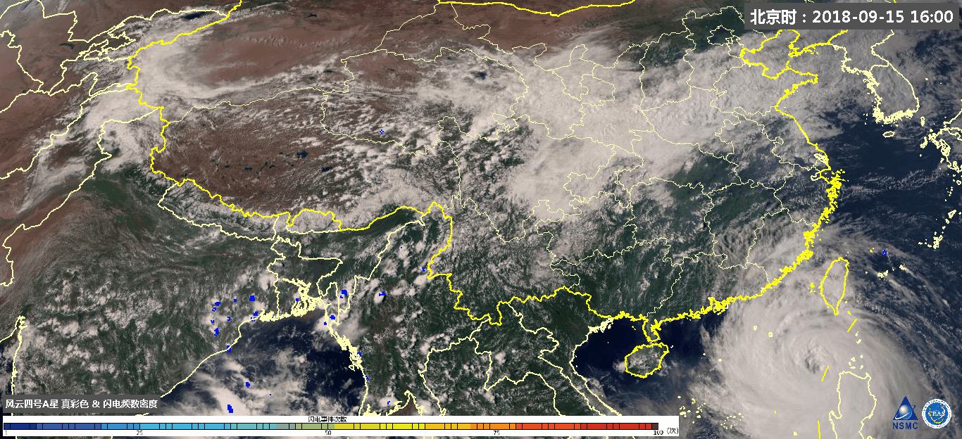
Super Typhoon Mangkhut

Slide 9
Introduction
Data and Methodology
Results
Summary

Slide 10
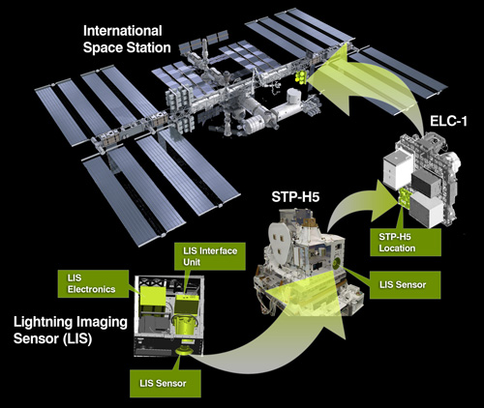
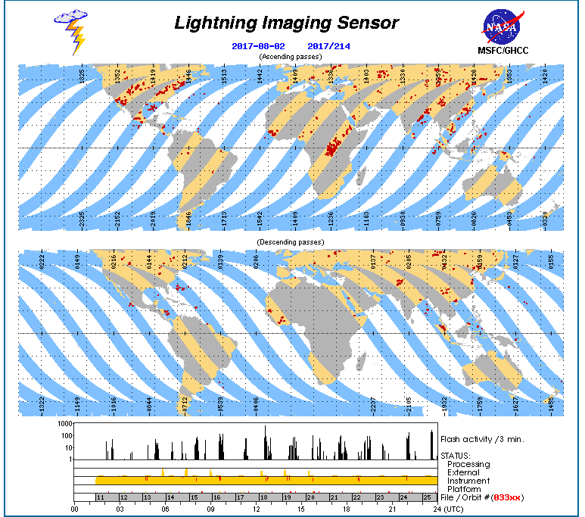
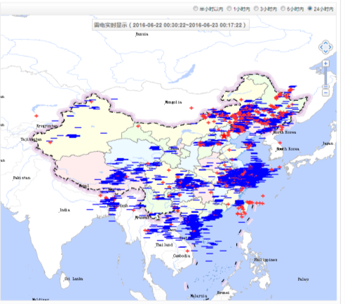
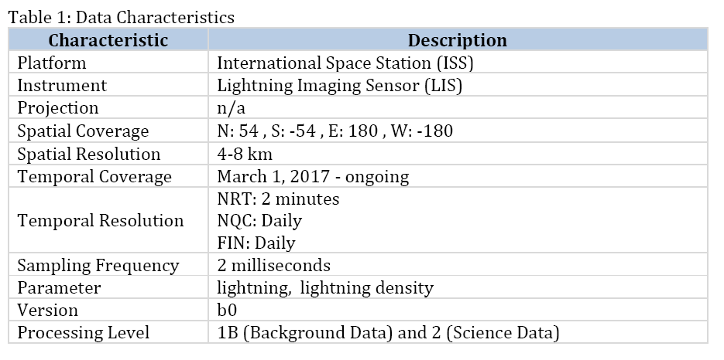
LLNC
(The Lighting Locating Network in China, CMA)
ISS / LIS
( International Space Station / Lightning Imaging Sensor)

Slide 11
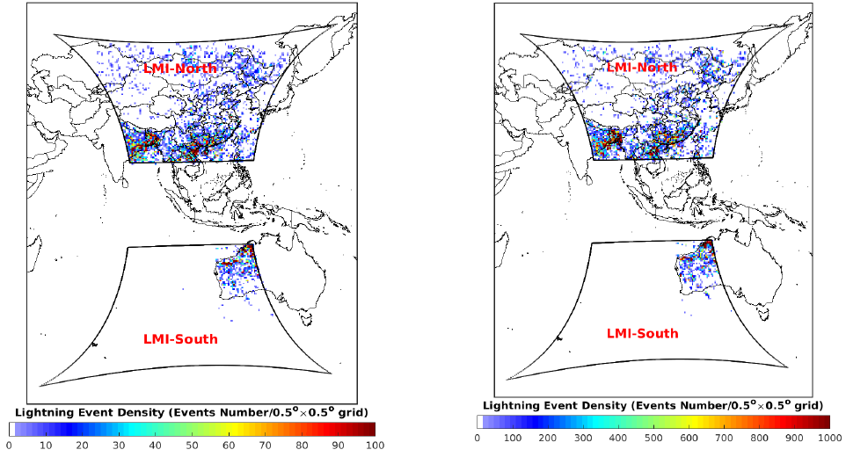
Lightning activity detected by lightning Imager during 2018 - 2020
FY-4A LMI
ISS LIS

Slide 12
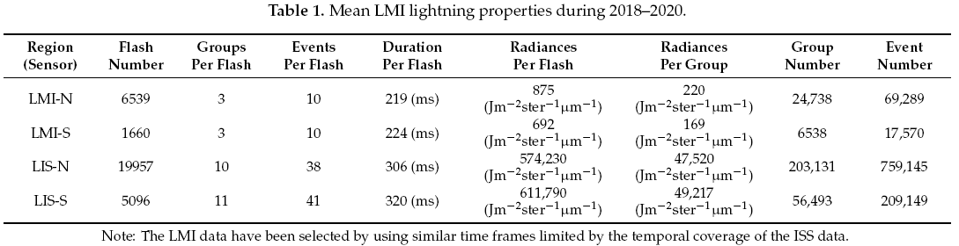
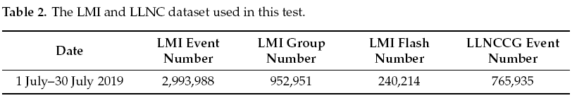
LIS Event number is approximately 11 times (12 times) higher than that of the LMI Event in LMI-N (LMI-S)
The proportion of LMI Flash, Group, and Event is approximately 1:4:11 both in the LMI-N and LMI-S
The proportion of LIS Flash, Group, and Event is approximately 1:4:38 (1:4:41) in the LIS-N (LIS-S)

Slide 13
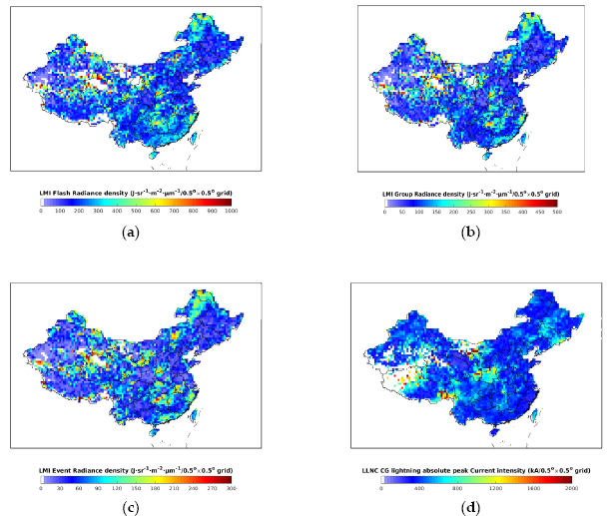
Flash
Group
Flash
Group
Event
CG
Event
CG
Lightning density distribution in spatial
Lightning radiance distribution in spatial

Slide 14
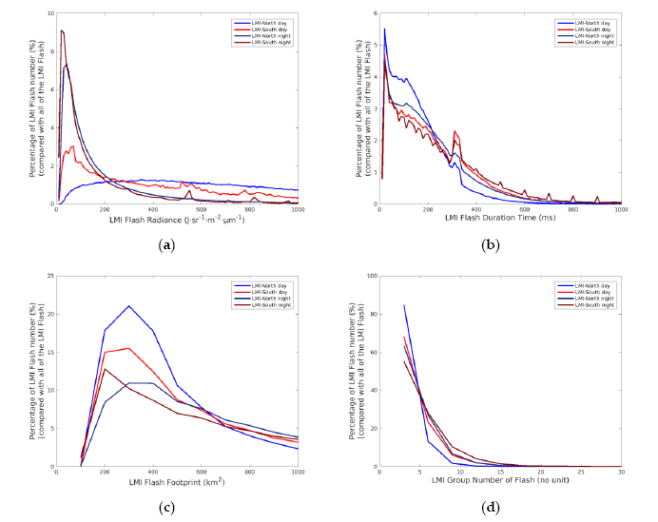
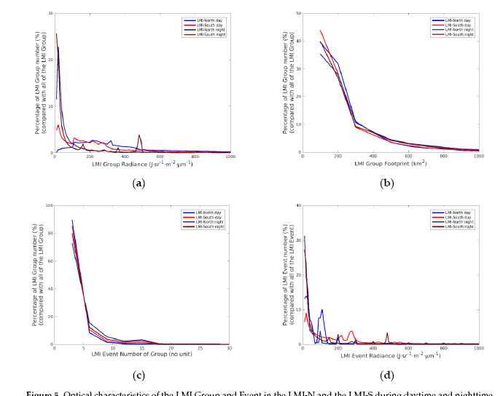
Comparison of LMI lightning optical characteristics during daytime and nighttime
Flash radiance
Flash duration
Group radiance
Group footprint
Flash footprint
Flash-Groups number
Group-Events number
Event radiance

Slide 15
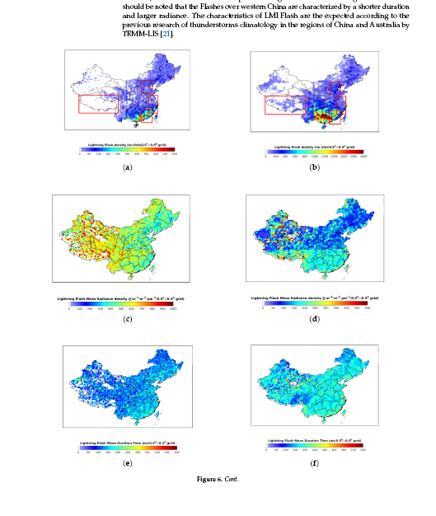
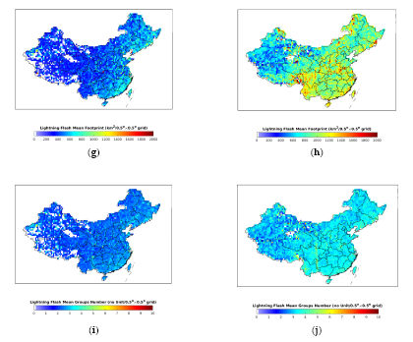
Spatial distribution features of LMI Flash during daytime and nighttime
BTH
Tibet-Plateau
YRD
PRD

Slide 16
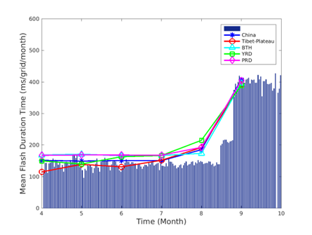
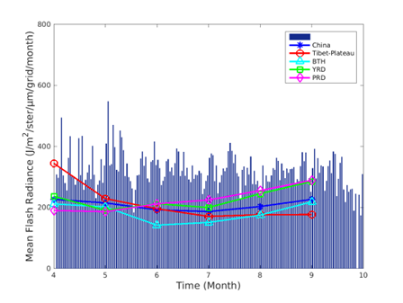
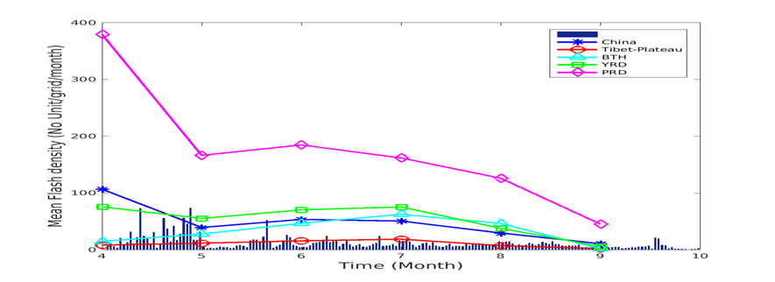
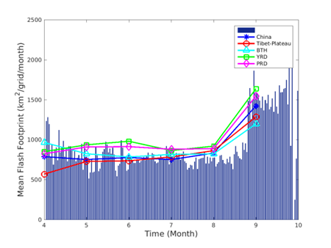
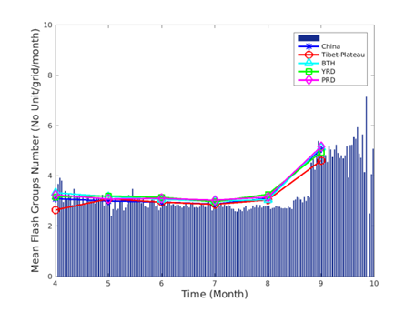
Temporal distribution features of LMI Flash during daytime and nighttime

Slide 17
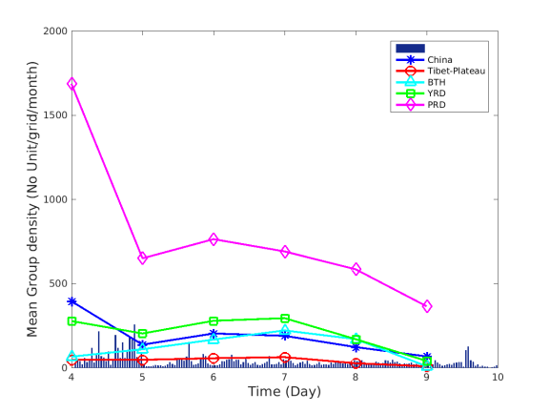
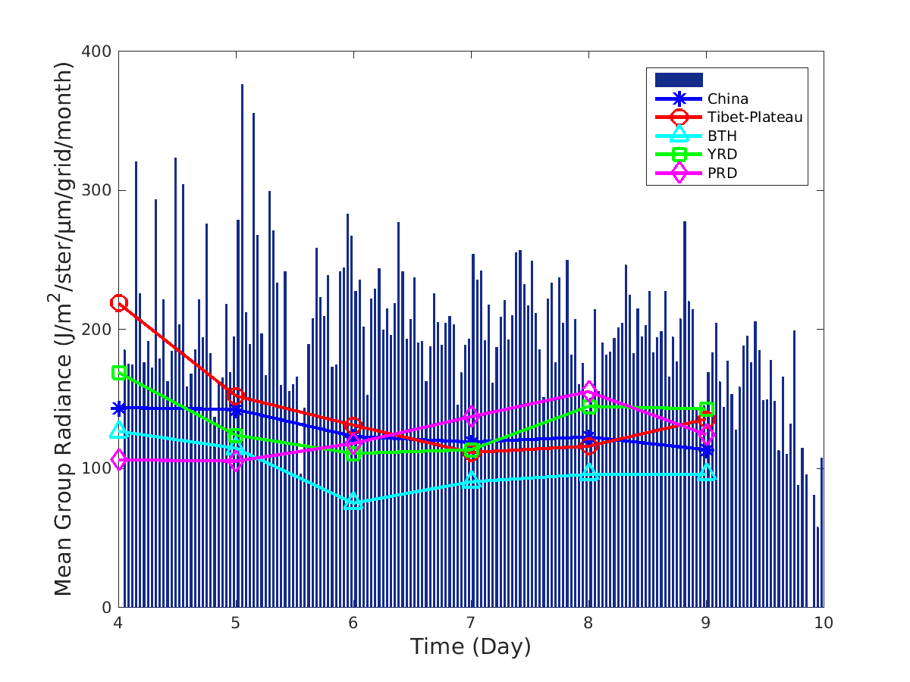
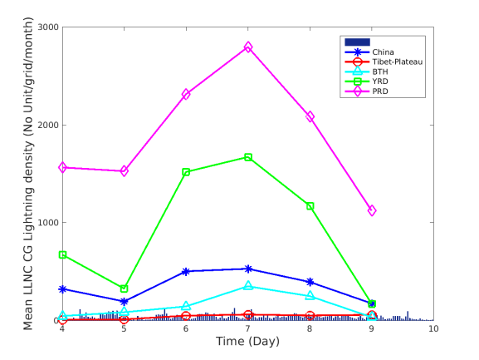
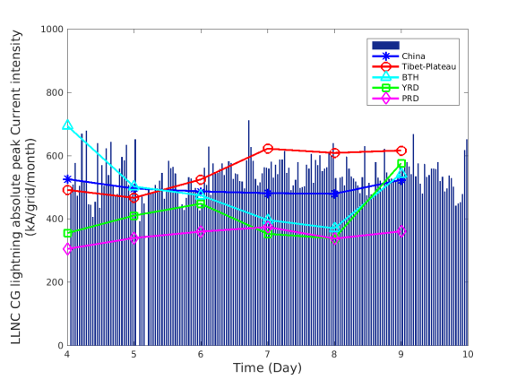
Temporal distribution features of LMI Group during daytime and nighttime

Slide 18
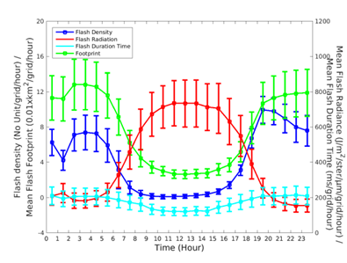
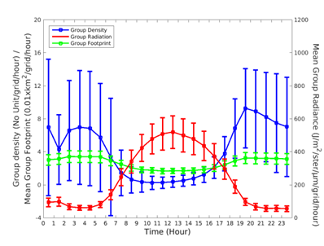
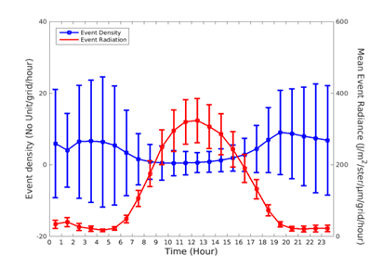
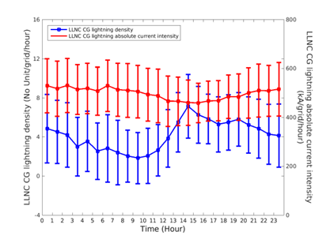
Hourly variation of LMI lightning

Slide 19
4 Summary
The geographical distribution of the maximum FY-4A LMI lightning density is in qualitative agreement with the ISS LIS lightning.
The optical characteristics of the LMI Flash in the LMI-N are consistent with that in the LMI-S.
The LMI Flash density is dominated by the middle and lower south of the Yangtze River.
The LMI Flash density in the PRD is significantly greater than those in the other three regions (TP, BTH, and YRD) from April to September.
There were more LMI lightning during the nighttime than that during the daytime, indicating the higher detection efficiency of the LMI in the nighttime than in the daytime.
The LMI data could be used for detecting and monitoring the lightning activity in China and adjacent sea area.

Slide 20
4 Summary
The LMI Level 2 products reflect the lightning activity in the LMI observation domain.
The LMI Level 2 products are meaningful for monitoring lightning activity.
Detailed evaluation of the LMI datasets will be further conducted by using the ground-based lightning location system with a highly accurate locating ability for both CG and IC lightning

Slide 21
Thank you !

