Slide 1

Data Validation and Mesoscale Assimilation of Himawari-8 Optimal Cloud Analysis Products
Michiko Otsuka^{*1}, Hiromu Seko^{*2}, Masahiro Hayashi^{*2}, Ko Koizumi^{*2}
1: Meteorological College/JMA, 2: Meteorological Research Institute/JMA
AOMSUC-11 and FYSUC-2021

Slide 2
Purpose of Study
Himawari-8 OCA (Optimal Cloud Analysis) can provide the water vapor information in clouds with high spatial and temporal resolution and with a wide coverage, including over the ocean.
Most heavy rainfall events in Japan are caused by low-level inflows from over the ocean (Kato 2018).
It can be beneficial for improving the initial states for prediction, analyses of water vapor fluxes, and understanding the factors and mechanisms of the torrential rainfall.
OCA products were validated against other observations and model outputs.
Data assimilation experiments on a few heavy rainfall events using OCA as relative humidity data were conducted.
AOMSUC-11 and FYSUC-2021

Slide 3
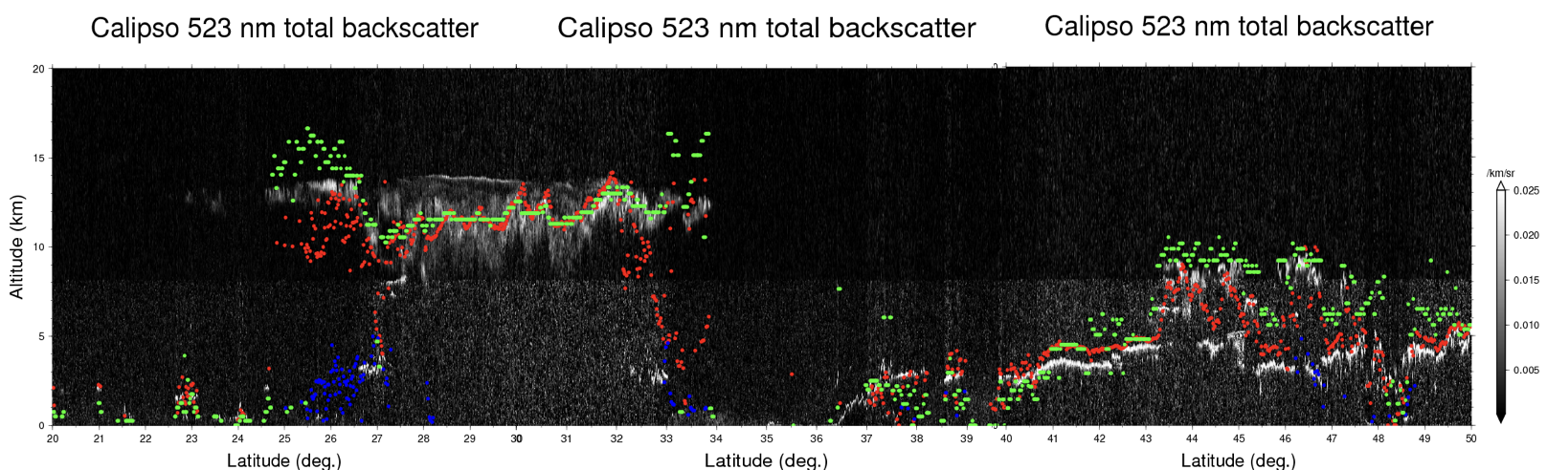
Himawari-8 OCA
(a)
(b)
CTP
COT
OCA is an optimal estimation method for extracting cloud parameters originally developed by EUMETSAT.
Himawari-8 OCA was developed by Hayashi and Watts (2016) using all 16 channels of AHI.
Cloud optical thickness (COT), cloud top pressure (CTP), cloud water path (CWP), cloud effective radius (CRE), and cloud phase were retrieved from 10-min full-disk scans of the domain within 20−50 °N and 120−150°E with a horizontal resolution of 0.02°. Only daytime data were used.
(c)
CWP
Example of Himawari-8 OCA. (a) CTP (hPa), (b) COT and (c) CWP (g m⁻² ) at 0200 UTC 8 September 2015.
Comparison of CTP between Himawari-8 OCA, MODIS and CALIPSO (Hayashi and Watts 2016).

Slide 4
Validation against surface observations
OCA CTP and COT, SYNOP weather and cloud types, and their corresponding ISCCP classification for collocated SYNOP and OCA data in July 2017.
COT
CTP
< 440 hPa
440- 680 hPa
> 680 hPa
CRE
CWP
Fair: CF ≦ 5
Cloudy: CF > 5
OCA cloud occurrences validated against SYNOP.
Appearance frequencies of cloud properties according to weather categories.

Slide 5
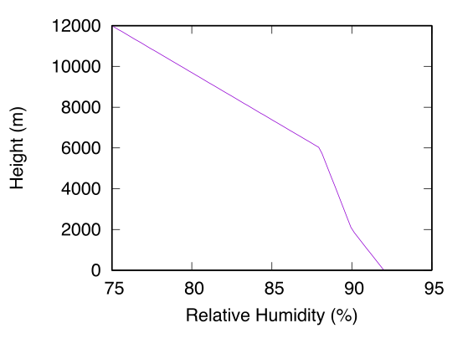
Validation against sonde observations
Threshold values for cloud existence according to elevations by Zhang et al. (2010).
OCA cloud occurrences validated against sonde observations in July 2017.
0000 UTC 2 (left) and 10 (right) July 2017 at Fukuoka station
Examples of relative humidity over water and ice and temperature profiles, and cloud layers (light blue rectangles) obtained by sonde observations together with OCA data points.
Histogram of differences of CTP between OCA and sonde in July 2017.

Slide 6

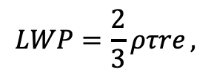
OCA assimilated as relative humidity (RH)
Large gaps between OCA CWP and JMA-NHM (JMA’s non hydrostatic model) CWP were occasionally found in the first-guess departure statistics.
Pseudo-RH assimilation is easy to implement.
Considering the results of the data verifications, we targeted only liquid clouds having COT below 50 and CTP below the 440-hPa level for assimilation.
CTH
Pseudo-RHs were obtained in every 500 m height within a cloud column as threshold values of Zhang et al. (2010).
$$LWP=\frac{2}{3}ρτre ,$$
CGT
Histograms of differences between OCA and NHM.
(a) CTP and (b) CWP.
CBH
$ρ$: water density, $τ:$ COT, r_{e}: CRE, LWC=0.30 g m⁻³.
AOMSUC-11 and FYSUC-2021

Slide 7
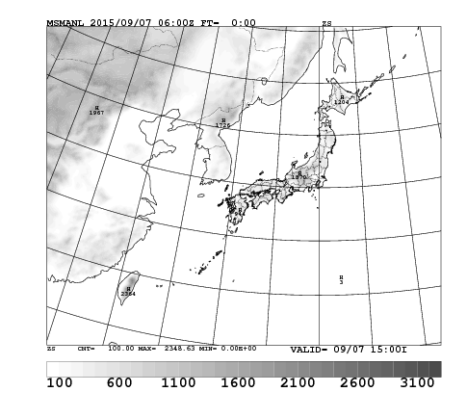
Data assimilation experimental settings
JMA NHM based variational analysis data assimilation (JNoVA, Honda et al. 2005)
4D-Var / 3-h time window / observational data assimilated hourly
Observation error for OCA RH: 30 %, data thinning scale: 0.04°
If OCA did not detect any clouds and first-guess RH was above the threshold value for the existence of a cloud, the pseudo-RH in that gird was set to a climatological clear-sky value derived from sonde observations from the past 10 years.
Frequency histogram of departures of OCA RH from (a) first-guess and (b) analyses during 0000-0900 UTC 9 Sep. 2015
Domain of JNoVA
AOMSUC-11 and FYSUC-2021

Slide 8
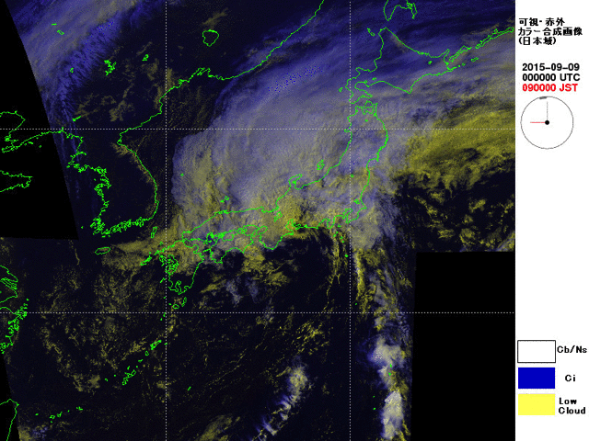
DA experiments on heavy rainfall events
Heavy rainfall event on 9 September 2015
The moist air circulating around the two typhoons brought torrential rainfalls to a wide area of Japan and, in particular, to the regions of eastern Japan.
The northward movement of low clouds over the southern sea suggested continuous low-level inflows to these region.
Surface weather map by JMA
at 0000 UTC 9 Sep. 2015.
IR and VIS composite image by JMA at 0000 -0900 UTC 9 Sep. 2015.
Distribution map of pseudo-RH data points at 0900 UTC. The color of each circle indicates the pseudo-RH value at the top of the profile.
Pseudo-RH data of around 90 % were obtained for the whole area, including over the ocean south of Japan, where low clouds, possibly associated with low-level inflows, were observed.
AOMSUC-11 and FYSUC-2021

Slide 9
Impacts on analyses
Water vapor and wind fields (TEST minus CNTL)
TEST: OCA pseudo-RHs were assimilated with the operational observations.
CNTL: Only operational observations were assimilated.
Significant differences in water vapor fields were seen in the lower to middle levels.
Sea surface pressure and wind speed at the surface and at 850 hPa were also slightly changed in TEST.
850 hPa
700 hPa
500 hPa
Water vapor mixing ratio (kg kg⁻¹) at (a) 850, (b) 700 and (c) 500 hPa.
(d) Sea surface pressure, wind speed at (e) the surface and (f) 850 hPa.
Differences in analysis results between TEST and CNTL at 0900 UTC 9 Sep. 2015.

Slide 10
Impacts on forecasts
Water vapor and wind fields (TEST minus CNTL)
An increase in southerly wind speed concurrent with humidity increase
The low-level inflows from the sea south of Japan had intensified over the area.
The meeting of increased southwest to south winds with southeast winds intensified convergences in northern Kanto and, later, in southern Kanto Regin where torrential rainfalls occurred.
FT09
FT12
FT15
RH
RH
RH
v
v
v
←
Differences of forecast RH and wind speed at 850 hPa between TEST and CNTL.
wind
wind
wind

Slide 11
Impacts on precipitation forecasts
FT09
FT12
FT15
The heavy rainfall bands over the region were better reproduced by TEST than by CNTL.
Threat and bias scores of the 3-h amount of forecast rainfall improved overall, especially in the early forecast hours.
Radar/rain gauge observation
TEST
CNTL
Precipitation forecast (a) threat and (b) bias scores for the 3-h precipitation thresholds at every 3 h of forecast time in CNTL (green lines) and TEST (red lines). Thin, thick, and dashed lines indicate threshold values of 1 mm, 10 mm, and 20 mm.
3-h precipitation (mm) in observations and forecasts on 9 Sep. 2015. (a), (b), and (c) Radar/rain gauge-analyzed precipitation (RAP); (d), (e), and (f) forecasts by TEST; (g), (h), and (i) forecasts by CNTL. (a), (d), and (g) FT = 09 (1800 UTC 9 Sep. 2015); (b), (e), and (f) FT = 12 (2100 UTC 9 Sep. 2015); (c), (f), and (i) FT = 15 (0000 UTC 10 Sep. 2015)

Slide 12
Discussion
Effects of water vapor transportation from the sea
Himawari-8 OCA could capture low-level moisture advection that triggered mesoscale heavy rainfalls as well as the synoptic-scale environment.
Currently, only Himawari-8 seems to be able to provide such water vapor information with a good coverage at low to high levels both on land and sea with such a frequency as 10 min.
The method to construct the pseudo-RH data and the preprocessing settings in JNoVA, including quality control, the magnitude of observation error, and data thinning, were established on a somewhat ad hoc basis and may need to improve in the future study.
While direct assimilation of radiances is still limited in water vapor channels, it is worth while demonstrating the use of VIS, near-IR, and other IR channels in mesoscale NWP using OCA products.
AOMSUC-11 and FYSUC-2021

Slide 13
Conclusion
Newly developed Himawari-8 OCA products derived from all 16 AHI channels were evaluated, mainly from the perspective of utilizing them in mesoscale data assimilation to produce better initial conditions for heavy rainfall predictions.
The data consistencies seemed satisfactory when OCA data were obtained under single cloud layer conditions without strong vertical development, whereas large uncertainties were found when multilayer or convective clouds were present.
Assimilation of OCA pseudo-RH caused substantial changes to water vapor fields in the initial conditions. When they successfully captured low-level inflows to the rainfall regions, they were able to significantly impact the precipitation forecasts at later forecast times.
AOMSUC-11 and FYSUC-2021

