Slide 1
～Session3 Nowcasting～ Overview of satellite-based nowcasting products
Shiro Omori
Japan Meteorological Agency
Notes:
I’m Shiro Omori, JMA.
I’ll present about the overview of satellite based nowcasting products.

Slide 2
Contents
What is nowcasting products?
Comparison of ground-based nowcasting product and satellite-based nowcasting product
Why satellite-based nowcasting product is necessary?
Example of satellite-based nowcasting products
International coordination mechanism for satellite-based nowcasting products
Notes:
This slide shows the contents of my presentation.
Firstly, I present what is nowcasting products.
Secondly, I present about comparison of ground-based nowcasting products with satellite-based nowcasting products.
Thirdly, why satellite-based nowcasting product is necessary?
Fourthly, I show examples of satellite-based nowcasting products.
Lastly, I present about international coordination mechanism.

Slide 3
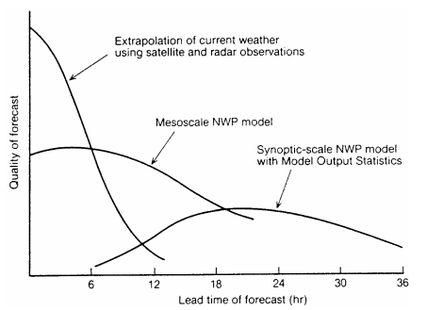
What is nowcasting products?
Target of nowcasting products
0-6 hours
For forecasters who need to watch current and near future weather condition
Quality of forecast
“Extrapolation of current weather” is better than that of “mesoscale NWP model”.
A schematic diagram of the relationship between
forecasting methodology and forecast range.
Notes:
This slide shows the shematic image which shows relationship between quality of forecast and lead time of forecast.
In the short range forecast from 0 to 6 hours, extrapolation of current weather shows better quality than mesoscale NWP mode.
So, for the forecasters who need to watch current and near future weather condition, nowcasting products are more useful than NWP model.

Slide 4
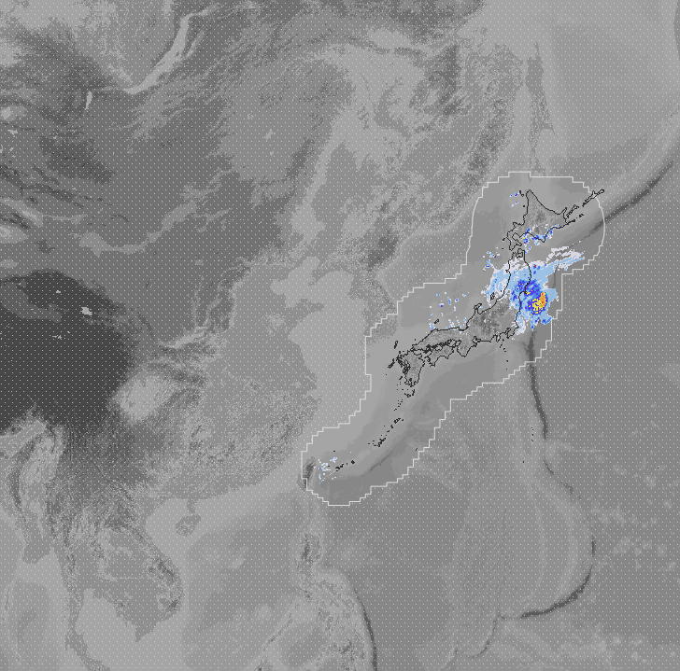
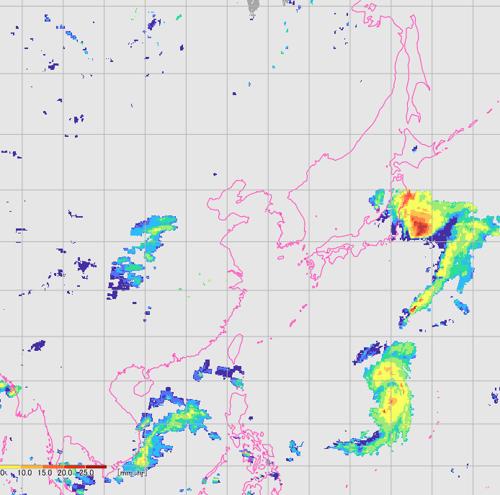
Comparison of ground-based nowcasting product and satellite-based nowcasting product
Regional radar composite map in Japan
Satellite-based precipitation map
(GSMaP produced by JAXA)
26th October 2021, 01UTC
Notes:
There are many nowcasting products.
Some are derived from ground-based weather radar observation, others are derived from satellite-based observation.
This slide shows an example of the comparison of ground-based nowcasting products with satellite-based nowcasting products.
As you may aware, ground-based nowcasting product is so fine, but observation area is limited near ground region.
On the contrary, satellite based observation is valuable in regions where ground-based observation are limited or non-existend, saying in the developing countires or island countries.

Slide 5
Why satellite-based nowcasting product is necessary?
Compared MTSAT-1R/2 with Himawari-8/9 ...
Spectral Band
5→16band
Observation frequency
Every 60 minutes → every 10 minutes
Forecasters must check more imagery more frequently.
Notes:
This slide shows the comparison of specification of JMA’s old MTSAT series satellites with current Himawari-8/9 satellite.
JMA’s current satellite, Himawari-8/9 have 16 observation bands and observes every 10 minutes.
So, current forecasters must check the more imagery more frequently than forecasters who used imagery from MTSAT series satellites.

Slide 6
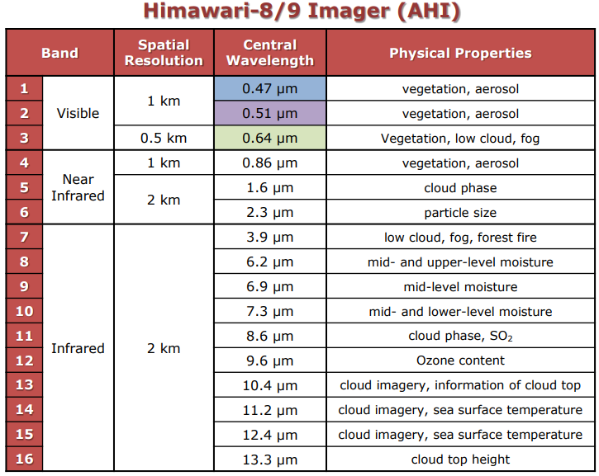
Why satellite-based nowcasting product is necessary?
Besides that, each bands represent various physical properties.
→ Forecasters need to have expertise for satellite imagery to understand the meaning.
Simple and easy-to-understand product is necessary!
Notes:
And this slide shows the features of each observation band of Himawari-8/9.
Each bands have various physical properties, so forecasters need to have expertise for satellite imagery to analyze the weather condition from satellite imagery.
So simple and easy-to-understand product is necessary.

Slide 7
Example of Satellite-based Nowcasting Product ～JMA is providing～
Basic nowcasting product
RGB composite imagery
Advanced nowcasting product
Convective cloud information
Fog
Volcanic ash
Aerosol
Sea surface temperature
Heavy rainfall potential and high-resolution cloud analysis information (for RSMC Nowcasting)
Notes:
From now on, I present about an example of satellite-based nowcasting products which JMA is providing.
Most basic nowcasting product is RGB composite imagery.
For advanced nowcasting products, we provide convective cloud information, fog detection, volcanic ash, aerosol product and sea surface temperature.
And we also provide heavy rainfall potential and high-resolution clould analysis information for RSMC Tokyo for nowcasting.

Slide 8
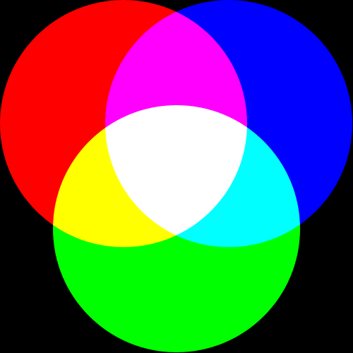
What’s RGB?
Red (R), green (G) and blue (B), which are the three primary colors of light, constitute color space expressing additive color composite
RGB compositing is a technique to display a color using this property of the three primary colors of light
three primary colors RGB
Notes:
This slide shows the meaning of RGB imagery.
Red, green and blue, which are the three primary colors of light, constitute color space expressing additive color composite.
RGB compositing is a technique to display a color using this property of the three primary colors of light.

Slide 9
RGB technique
Assign the three primary colors of red, green and blue for multiple bands of satellite images and compose them
Since various information are derivable by one RGB composite imagery, it is very useful for monitoring by forecasters
The European Organisation for the Exploitation of Meteorological Satellites has been developing the composites (EUMETSAT recipes)
Notes:
This slide shows how to make RGB imagery.
What we should do is just allocate the three primary colors of red, green and blue for multiple bands of satellite images and compose them.
Thus, information of multiple bands are incorporated to one image.
Since various information are derivable by one RGB composite imagery, it is very useful for monitoring by forecasters.
EUMETSAT has been developing the composites.
It means, they explore how to compose satellite images to make an RGB composite imagery useful for monitoring.

Slide 10
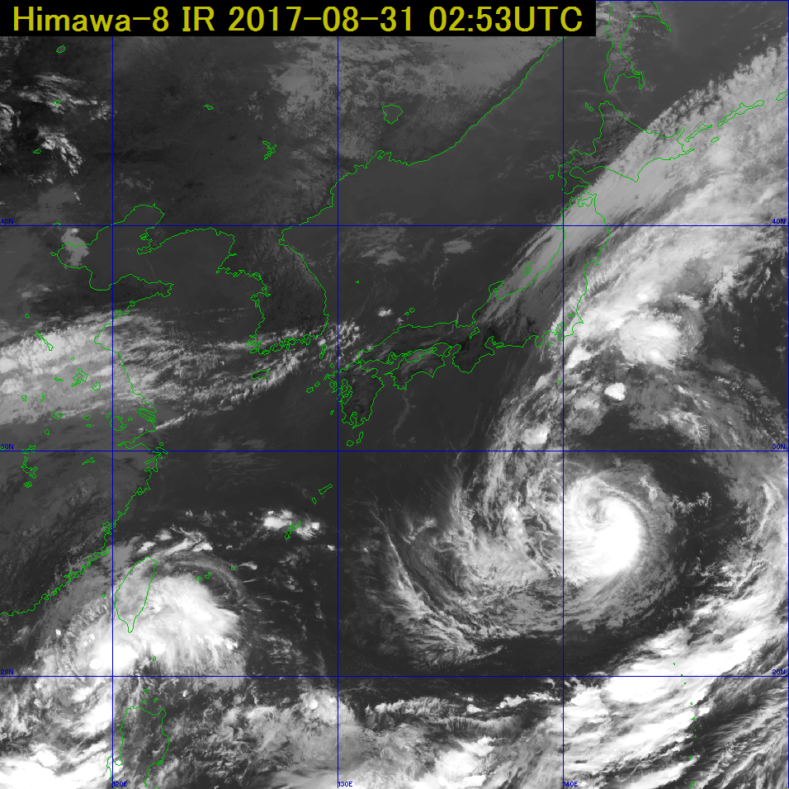
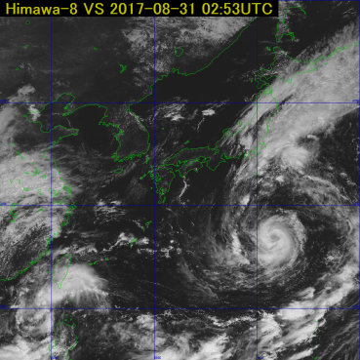
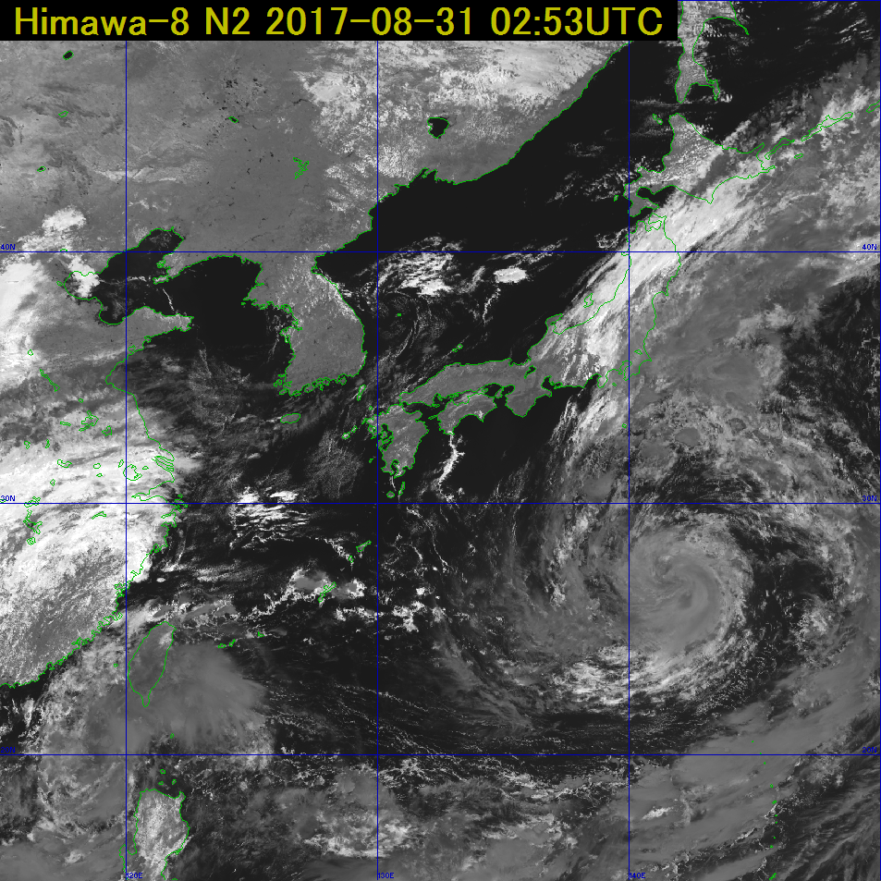
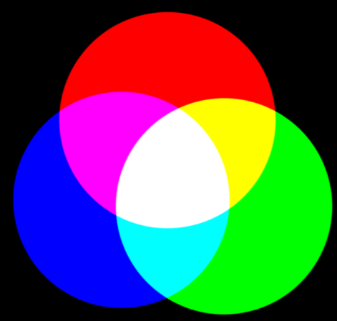
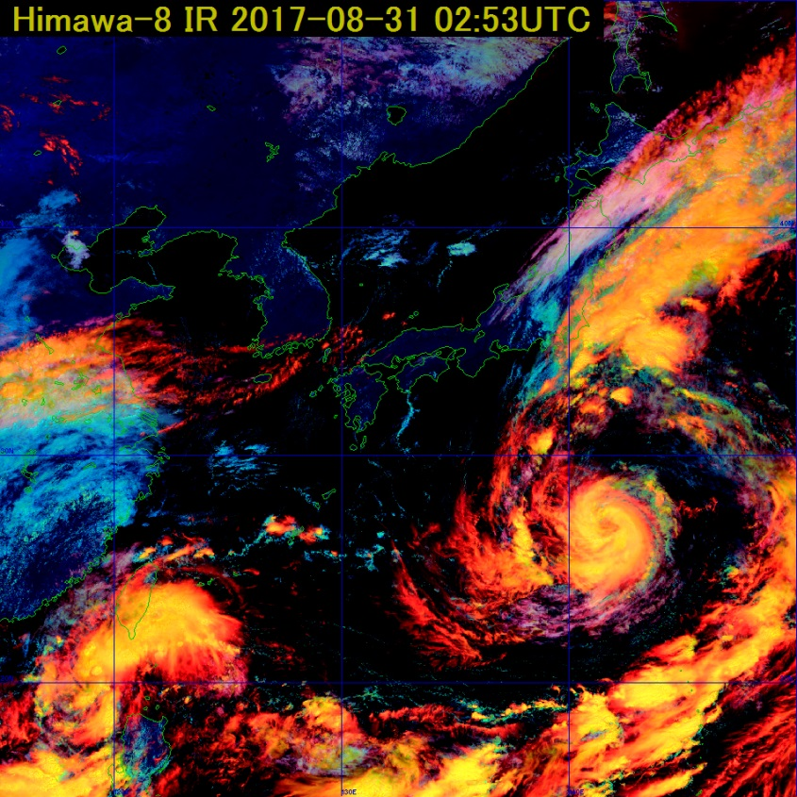
Example of RGB composite imagery
“High“ cloud
“Thick“ cloud
“Ice“ cloud
IR
VS
NIR
Thick and high cloud (Cb) areas appear yellow!
Cloudless
Thin high-level cloud
with ice particles
If you want to focus on the low level clouds, look at cyan area.
Thin high-level cloud with water droplets
Thick high-level cloud with ice particles
Thin low-level cloud with water droplets
Thick low-level cloud with ice particles
Thick low-level cloud with water droplets
Notes:
This slide shows an example of RGB imagery.
For this RGB imagery, IR band is assigned for red, visible band is assigned for green and near infrared band is assigned for blue color.
In the composite imagery, thick and high cloud area appears yellow color.
In this manner, forecasters easily acknowledge the important weather condition from RGB imagery whereas to make RGB imagery is very simple way and don’t need so much computer resource.

Slide 11
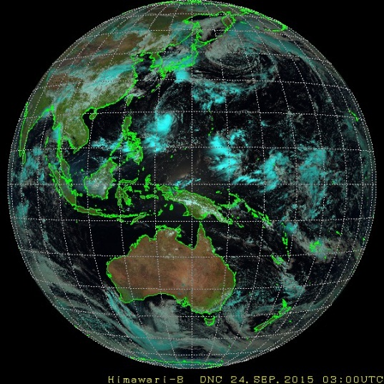
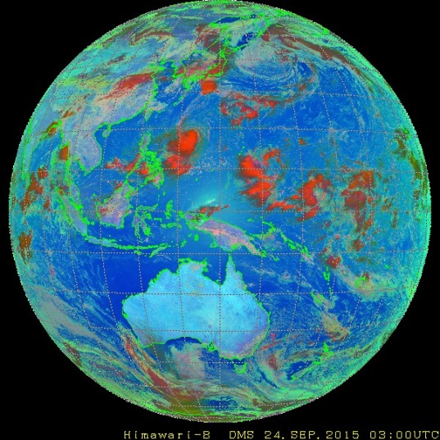
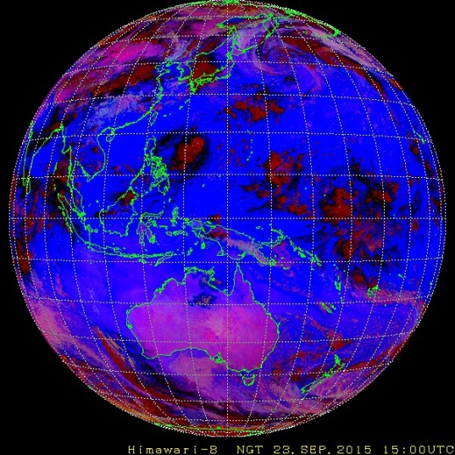
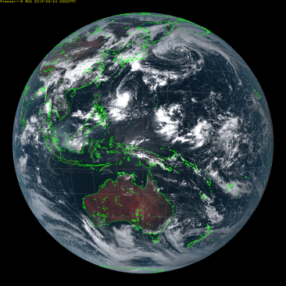
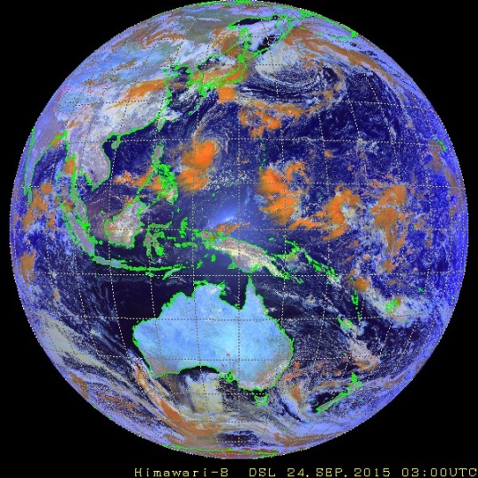
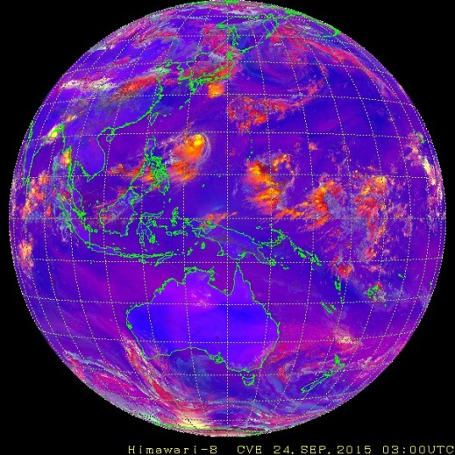
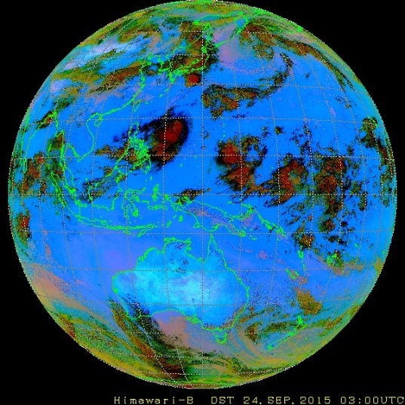
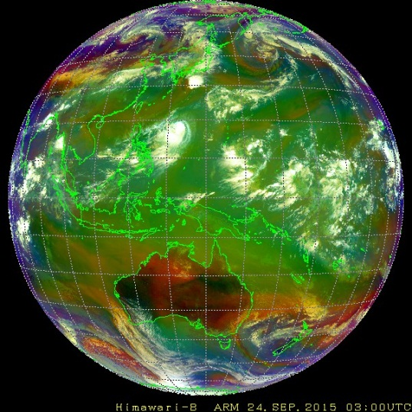
RGBs from Himawari-8
Day Natural Colors
Day Microphysics
Night Microphysics
True Color
Day Snow-Fog
Day Convective Storm
Dust
Airmass
http://www.data.jma.go.jp/mscweb/data/himawari/sat_img.php?area=fd_
Notes:
This slide shows the list of RGB imageries which JMA currently provides for users through website.
For each purposes, various RGB imagery is developed and provided.

Slide 12
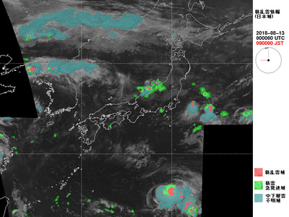
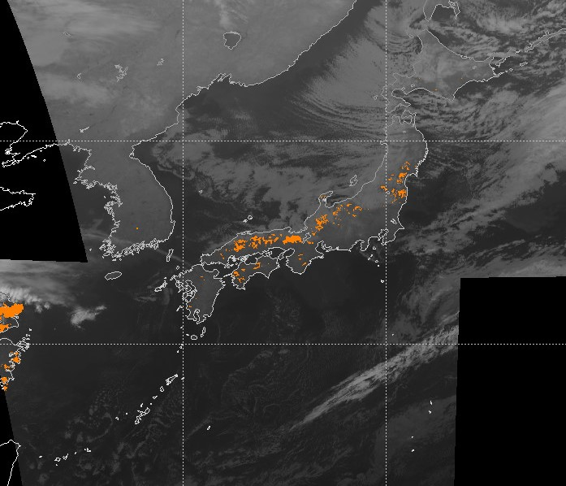
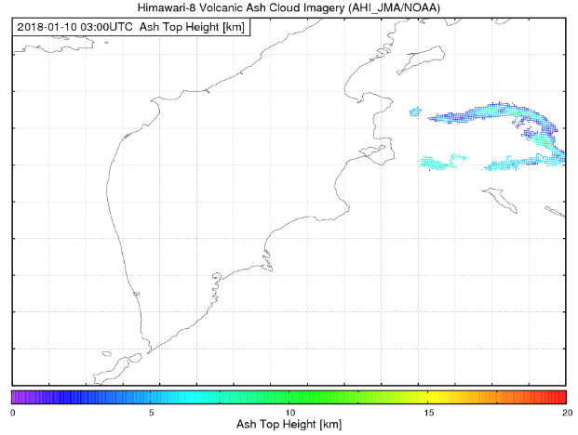
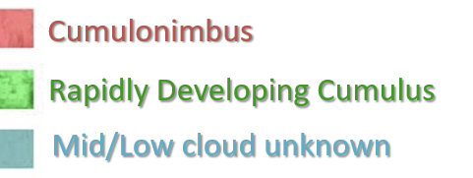
Advanced nowcasting product
Convective Cloud Information
Fog Detection
Volcanic Ash (Produced by VOLCAT)
Ash top height on 10 Jan. 2018
Orange: detected fog area
Notes:
From now on I present about advanced nowcasting products.
This slide shows products for aviation safety.
Convective cloud information includes cumulonimbus areas rapidly developing cumulus areas and mid/low cloud unknows areas.
Fog areas are detected from Himawari-8 and the information is provided for safe takeoff and landing around airport areas.
And volcanic ash product, which is produced by VOLCAT, is also provided for Volcanic Ash Advisary Groups.

Slide 13
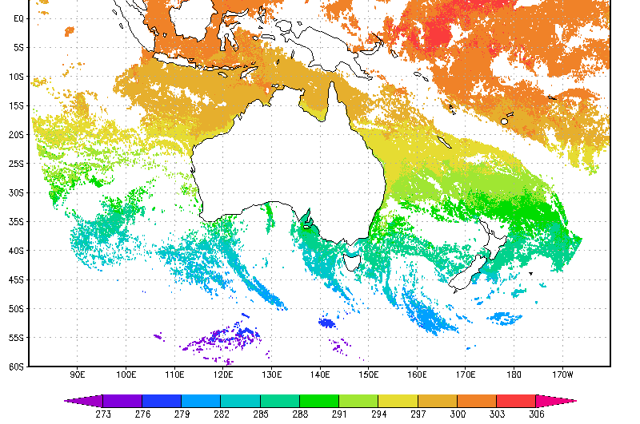
Advanced nowcasting product
Algorism is provided by JAXA
Notes:
This slide shows the other nowcasting products.
Aerosol products are retrieved from Himawari-8.
This product is used to monitor Aeolian dust events, and assimilated into JMA’s aerosol prediction model.
And Sea Suface Temperature is also retrieved form Himwari-8 and this product is utilized for Global SST analysis in JMA.
These retrieval algorithm are developed and provided by JAXA.

Slide 14
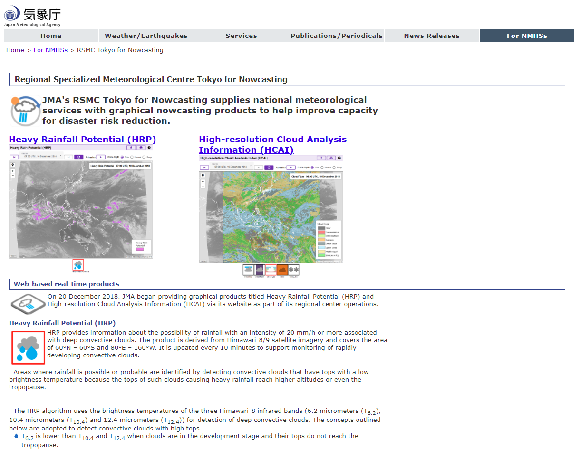
RSMC Tokyo for Nowcasting
https://www.jma.go.jp/jma/jma-eng/jma-center/nowcasting/
Notes:
This slide show an introduction of Regional Specialized Meteorological Center Tokyo for Nowcasting.
On this website, we provide heavy rainfall potential and high-resolution cloud analysis information to help improving capacity for disaster risk reduction.

Slide 15
International coordination mechanism for satellite-based nowcasting products
WMO established, for user convenience, consistent, harmonized mechanism to ensure continuous and sustained provision of consistent, well-characterized satellite product for nowcasting and severe weather risk reduction.
→ “SCOPE-Nowcasting”
Notes:
Whereas many satellite operators, including JMA, provide various satellite nowcasting products, WMO established, for user convenience, consistent and harmonized mechanism to ensure continuous and sustained provision of consistent, well-characterized satellite products for nowcasting and severe weather risk reduction, called SCOPE-Nowcasting.

Slide 16
SCOPE-Nowcasting
Original Pilot Project
Basic Nowcasting, Provision of RGB imagery
Satellite derived volcanic ash information for aviation
Satellite derived precipitation information
Satellite derived sand and dust information
New Pilot Project
Nowcasting in a Big Data World: Multi-sensor feature-based nowcasting of convective impacts
Advanced Nowcasting: Utilization of low-level satellite-derived moisture field for nowcasting convective development
Advanced Nowcasting: Incorporating satellite-based MW observations about column condensed water into nowcasting applications
Notes:
This slide shows the list of pilot project of SCOPE-Nowcasting.
As mentioned in my presentation, JMA has been providing nowcasting products which are included in the SCOPE-Nowcasting pilot projects.
JMA has been participating for these projects and continues to provide internationally cooridinated nowcasting products.

Slide 17
Thank you for your attention !

