Slide 1
LIGHTNING DETECTION BASED ON MICROWAVE SENSING USING MACHINE LEARNING ALGORITHMS
NATIONAL RESEARCH TOMSK STATE UNIVERSITY
Presented by Olga Nechepurenko
Co-authors:
Irina Kuzhevskaia
Vladislav Chursin
Marina Volkova

Slide 2
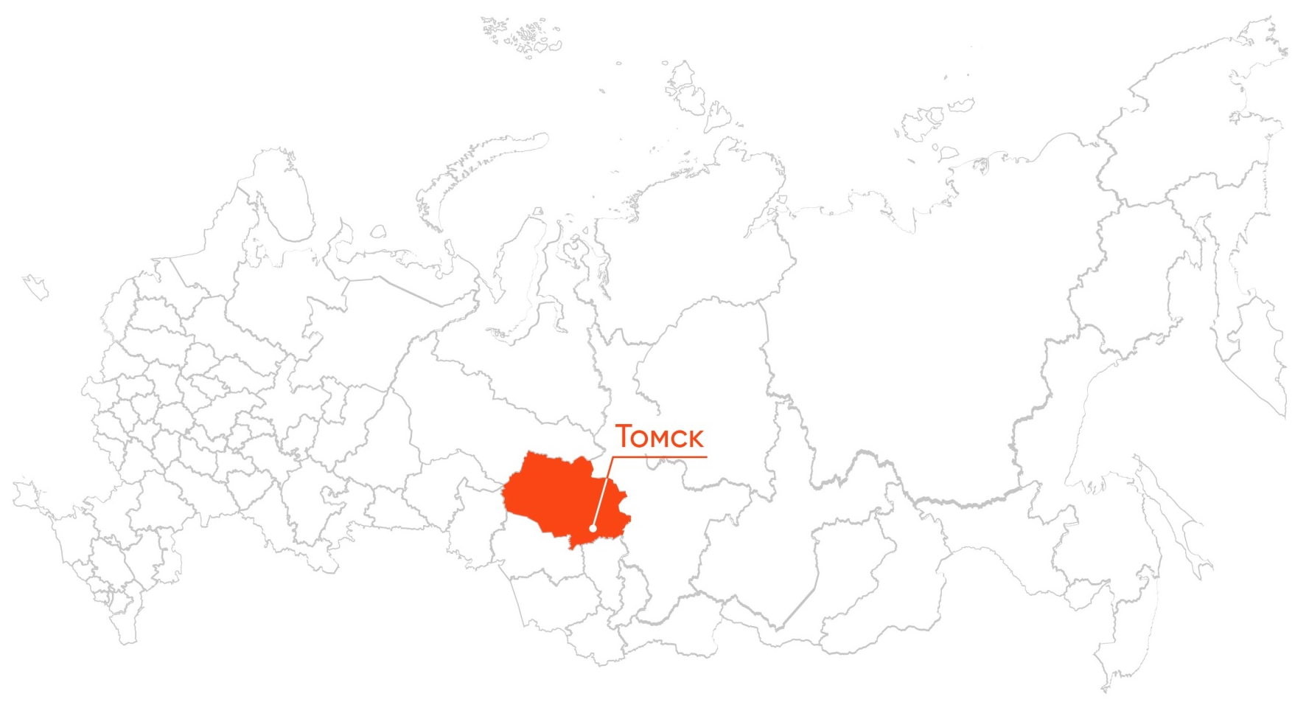
Tomsk
Tomsk
Founded in 1604
The population is 589 701 people (2021) Often called a students' town (6 universities and many scientific institutes)
2 / 22

Slide 3
MAIN DISCUSSION POINTS
REPORT
OVERVIEW
Pre-introduction
Methodology
Key steps
Diagnostic Test Accuracy
Benefits and drawbacks
3 / 22

Slide 4
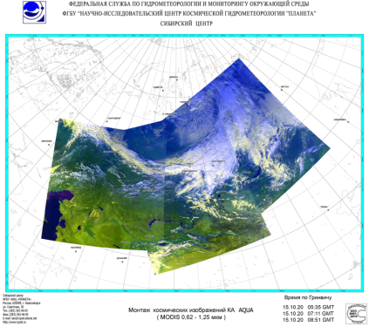
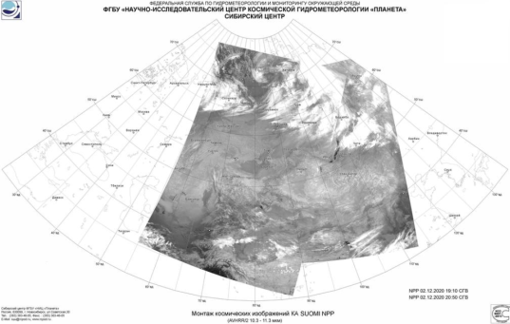
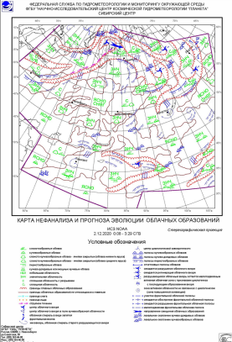
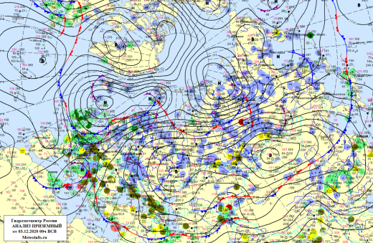
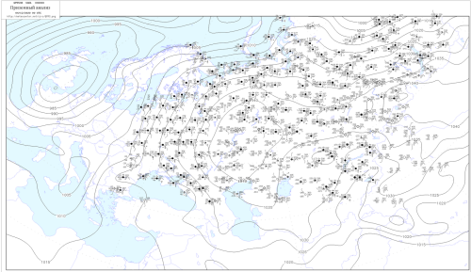
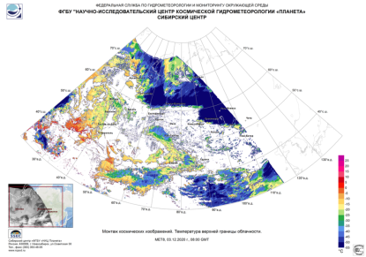
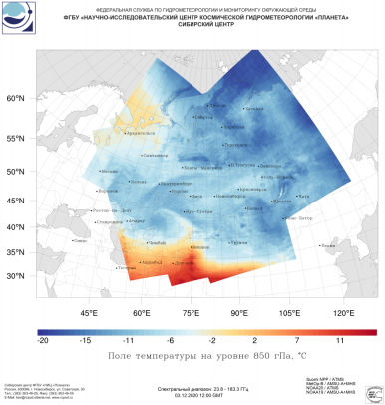
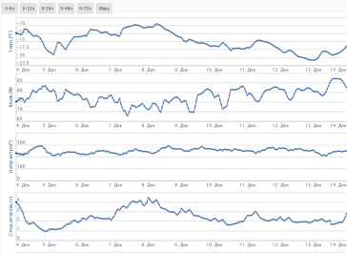
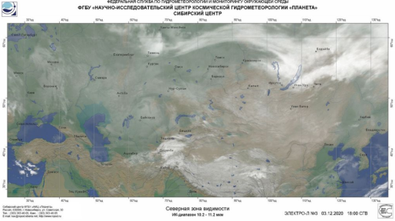
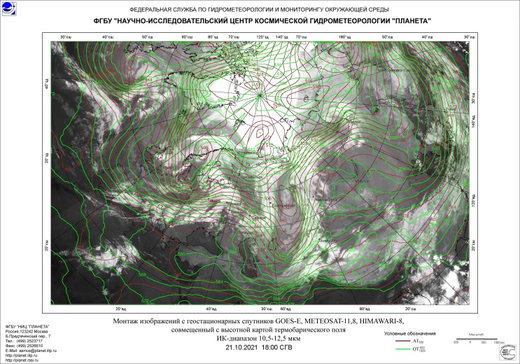
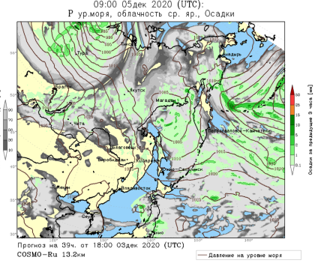
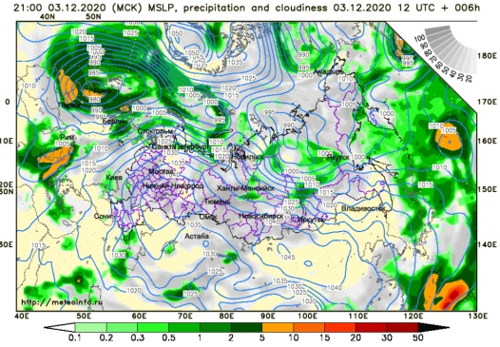
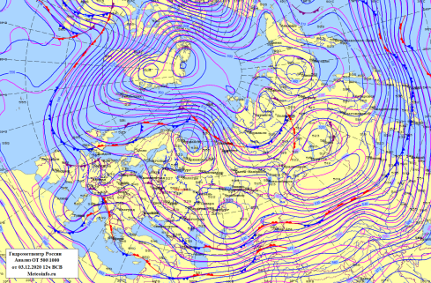
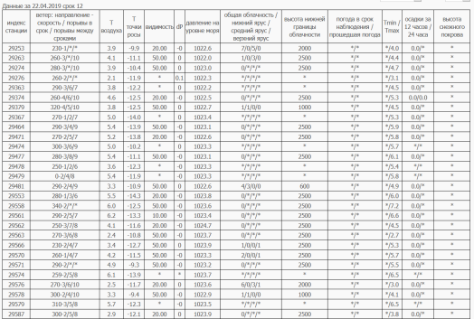
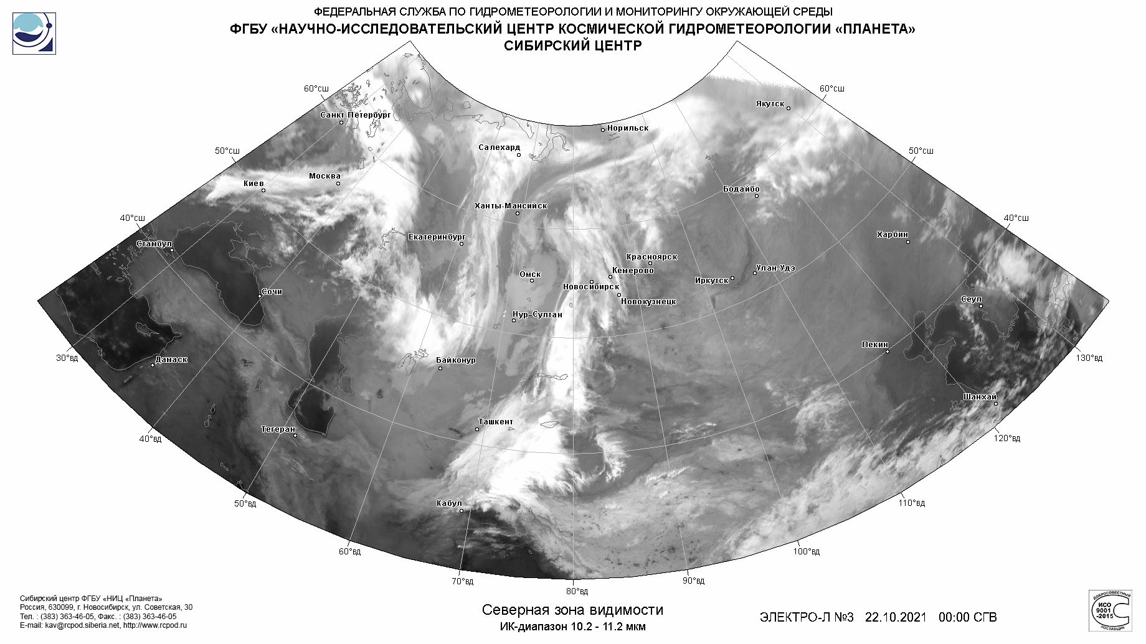
According to:
https://meteoinfo.ru/mapsynop
https://rcpod.ru/index.html
PRE-INTRODUCTION
4 / 22

Slide 5
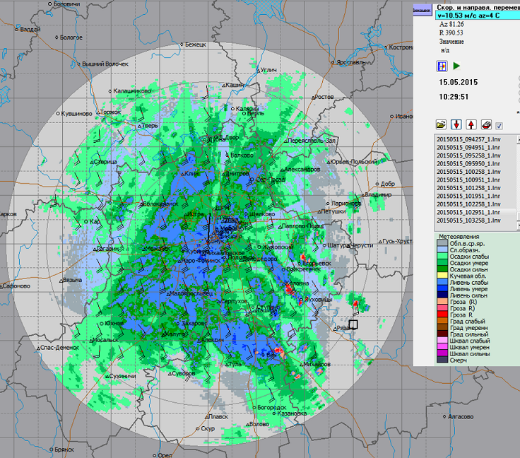
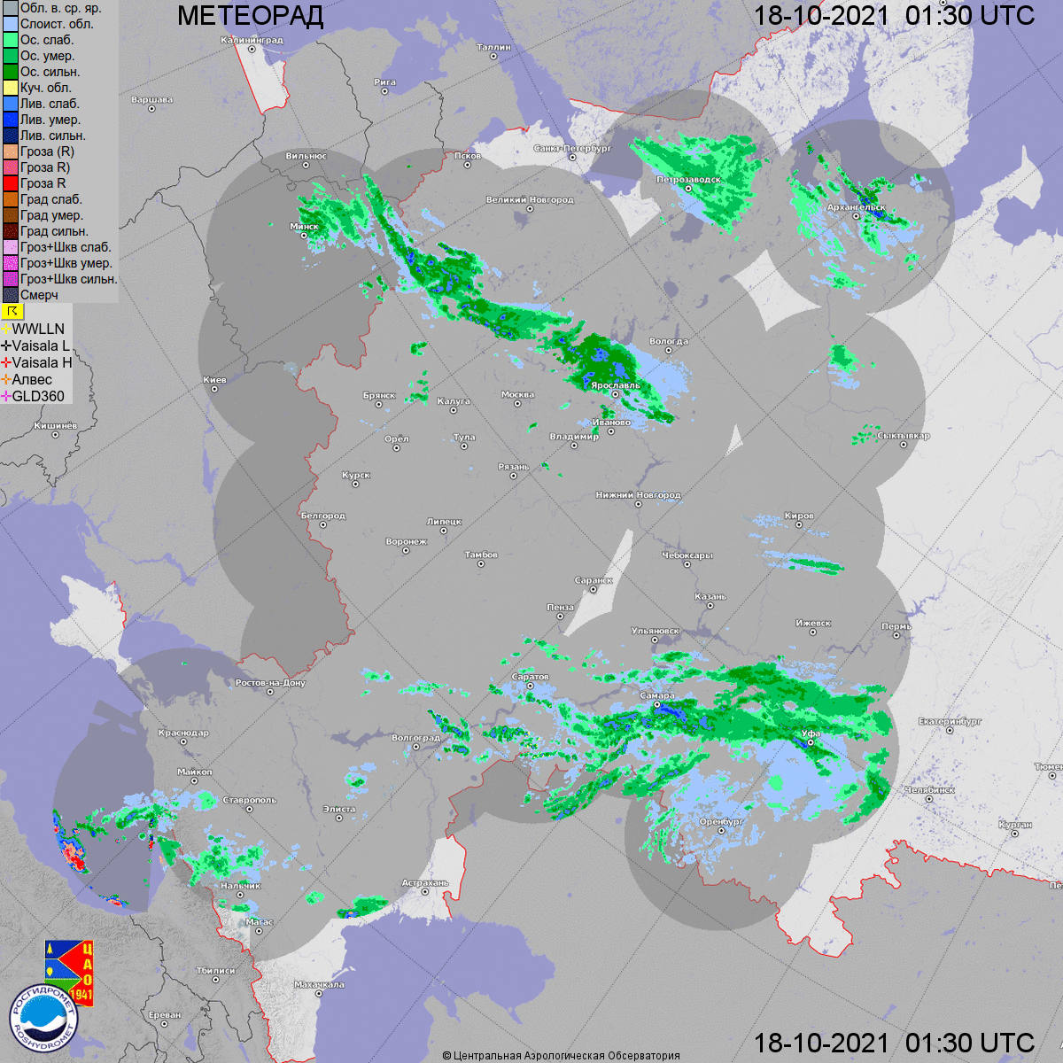
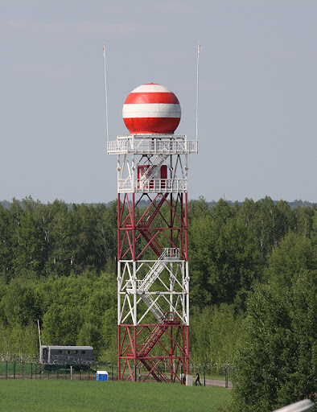
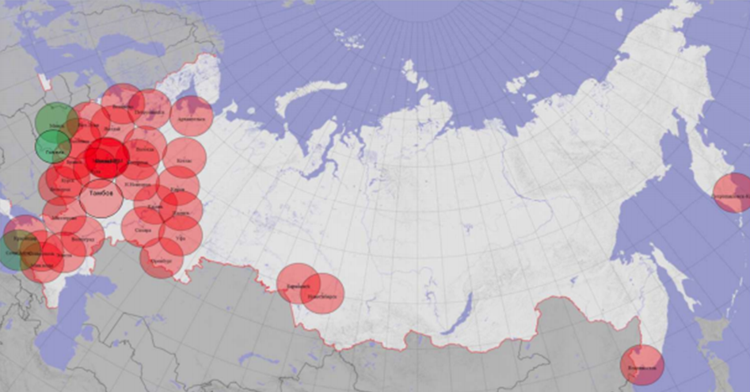
Photo credit:
https://meteoinfo.ru/novosti/11066-15052015-
Our territory
Photo credit:
http://meteorad.ru/static/method_letter_2019.pdf
Photo credit:
https://meteoinfo.ru/radanim
Photo credit:
http://www.almaz-antey.ru/osnovnaya-produktsiya-grazhdanskaya-naznacheniya/dmrl-s/
PRE-INTRODUCTION
5 / 22

Slide 6
Key steps
S1
Data acquisition from polar-orbiting spacecrafts
S2
Satellite-retrieved vertical profiles of meteorological parameters
S3
Correction of retrieved vertical profiles of temperature and specific moisture content
S4
Estimation of the potential and probable zones for weather event
S5
Outcome mapping
6 / 22

Slide 7
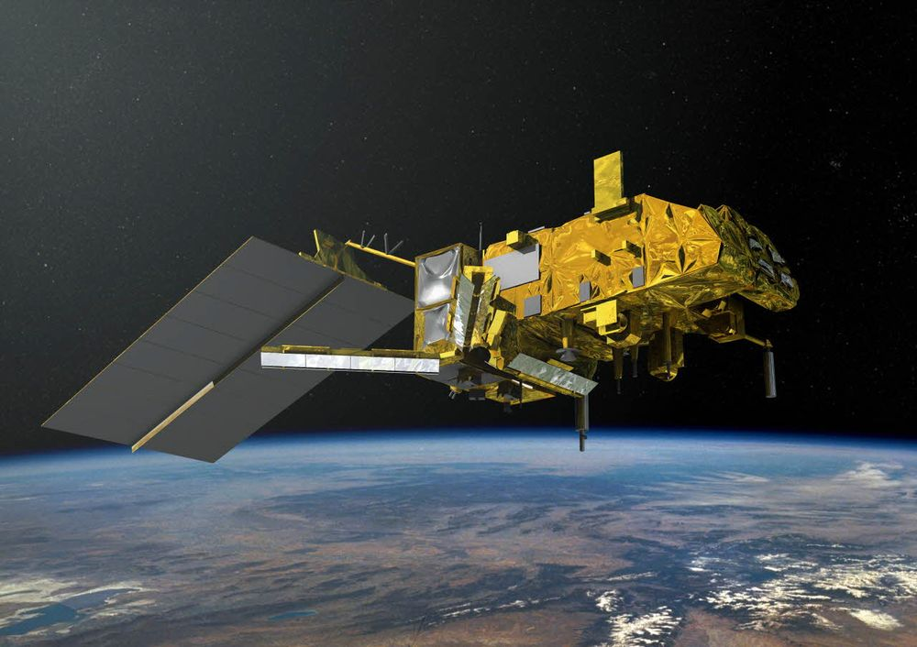
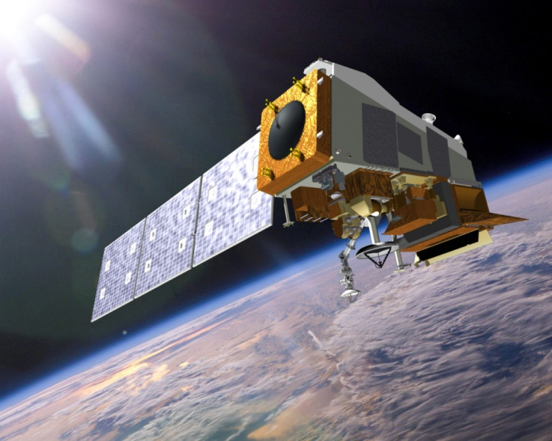
S1 Data acquisition from polar-orbiting spacecrafts
METOP-B
(AMSU / MHS)
Suomi-NPP (ATMS)
NOAA-18, NOAA-19
(AMSU / MHS)
About 16 to 18 images per day
https://www.rcpod.ru/
7 / 22

Slide 8
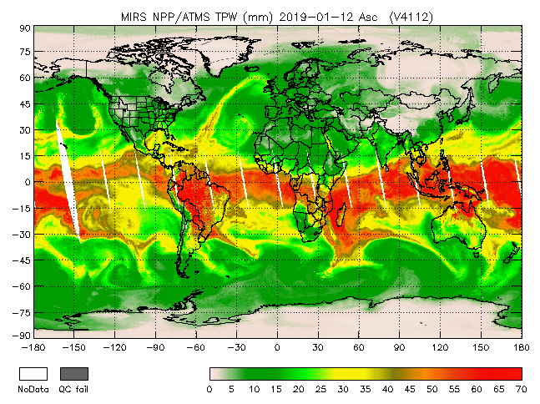
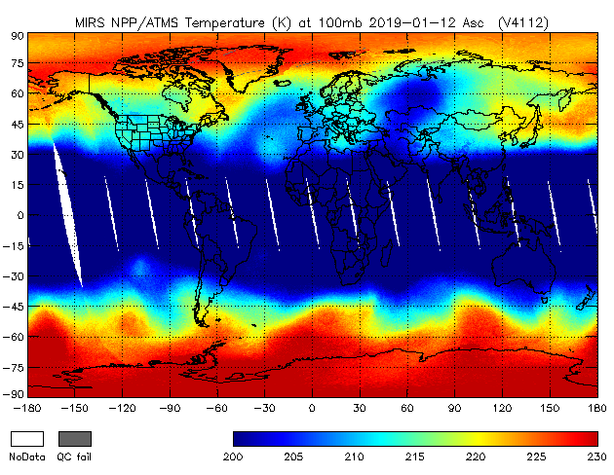
S2 Satellite-derived vertical profiles of meteorological parameters
The specialized software package MIRS, developed by the NOAA / NESDIS Satellite Applications and Research Center (STAR)*.
The system's calculation algorithms have passed several tests, and the developers carry out daily data quality assessments based on forecast model data.
* https://www.star.nesdis.noaa.gov/mirs/highresolutionv.php
8 / 22

Slide 9
S3 Correction of retrieved vertical profiles of temperature and specific moisture content
40
30
The author's correction algorithm relies on
12 trained feedforward neural networks
20
42 %
Temperature
Mandatory level, hPa | RMSE
 | Temperature, ˚С | Specific moisture content, g/kg
1000 | 2.07 | 1.03
900 | 1.89 | 0.95
850 | 1.71 | 0.93
700 | 1.16 | 0.75
500 | 1.06 | 0.27
300 | 1.42 | 0.03
10
38 %
Specific moisture content
0
Item 1
Item 2
Item 3
Item 4
Item 5
9 / 22
WMO’s remote sensing data requirements

Slide 10
S4 Estimation of the potential and probable zones for weather event
Calculations are performed using machine learning and neural network technology
Input:
temperature and specific moisture content vertical profiles (corrected);
vertical profiles of dew point temperature, relative humidity, and dew point depression (calculated);
VT, CT, TT and K-index values;
cloud base height (CBH) of convective cloudiness.
10 / 22

Slide 11
S4 Estimation of the potential and probable zones for weather event
Each pixel:
Thunderstorm
Calculations are performed using machine learning and neural network technology
Rain
Drizzle
Rain shower
light / moderate / severe
Input:
temperature and specific moisture content vertical profiles (corrected);
vertical profiles of dew point temperature, relative humidity, and dew point depression (calculated);
VT, CT, TT and K-index values;
cloud base height (CBH) of convective cloudiness.
Snow grains
Snow
Sleet
Snow shower
Wet snow shower
Snow pellets
Ice pellets
No phenomena
10 / 22

Slide 12
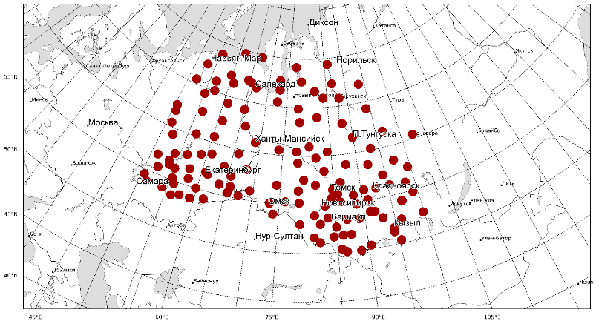
Model training on reference data
S4 Estimation of the potential and probable zones for weather event
Moscow
OUTERWEAR
Novosibirsk
May – October 1990 – 2018
135 stations
Reference data:
open database on atmospheric phenomena, RIHMI-WDC
11 / 22

Slide 13
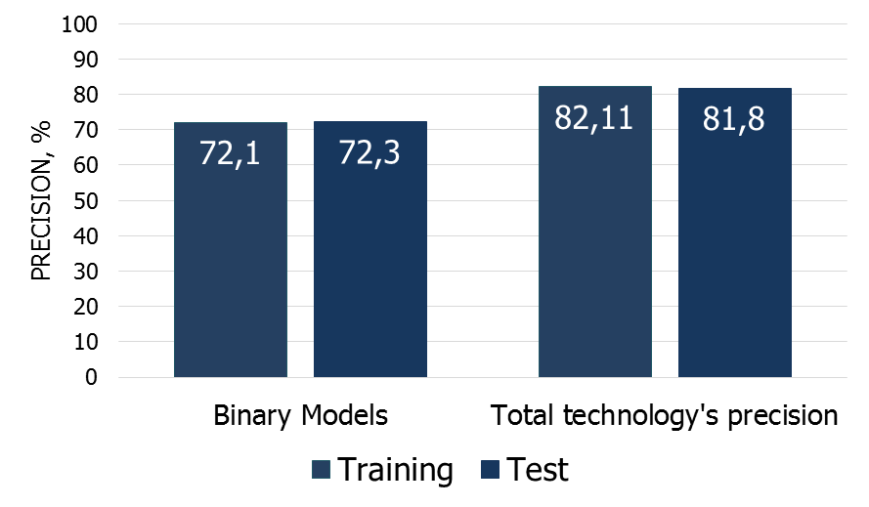
S4 Estimation of the potential and probable zones for weather event
Model training on reference data
ERA5
Ground based weather network
Testing stages:
Sampling normalization;
Validation of each binary classification model;
Converting the outputs of the previous procedures into additional predictors;
Validation of a multiclassification multilayer forward propagation neural network.
Spacio-temporal comparison
(1 325 245 cases)
Test
Training
30%
397 573 cases
70%
927 672 cases
Training stages:
Sampling normalization;
Binary classification models for each phenomenon (XGBoost);
Conversion of outputs from previous procedures into additional predictors;
Multiclassification multilayer neural network of direct propagation;
Saving parameters of each model
12 / 22

Slide 14
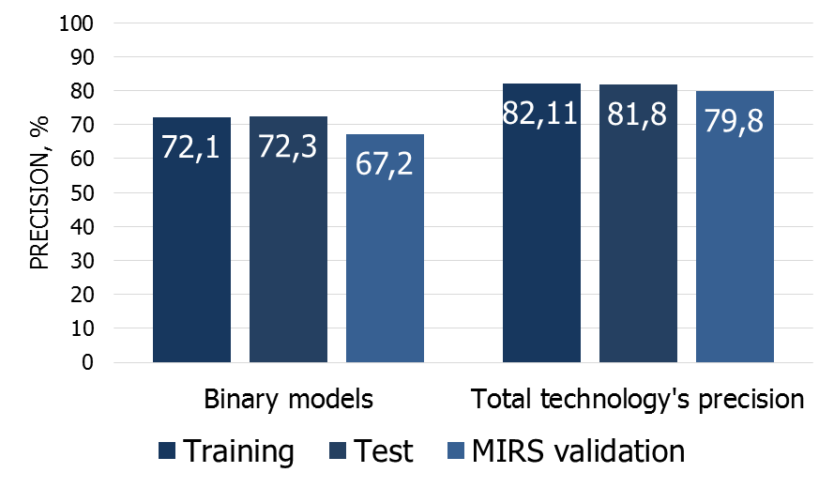
S4 Estimation of the potential and probable zones for weather event
Model training on reference data
The MIRS
Ground based weather network
Spacio-temporal comparison
(141 990 cases)
Testing stages:
Sampling normalization;
Validation of each binary classification model;
Converting the outputs of the previous procedures into additional predictors;
Validation of a multiclassification multilayer forward propagation neural network.
13 / 22

Slide 15
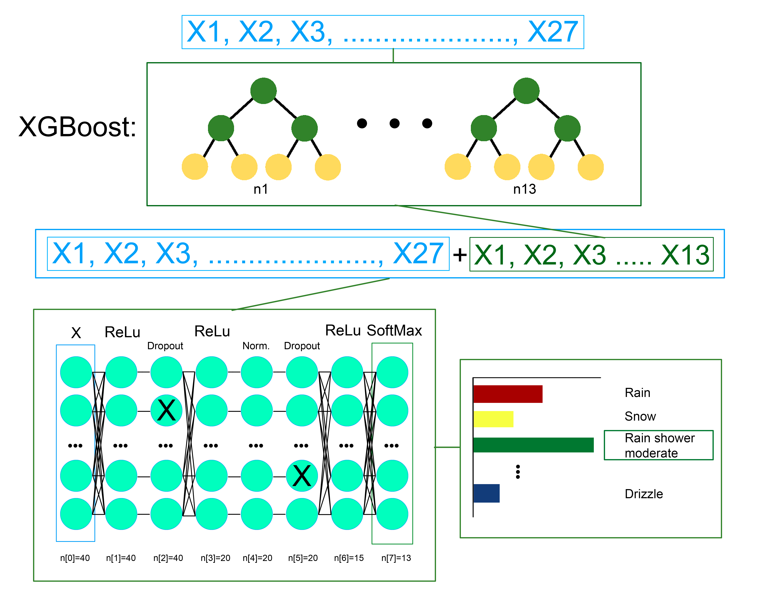
Model training on reference data
S4 Estimation of the potential and probable zones for weather event
OUTERWEAR
May – October 1990 – 2018
135 stations
Reference data:
open database on atmospheric phenomena, RIHMI-WDC
14 / 22

Slide 16
S5 Outcome mapping
100
90
80
Moderate shower rain
Weak shower rain
70
60
Novosibirsk
Novosibirsk
50
%
Probable atmospheric phenomena
for 29.07.2019
Zones of probable thunderstorm development
for 29.07.2019
15 / 22

Slide 17
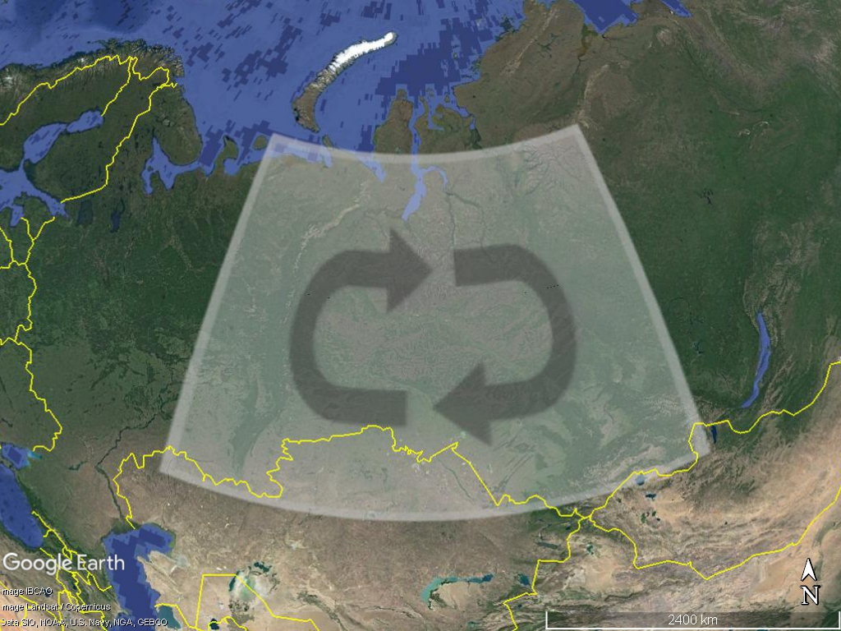
Diagnostic Test Accuracy
Thunderstorms + weather event
May – October 2019 – 2020
135 stations
Reference data:
open database on atmospheric phenomena, RIHMI-WDC
database of weather reports (WAREP) with coded events
50 – 70N and 50 – 100E
No more 5 km away from the weather station
No more ± 5 (10) min
Novosibirsk
16 / 22

Slide 18
Contingency table Confusion matrix
VERIFICATION OF
CATEGORICAL THUNDERSTORM
FORECAST FOR SIBERIA
Event forecast | Thunderstorm observed |  | Marginal total | Precision (P)
 | Yes | No
Yes | 821 | 156 | 977 | 84
No | 146 | 810 | 956 | 85
Marginal total | 967 | 966 | 1933
Recall (R) | 85 | 84 |  | 169
Heidke Skill Score (HSS) 0,68
Peirce's Skill Score (PSS) 0,69
17 / 22

Slide 19
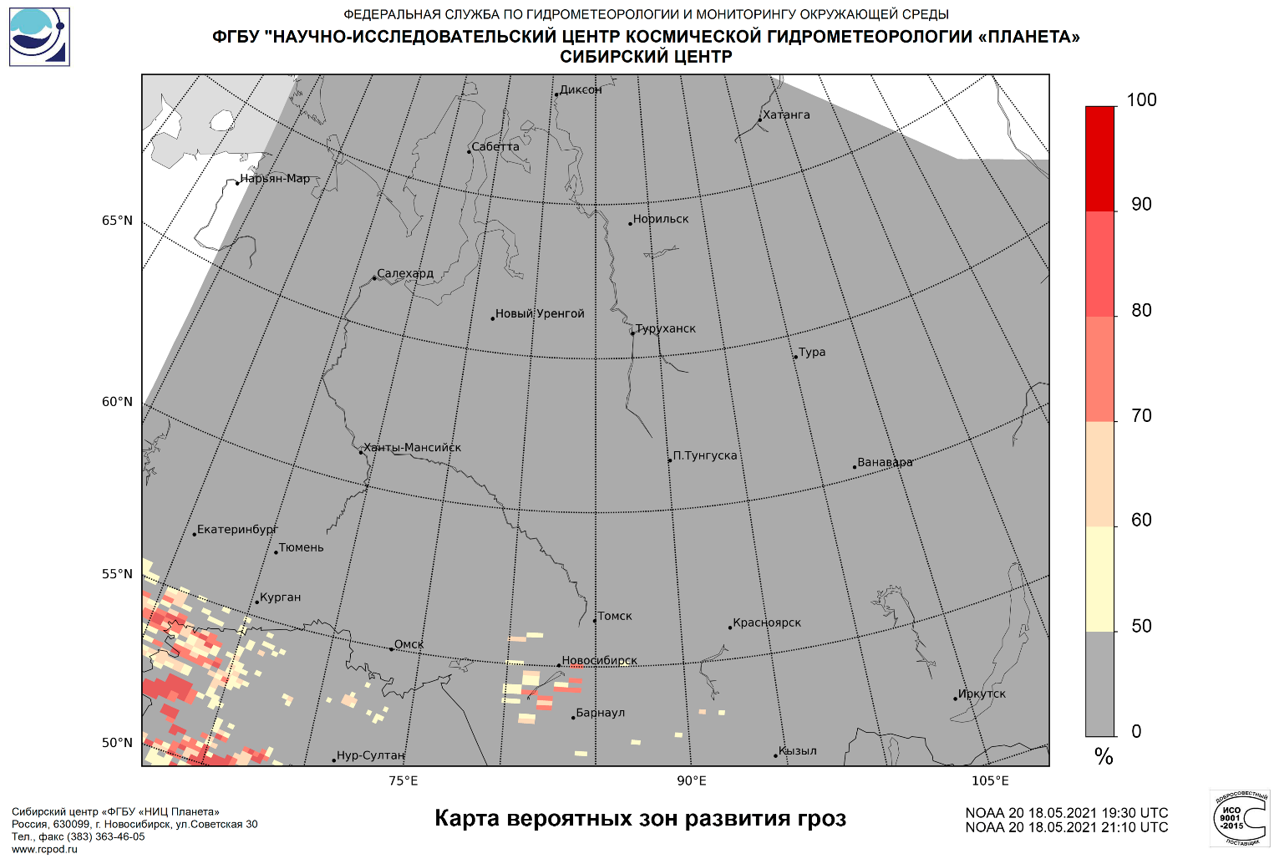
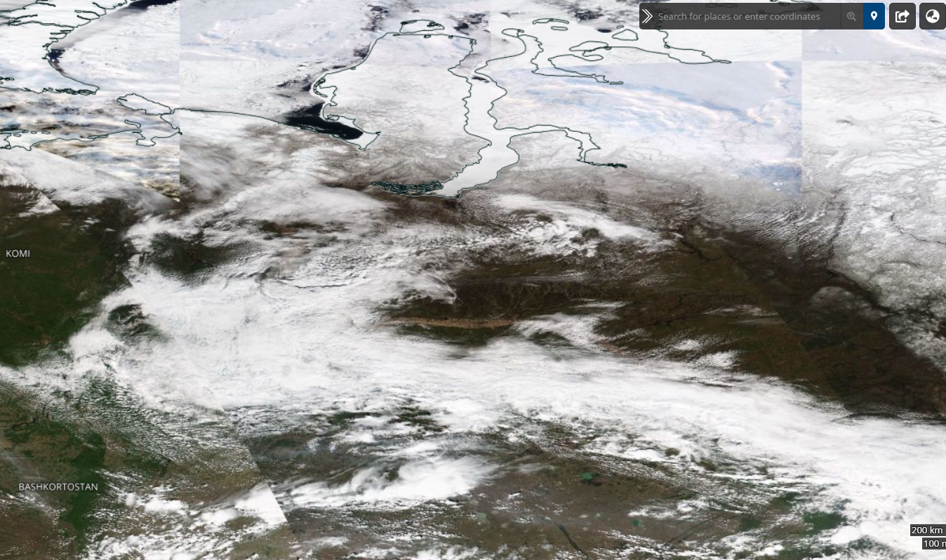
Novosibirsk
18 UTC
Novosibirsk
19-21 UTC
Case study
18.05.2021
Thunderstorms, hailfall in the vicinity of Novosibirsk 55°03′N 82°57′E
Photo credit:
https://worldview.earthdata.nasa.gov/
18 / 22

Slide 20
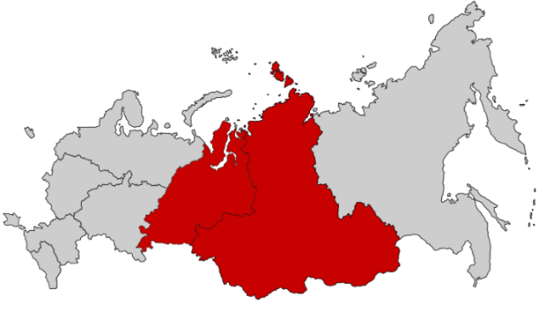
Benefits and drawbacks
“Working area” of the methodology
A unique approach to atmospheric phenomena detection by analyzing the vertical distribution of meteorological parameters in the atmospheric column using machine learning technology
Adaptability of the technology for determining the probable zones of atmospheric phenomena for the territory of Siberia. Consideration of complex interrelations in the distribution of meteorological values, spatial and intra-annual dependencies of phenomena recurrence
High reliability of the results of technology calculations, confirmed by the author's tests. Selection of thunderstorm zones, atmospheric precipitation with different intensity and phase state
Analysis of atmospheric events over areas with a sparse weather network
19 / 22

Slide 21
WORDS TO REFLECT ON
No one has a sorrier lot than
the weatherman. He is ignored when he is right, but execrated when he is wrong.
Epigraph in Isaac Asimov’s Book of Science and Nature Quotations (1988)
20 / 22

Slide 22
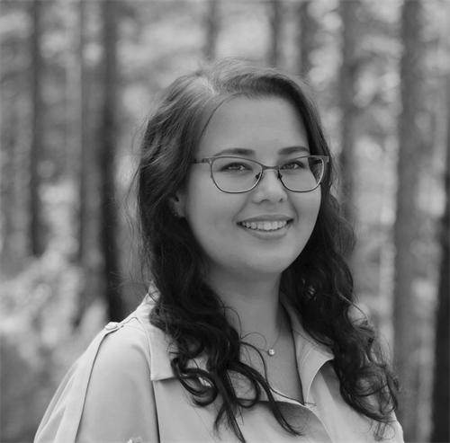
MEET THE ATHORS
OLGA NECHEPURENKO
IRINA
KUZHEVSKAIA
MARINA VOLKOVA
VLADISLAV CHURSIN
PhD in Physics and Mathematics
Associate professor, TSU
PhD in Geography
Associate professor, TSU
PhD in Geography
Associate professor, TSU
Junior researcher,
The Siberian state research center “Planeta”
PhD student, TSU
21 / 22

Slide 23
CONTACT
INFORMATION
49 A. Ivanova St., Tomsk, Russia, 634028
o.e.nechepurenko@gmail.com
+7 (906) 928 1659
SPASIBO!*
*thank you!
22 / 22

