Slide 1

Satellite data utilization in NWP
SATO, Yoshiaki
Numerical Prediction Development Center
Japan Meteorological Agency
AOMSUC-11
1-4 Nov. 2021

Slide 2
Introduction
Numerical Weather Prediction (NWP) is a foundational capability for nearly all weather and climate applications.
Global NWP depends on global coverage of observations.
  The reliability of the Global NWP highly depends on the accuracy of the initial condition analysis and the accuracy highly depends on the ingested observing data.
  While surface-based observations are still important since they can provide information on atmospheric state directly, it is hard to cover the whole globe
  Space-based remote observations are very important for complementing surface-based observations to cover the whole globe homogeneously.
This presentation overviews the status on satellite data utilization on NWP

Slide 3
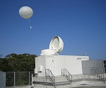
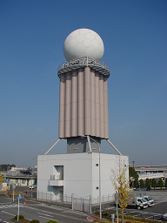
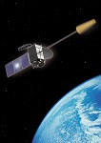
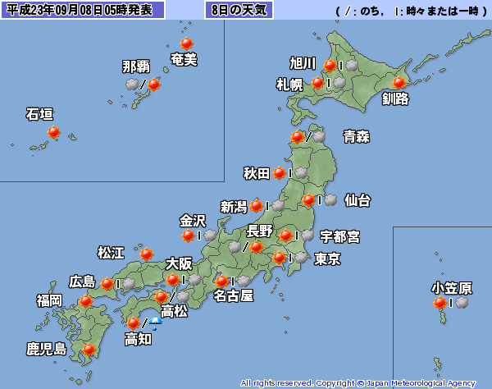
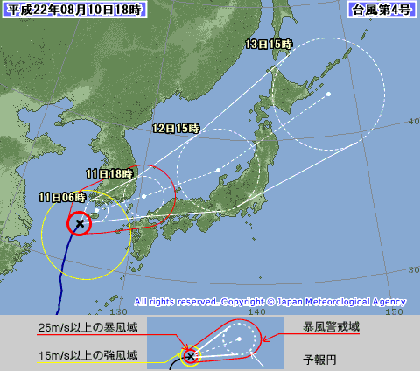
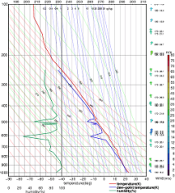
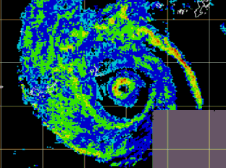
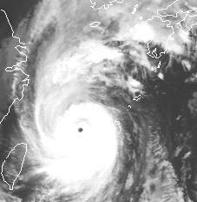

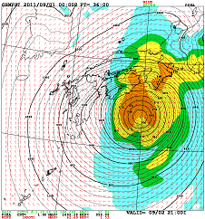
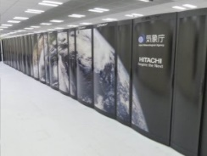
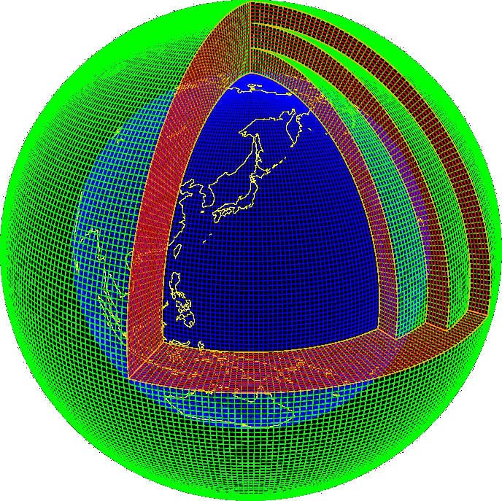
Role of NWP
Various Observing System
Weather
Watch
Forecast
Warning
input
General Public
NWP
Info
Making Official
Forecast
Basis of
Forecast
TV/Radio Broadcast
Internet
Weather Company
Relating Organs

Slide 4
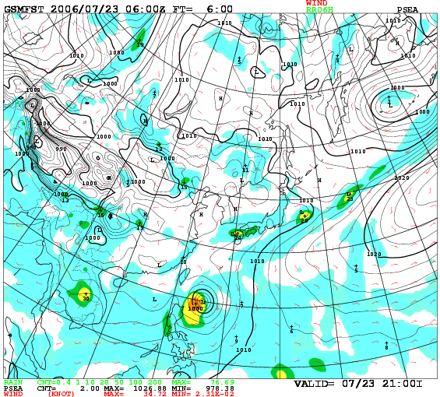
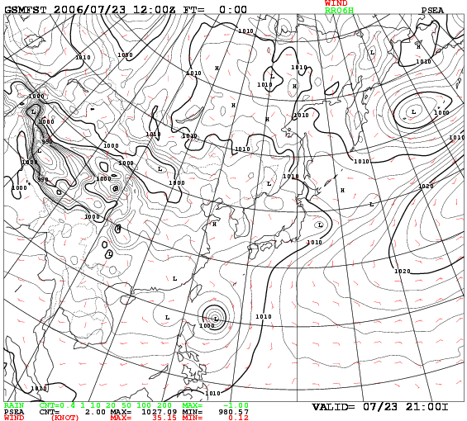
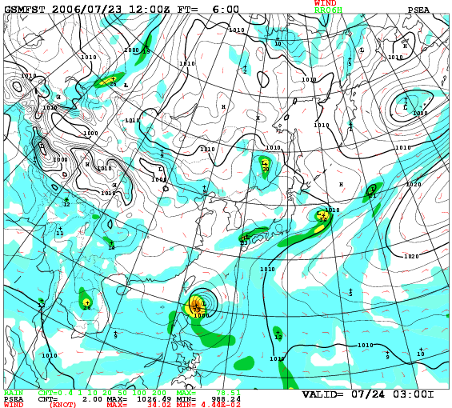
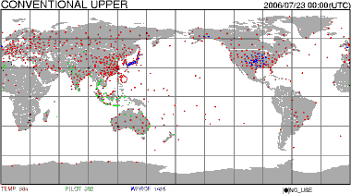
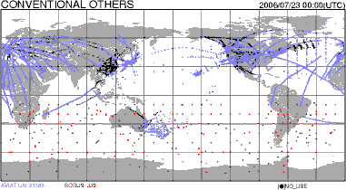
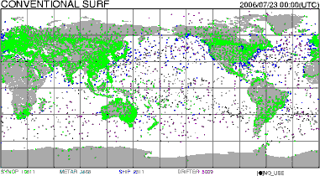
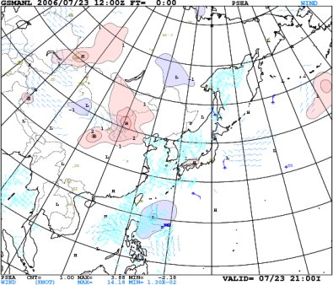
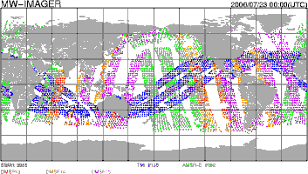
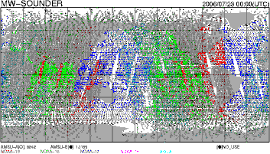
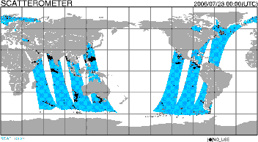
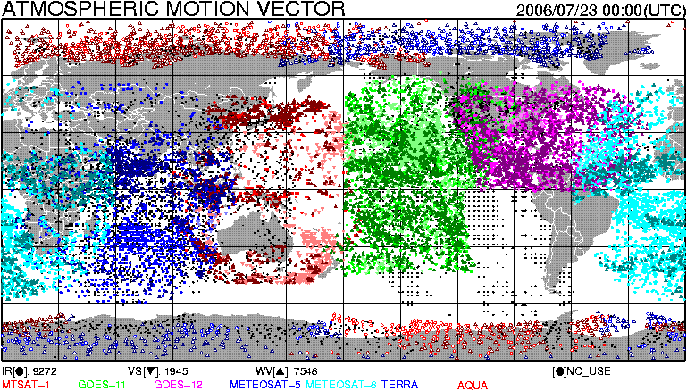
Data Assimilation
The First Guess
Forecast from the last IC
Data Assimilation
NWP model
Analysis = IC(Initial Condition)
Forecast from the latest IC
Data assimilation:
Correcting latest NWP data using various types of the latest observing data to produce the better analysis of the current atmospheric state and it will be used as the initial conditions of the next forecast.
Innovation
Various Obs.

Slide 5
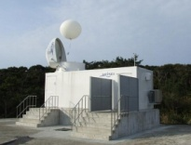
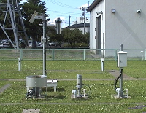
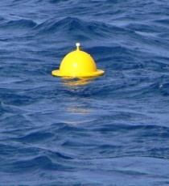
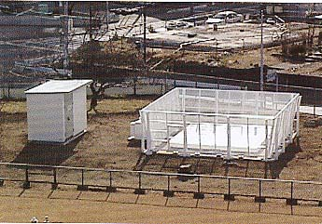
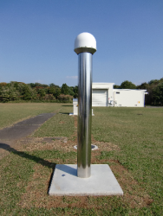
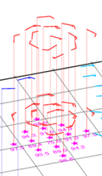

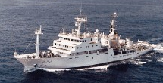
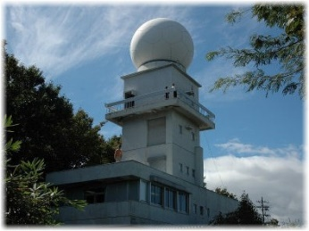
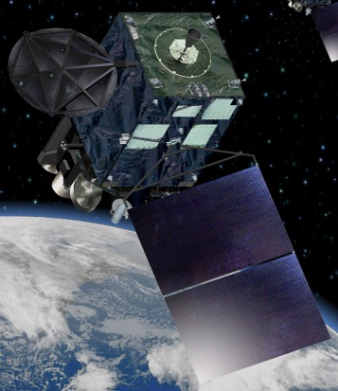
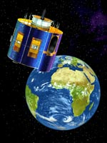
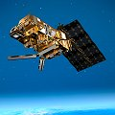
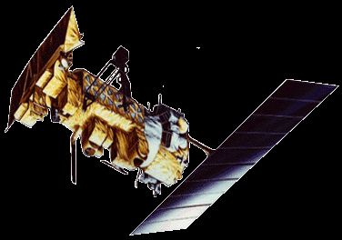
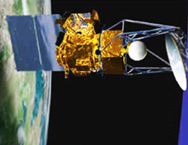
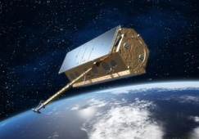
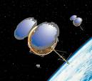
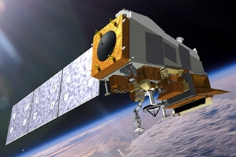
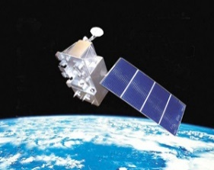


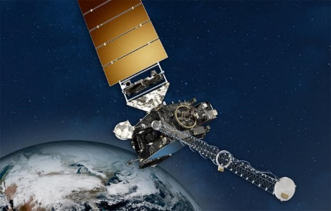
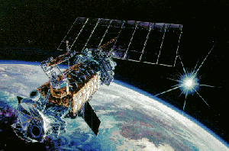
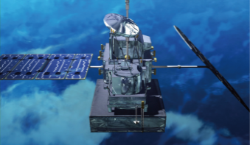
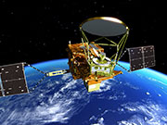
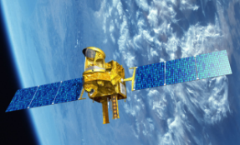
Observing data assimilated in JMA NWP
Buoy
Upper Air Observation
Surface Observation
Wind Profiler
GNSS Receiver
(Dual Polarized)
Doppler Radar
Typhoon Bogus
Ship based Observation
Aircraft based Observation
In situ obs.
Surface based remote sensing
Pseudo obs.
Operational Satellite
Earth Observing
Satellite
GNSS RO Satellite
TerraSAR-X
TanDEM-X
image: ©EADS
Astrium.
NOAA
(image: © NOAA)
Metop
(image: © ESA)
Coriolis
（image: ©NRL ）
COSMIC
(image: ©UCAR
ひまわり（画像：気象庁HP）
METEOSAT
(image: © ESA)
Aqua
（image: ©NASA ）
Terra
（image: ©NASA ）
Suomi-NPP
(image: © NOAA)
FY-3(image:©CMA)
GCOM-W1
（image: ©JAXA ）
Megha-Tropiques
（image: ©CNES）
GPM-core
（image: ©JAXA ）
GEO
DMSP（image: ©NASA ）
5
GOES(image: © NOAA)
LEO

Slide 6
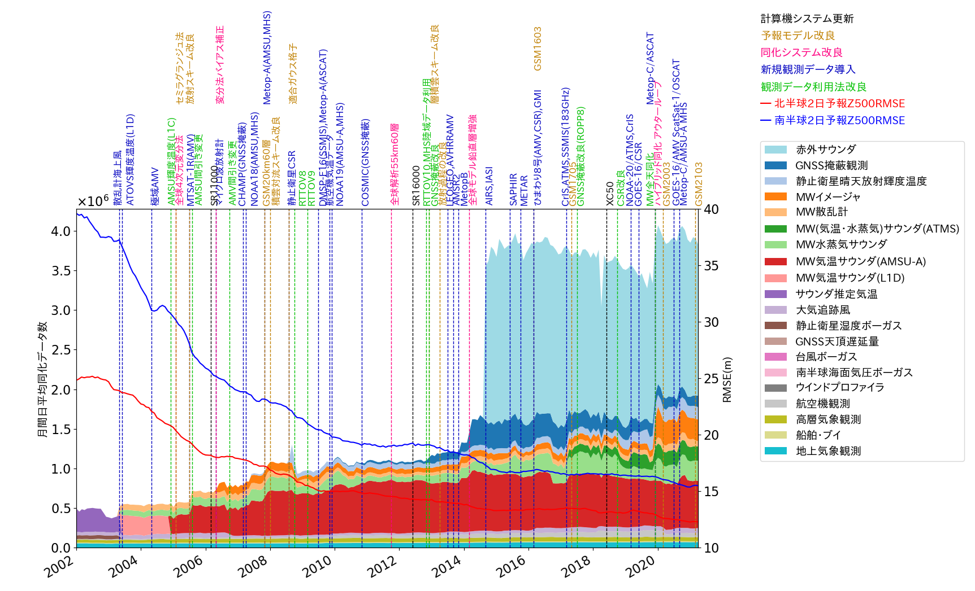
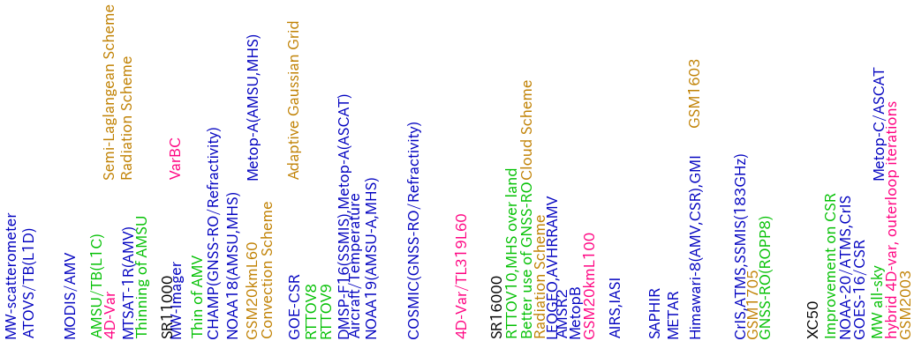
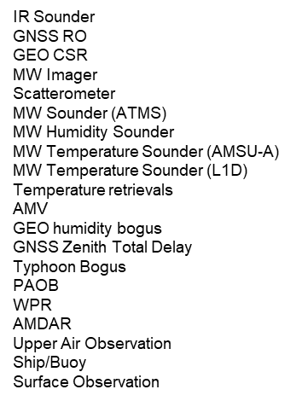
History of the assimilated data amount on JMA GSM and Day 2 forecast RMSE on Z500
HPC system Upgrades
Improvements on NWP models
Improvements on DA systems
Newly introduced obs.
Improvements on obs. usage
Z500 RMSE over N. Hem.
Z500 RMSE over S. Hem.
Space-based Obs.
Non radiance data

Slide 7
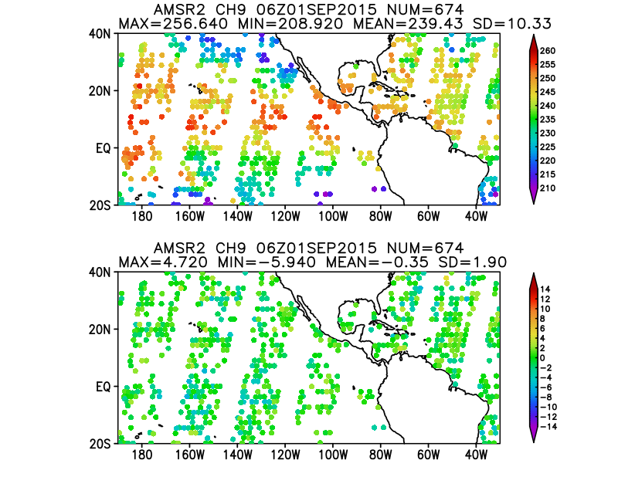
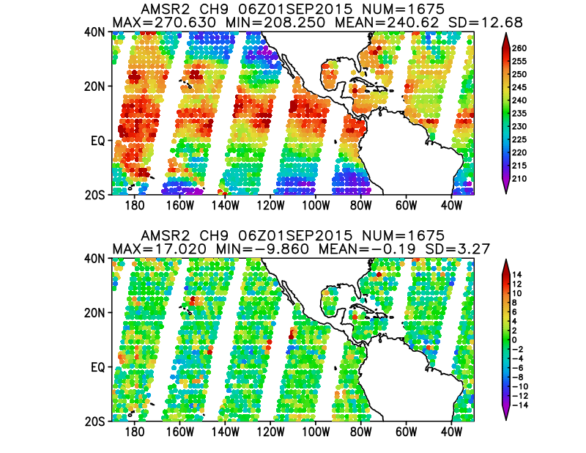
All sky radiance assimilation
Although computing cloud and precipitation droplets effect is very difficult, the advanced NWP center had started using the radiance data not only over the clear but cloudy and rainy regions. JMA is also using some of the sensors in all sky mode.
Clear Sky Radiance Assimilation
All Sky Radiance Assimilation
Observed radiance
Observed radiance
O-B (Difference of Obseved and Computed radiance)
O-B (Difference of Obseved and Computed radiance)

Slide 8
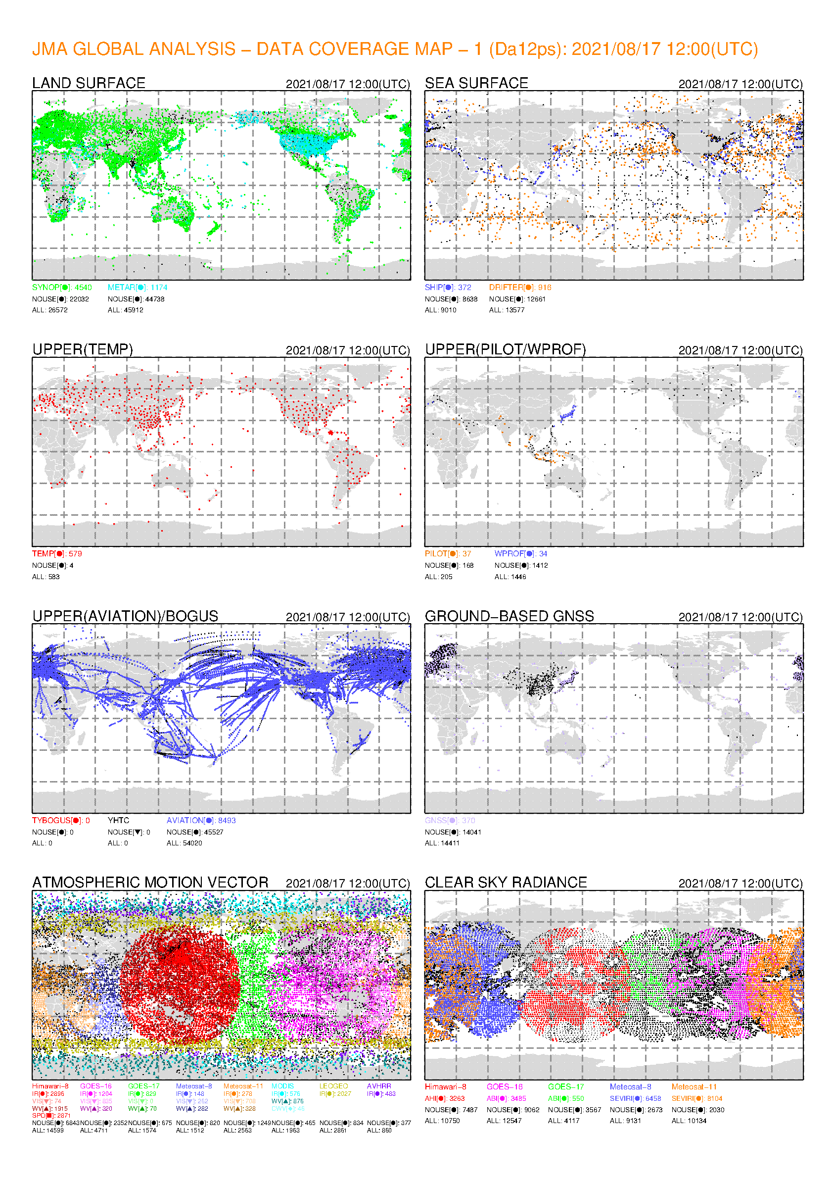

A sample of current assimilated data distribution
Land Surface Obs.
Ocean surface Obs.
MW Sounder
MW Imager
Upper Air Obs.
Upper Air Wind Obs.
MW Temp. Sounder
MW Humid. Sounder
Aircraft-based Obs.
Ground-based GNSS Obs.
IR Sounder
Scatterometer
AMV
GEO CSR
GNSS RO
Color dots show the assimilated obs. on JMA Global DA system
Red frames show satellite (space based) obs.

Slide 9


DBNet
[Exchanged Data]
MW Sounder：AMSU-A, MHS, ATMS, MWHS, MWTS
IR Sounder：IASI, CrIS
Direct Broadcast Network
  DBNet is a framework to exchange direct receiving satellite data via landline. With this framework, the NWP centers can acquire the satellite data earlier than the global data dissemination by the satellite operator
  The same data quality and format by using the same software
  The framework is extending to the newer sensors

Slide 10
Summary of Operationally Assimilated Satellite Data in JMA
Oct. 2021
Type | Satellite/Instrument | Global Analysis | Meso Analysis | Local Analysis
1. MW Sounder | NOAA15,18,19,Metop-A,-B,-C,(Aqua)/AMSU-A | Radiance | Radiance | Radiance (no Metop-C)
 | NOAA19,Metop-A,-B,-C/MHS | Radiance (all-sky) | Radiance | Radiance (no Metop-C)
 | DMSP-F17,18/SSMIS | Radiance (all-sky) | - | -
 | Suomi-NPP, NOAA20/ATMS | Radiance (all-sky) | - | -
 | Megha-Tropiques/SAPHIR | Radiance (all-sky) | - | -
 | FY-3C/MWHS-2 | Radiance (all-sky)
2. IR Sounder | (Aqua/AIRS) | Radiance | - | -
 | Metop-(A),B/IASI | Radiance | - | -
 | Suomi-NPP, NOAA20/CrIS | Radiance | - | -
3. MW Imager | DMSP-F17,18/SSMIS | Radiance (all-sky) | Radiance, Rain Rate | Radiance
 | GCOM-W/AMSR2 | Radiance (all-sky) | Radiance, Rain Rate | Radiance
 | GPM-core/GMI | Radiance (all-sky) | Radiance, Rain Rate | Radiance
 | (FY-3C/MWRI) | Radiance (all-sky) | - | -
 | (Coriolis/WindSat) | Radiance (all-sky) | - | -
4. VIS/IR Imager | Himawari-8 | CSR, AMV | CSR, AMV | CSR, AMV
 | GOES-16,17 | CSR, AMV | N/A | N/A
 | Meteosat-8,11 | CSR, AMV | N/A | N/A
 | NOAA15,18,19,Metop-A,-B/AVHRR | AMV | N/A | N/A
 | Aqua,Terra/MODIS | AMV | N/A | N/A
 | LEOGEO composite image | AMV | N/A | N/A
5. Scatterometer | Metop-A,-B,-C/ASCAT | OSWV | OSWV(Metop-A, -B only) | -
6. Radio Occultation | Metop-A,-B/GRAS | Bending Angle | Refractivity | -
 | TerraSAR-X/IGOR | Bending Angle | Refractivity | -
 | TanDEM-X/IGOR | - | Refractivity | -
 | COSMIC/IGOR | Bending Angle | Refractivity | -
7. Radar | GPM/DPR | - | Relative Humidity | -
8. Soil Moisture | GCOM-W/AMSR2 | - | - | Soil Moisture
 | Metop-A,-B/ASCAT | - | - | Soil Moisture
CSR: Clear Sky Radiance on water vapor channels, AMV: Atmospheric Motion Vector, OSWV: Ocean Surface Wind Vectors

Slide 11
The other space-based data
There are some space-based data not used in JMA NWP Systems
  Cloud radar: CPR/Cloudsat
  Lidar: CALIOP/CALIPSO
  Doppler Wind Lidar: ADM Aeolus
While the data are not used in JMA data assimilation, they provide the valuable information for NWP evaluation.
Some advanced NWP centers such as ECMWF already started using the Doppler Wind Lidar data (as wind velocity along beam) and reported that the data have large positive impact on NWP performance.
  JMA is also assessing the impact.

Slide 12
Future Vision

Slide 13
Future Vision
WMO published “Vision for the WMO Integrated Global Observing System (WIGOS) in 2040” in 2019, which replace “Vision for the Global Observing System (GOS) in 2025” published in 2009.
  The vision provides target to guide the evolution of the WMO WIGOS.
  The vision is composed by “space-based observing system components” and “surface-based observing system components”
  The “space-based observing system components” are divided into the four categories.
    Subcomponent 1: Backbone system with specified orbital configuration and measurement approaches
    Subcomponent 2: Backbone system with open orbit configuration and flexibility to optimize implementation
    Subcomponent 3: Operational pathfinders and technology and science demonstrators
    Subcomponent 4: Additional capabilities

Slide 14
Subcomponent 1 (#1/2)
Geostationary core constellation satellite
  Multi-spectral VIS/IR imagery with rapid repeat cycles.
  IR hyperspectral sounders
  Lightning mappers
  UV/VIS/NIR sounders
Sun-synchronous core constellation satellite
  IR hyperspectral sounders
  MW sounders
  VIS/IR imagery, realization of a day/night band
  MW imagery
  Scatterometers

Slide 15


Current activity
For NWP, one of the most important instruments in the coming years must be GEO IR hyperspectral sounders
  Still LEO IR hyperspectral sounders are the very important instruments currently, the rapid refresh sounding data are very promising.
  With collaborating satellite operators, some NWP centers conducted observing system experiment (OSE) and observing system simulation experiment (OSSE) to assess the impact for promoting the project.

Slide 16
Subcomponent 1 (#1/2)
Geostationary core constellation satellite
  Multi-spectral VIS/IR imagery with rapid repeat cycles.
  IR hyperspectral sounders
  Lightning mappers
  UV/VIS/NIR sounders
Sun-synchronous core constellation satellite
  IR hyperspectral sounders
  MW sounders
  VIS/IR imagery, realization of a day/night band
  MW imagery
  Scatterometers

Slide 17
Subcomponent 1 (#2/2)
Additional sun-synchronous satellite
  Wide-swath radar altimeters and high-altitude, inclined, high-precision orbit altimeters
  IR dual angle view imagers,
  MW imagery for surface temperature
  Low-frequency MW imagery
  MW cross-track upper stratospheric and mesospheric sounders
  UV/VIS/NIR sounders, nadir and limb
  Precipitation radars and cloud radars
  MW sounder and imagery in inclined orbits
  Absolutely calibrated boroadband radiometers and total solar irradiance and solar spectral irradiance radiometers
  Global Navigation Satellite System (GNSS) radio occultation (basic constellation)
  Narrow-band or hyperspectral imagers
  High-resolution multi-spectral VIS/IR imagers
  SAR imagers and altimeters
  Gravimetry missions
Other missions
  [Skipped]

Slide 18
Summary
Satellite data are very important for initial condition analysis (data assimilation) process (and validation process) in NWP, since it covers wide area and many variables.
  For the data assimilation, it is important to use as many kinds of observing data as possible.
  To use the data on realtime operation, it is important to acquire the data in short latency.
  The more mutual data exchange is important.
I introduced a summary of current satellite data usage in JMA. And additional information relating to the WMO vision was provided.
  For the future sensors, some NWP centers are assessing the impact with collaborating the satellite operators for realizing them.

