Slide 1
“Satellite Meteorology Training in WMO RAV during 2020/21; the Australian VLab Centre of Excellence experience”
Presenter: Bodo Zeschke. Bureau of Meteorology Training Centre,
Australian VLab Centre of Excellence Point of Contact

Slide 2
Contents
Introducing the Australian VLab Centre of Excellence
Attendance at our Regional Focus Group meetings
Regional achievements in satellite meteorology training
Highlights of our monthly Regional Focus Group meetings
Topics covered
Our presenters
Recordings of the Regional Focus Group meetings

Slide 3
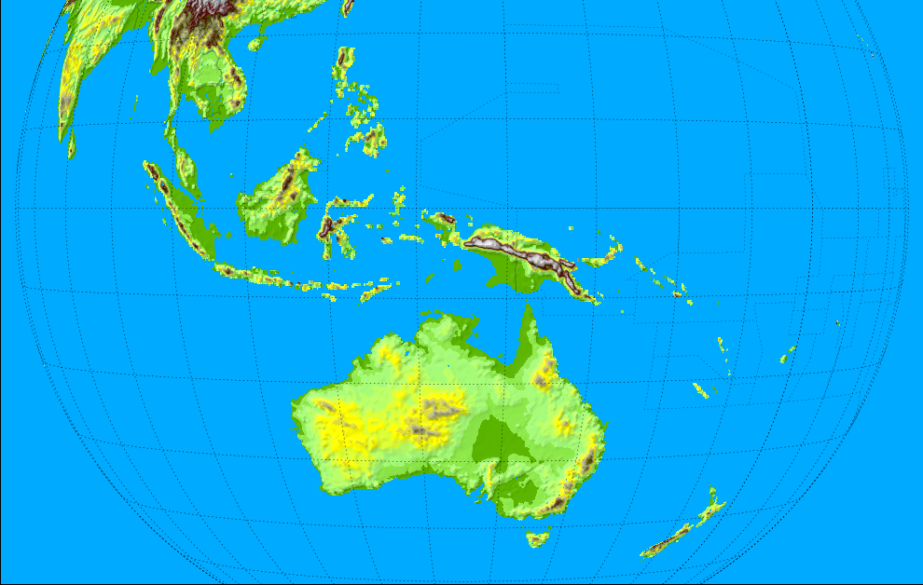
1: Australian VLab Centre of Excellence and RAV contacts (see also https://www.wmo-sat.info/vlab/centres-of-excellence/)
Philippines
Guam
Malaysia
Singapore
Micronesia
Dr Mick Pope
(Head of CoE)
Bodo Zeschke
(Main Point of Contact)
Kiribati
Solomon Islands
Indonesia
Timor-Leste
Tuvalu
PNG
Other important contacts:
JMA
CMA
KMA
USA
EUMETSAT
Fiji
Vanuatu
Samoa
RAV
Tonga
Satellite Champions
RAV contacts frequently attending our training
Other RAV contacts
Melbourne
New Zealand

Slide 4
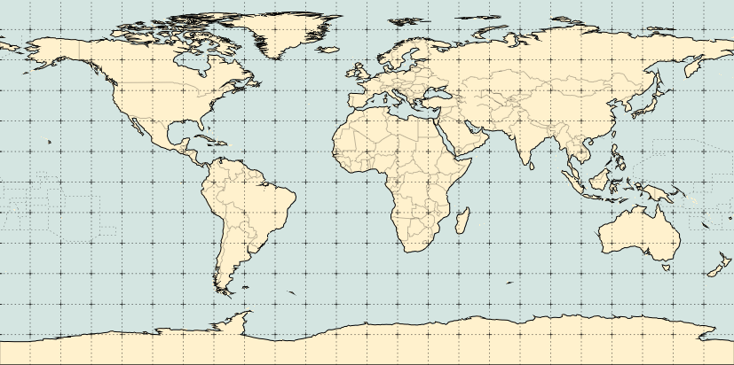
2: The past 2 years of Regional Focus Group meetings – statistics January 2020 to September 2021
2.2
1.4
5.9
1.2
1.1
1.4
0.5
0.1
0.1
0.1
0.1
0.1
0.2
0.2
4.3
1.1
1.1
0.4
2.2
5.1
0.1
0.4
0.1
1.1
77 (4.5 per session) participants could not be identified
Average number of remote participants per session by geographical location shown above
Total number of remote stakeholders attending the 17 sessions = 590+
Average number of participants per session = 34.7+

Slide 5
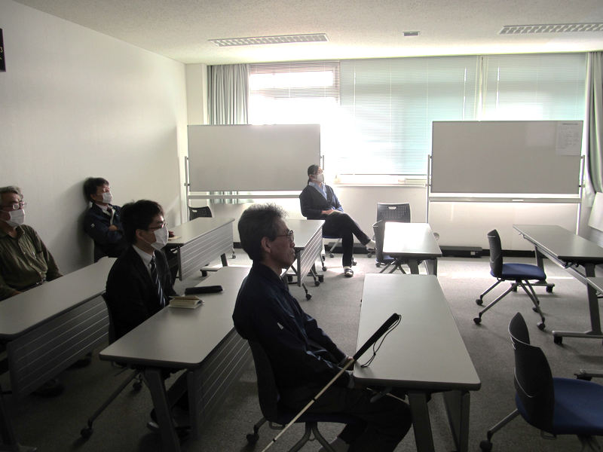
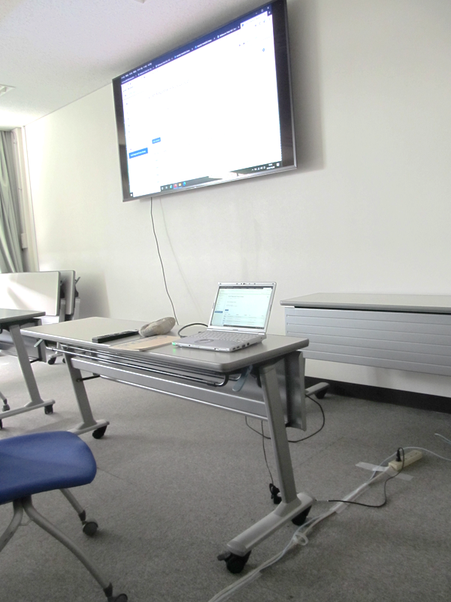
Multiple attendees per login during 2020/21
Our Principal Sponsoring Satellite Operator, the Japanese Meteorological Agency
images courtesy A.Shimizu JMA

Slide 6
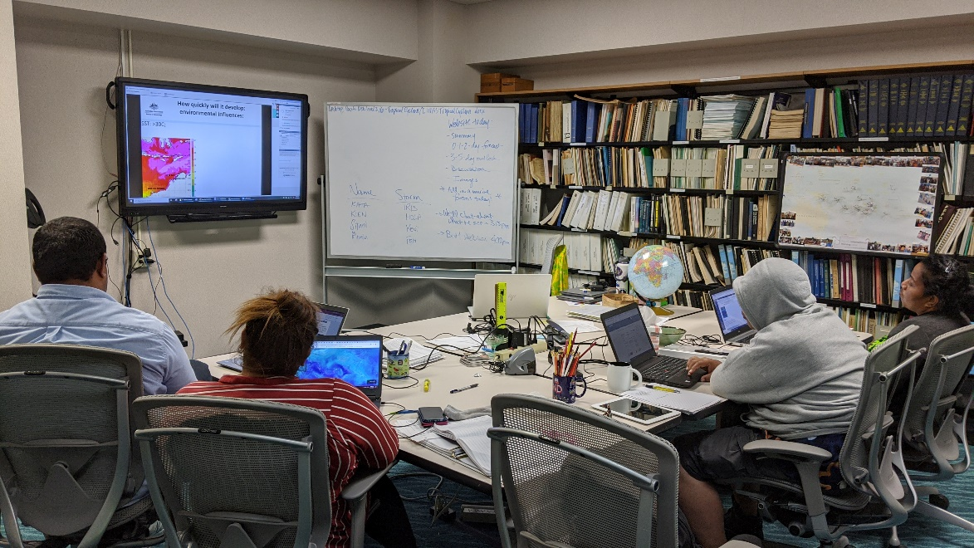
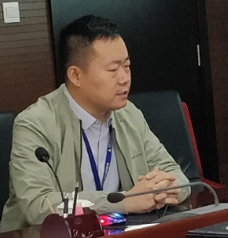
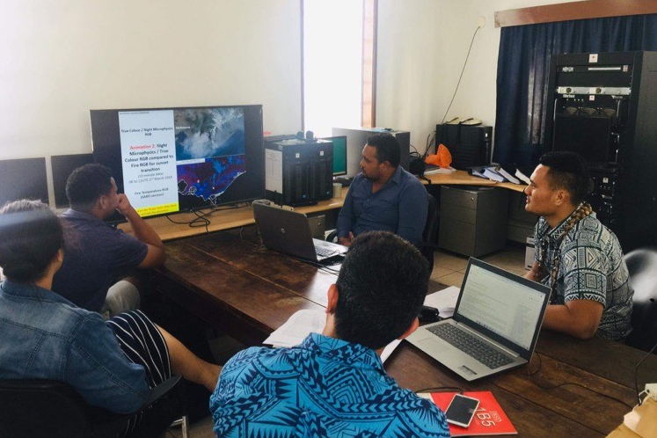
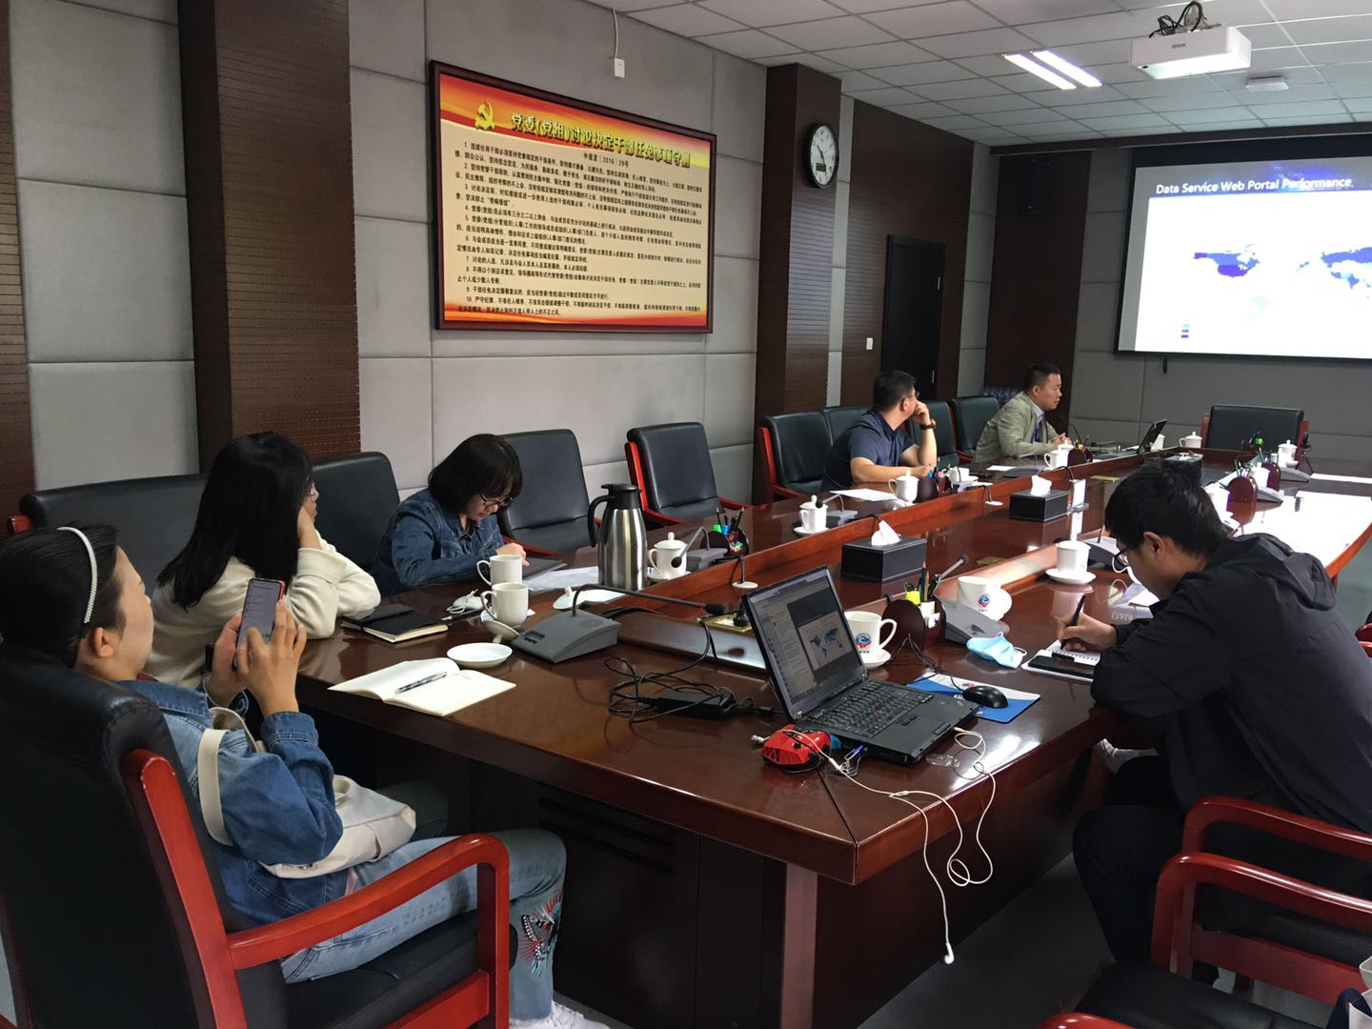
Multiple attendees per login during 2020/21
NOAA-NWS Pacific International Training Desk, Hawaii
image courtesy Jennifer Strahl
China Meteorological Administration
Samoa Meteorological Service
image courtesy Ji Wenbin
image courtesy Silipa Mulitalo

Slide 7
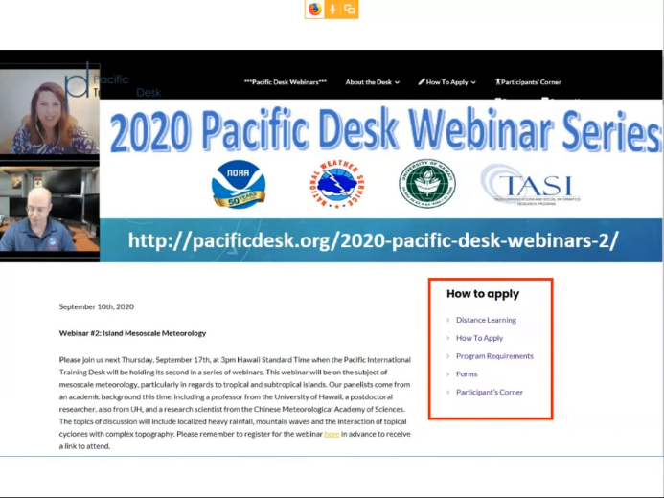
3: Celebrating regional achievements in satellite meteorology training (over the past two years…)
2
Celebrating the 100th BMKG Indonesia Online Group Discussion
1
3
8 years of Australian VLab CoE Regional Focus Group meetings
2 years of NOAA-NWS / UH-TASI Pacific Desk Webinars

Slide 8
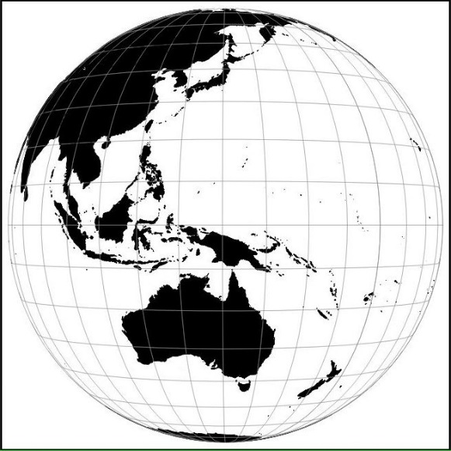
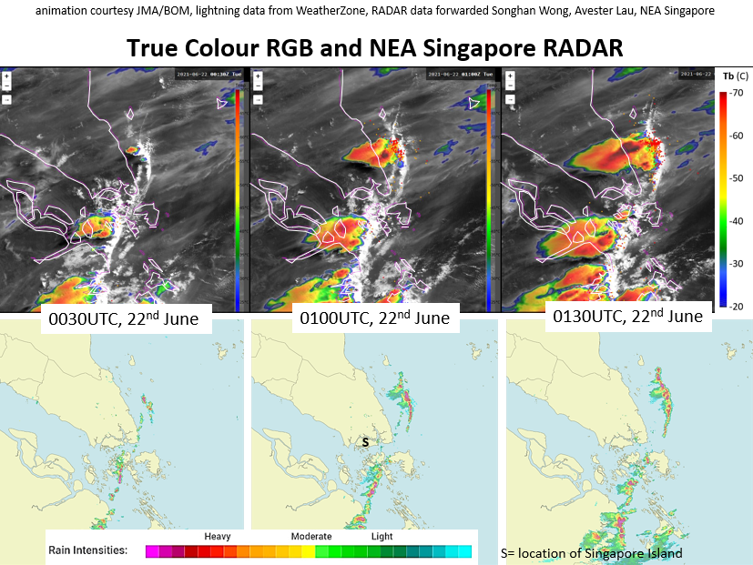
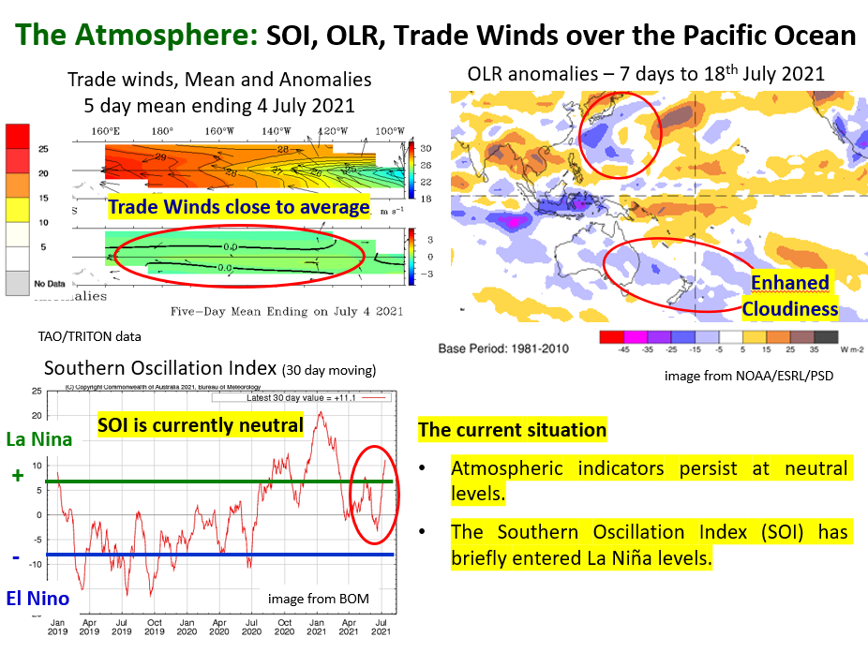
4a: Highlights of Monthly Regional Focus Group Meetings: Topics covered (over the past two years…)
2
Sumatra Squall line June 21
Tropical & midlatitude case studies
Australian flooding March 21
1
Weather and Forecast Discussions
Latest developments in meteorology
3

Slide 9
4a: Highlights of Monthly Regional Focus Group Meetings: Topics covered (over the past two years…)
2
Sumatra Squall line June 21
Tropical & midlatitude case studies
Australian flooding March 21
1
Pre-season updates
Latest developments in meteorology
3

Slide 10
4a: Highlights of Monthly Regional Focus Group Meetings: Topics covered (over the past two years…)
5
Satellite data delivery
4
6
Information about new satellites
New satellite derived products

Slide 11
4a: Highlights of Monthly Regional Focus Group Meetings: Topics covered (over the past two years…)
8
Remote forecast simulation conducted during COVID restrictions
Remote satellite meteorology teaching during COVID restrictions
Farewell to Shimizu-san
7
9

Slide 12
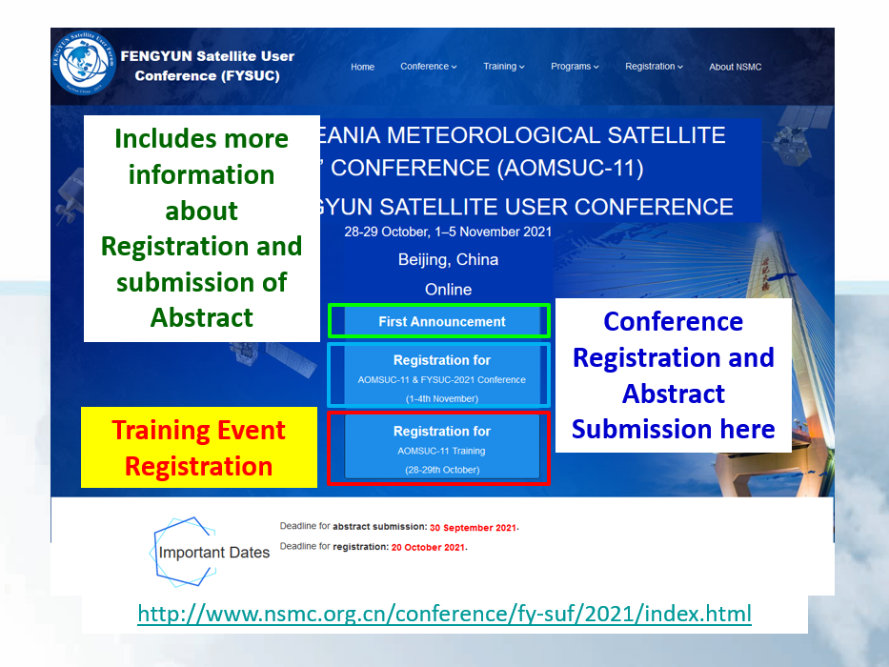
4a: Highlights of Monthly Regional Focus Group Meetings: Topics covered (over the past two years…)
11
Reporting on AOMSUC-10
10
12
Disseminating information regarding the Technical Teleconference between NOAA, JMA and BOM
Advertising AOMSUC-11

Slide 13
4b: Highlights of the VLab Sessions of 2020 / 2021: A constellation of presenters from across the region

Slide 14
4b: Highlights of the VLab Sessions of 2020 / 2021: A constellation of presenters from across the region

Slide 15
4b: Highlights of the VLab Sessions of 2020 / 2021: A constellation of presenters from across the region

Slide 16
4b: Highlights of the VLab Sessions of 2020 / 2021: A constellation of presenters from across the region

Slide 17
4b: Highlights of the VLab Sessions of 2020 / 2021: A constellation of presenters from across the region

Slide 18
5: Recordings of our Regional Focus Group Discussions http://www.virtuallab.bom.gov.au/archive/regional-focus-group-recordings/

