Slide 1
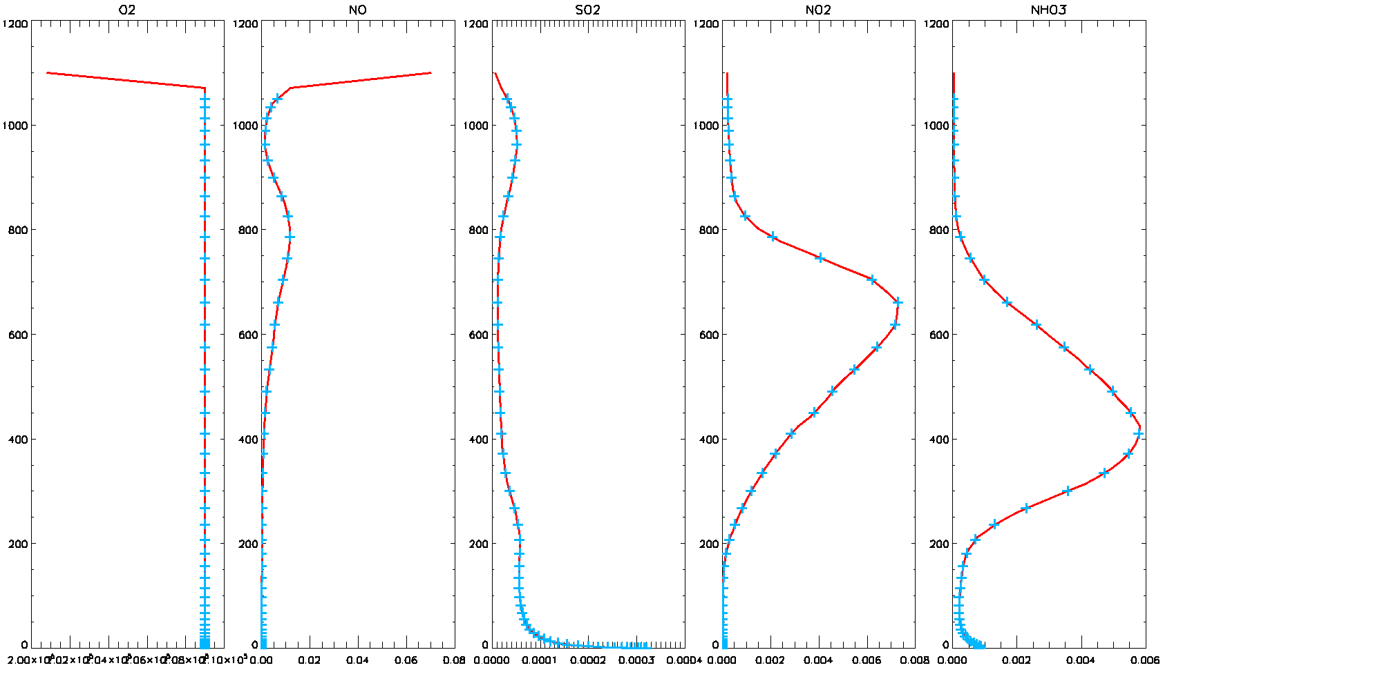
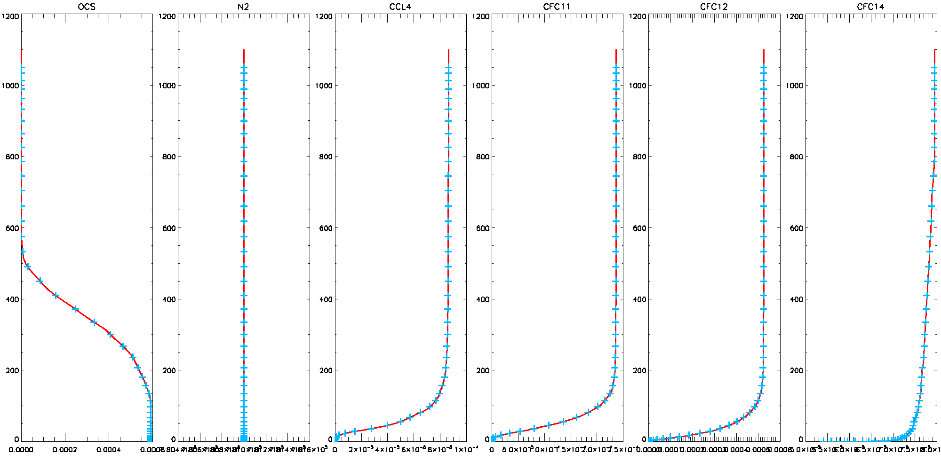
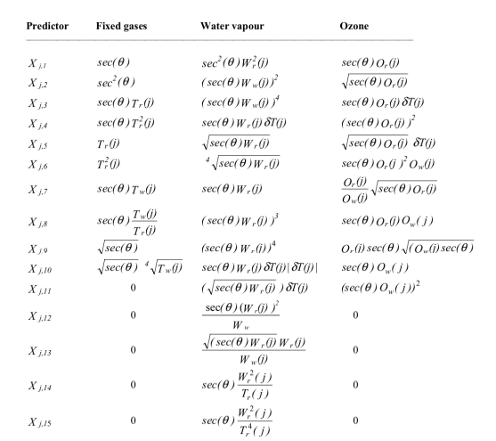
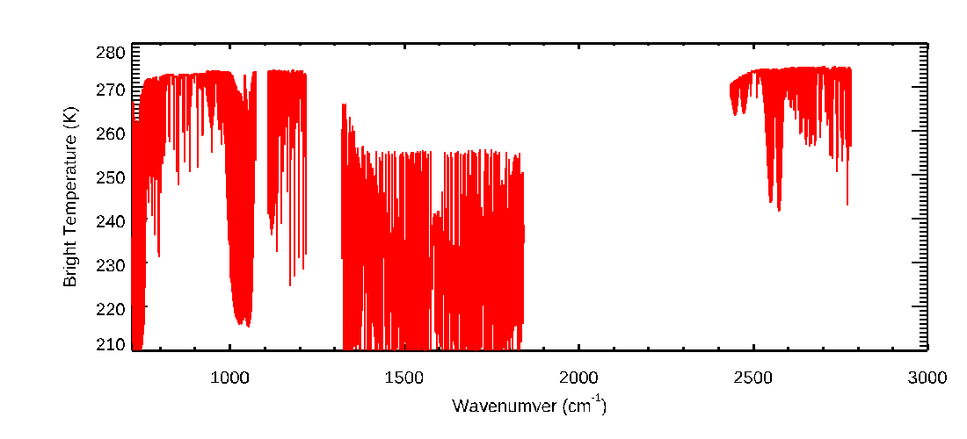
Estimate GK2A RTTOV coefficients and its application for validating clear sky radiance
Heewoo Shin, Byung-il Lee, heeyoung Lee, Hyein Park, Jaemyun Shim
NMSC ( National Meteorological Satellite Center) / KMA ( Korea Meteorological Administration)
Introduction
NMSC/KMA has developed various meteorological products to monitor meteorological phenomena using GK2A/AMI. The clear sky radiance or brightness temperature simulated by the radiative transfer model is used as an auxiliary data for algorithm development. NMSC/KMA uses Radiative Transfer for TOVS(RTTOV) with coefficients provided by Numerical Weather Prediction Satellite Application Facillites(NWP-SAF) to calculate clear sky radiance. Since the coefficients of the RTTOV is very important information for simulating satellite observation clear sky radiance, so, we are trying to estimate NMSC’s coefficients using AER Line-By-Line Radiative Transfer Model (LBLRTM) and compared the results with the original coefficients.
Method
Step. 1
Step. 3
For use the atmospheric profiles to the LBLRTM, interpolate the ECMWF 101layer into 54 layer. The trance gases is OCS, N₂, CCL4, CFC11, CFC12, CFC14, O₂, NO, SO₂, NO₂, NHO₃.
From calculated the optical depth for each layer, we can calculate the transmittance by function (1).
For the optical depth parameterization, we calculate optical depth by Fig. 3 table using regression method.
$T_{ch}=OD(\sum_{i=1}^{54}{Mixing gas}+\sum_{i=1}^{54}{Ozone gas}+\sum_{i=1}^{54}{Watervapor})×{SRF}_{ch}$ (1)
$T$ - transmittance
$ch$ - each GK2A channel(band07~16)
$SRF$ – GK2A Spectral Response Function
Fig. 1 Distribution of vertical profile of ECMWF 101 layer(red line) and 54 layer(sky dot) for the trace gases.
Step. 2
To train the fast coefficient, divide 83 atmosphere profiles each at solar zenith angle 6, calculate optical depth for the mixing, ozone, and water vapor gas from GK2A band07(3.8 um) to band16(13.3 um) using LBLRTM HITRAN 2008.
Fig.2 Distribution of bright temperature of GK2A Band07~16.
Fig.3 Conversion table for calculate regression variation.

Slide 2
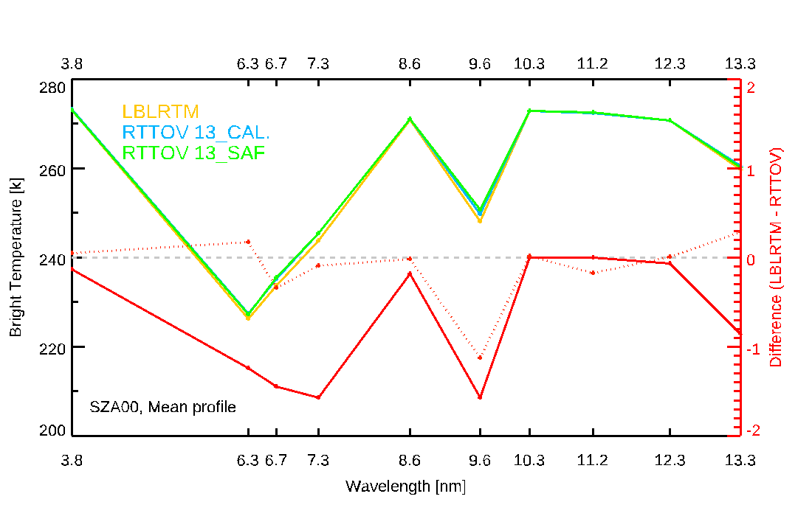
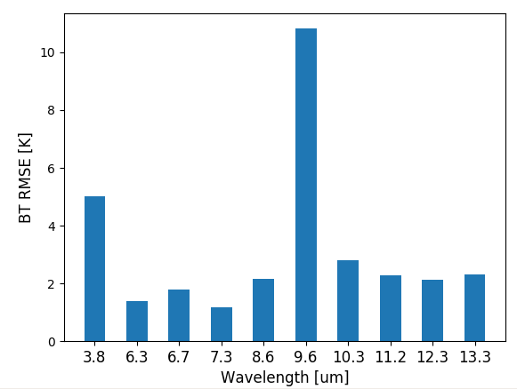
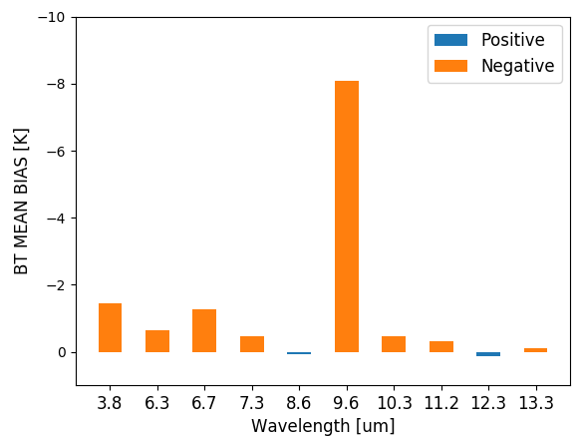
Estimate GK2A RTTOV coefficients and its application for validating clear sky radiance
Heewoo Shin, Byung-il Lee, heeyoung Lee, Hyein Park, Jaemyun Shim
NMSC ( National Meteorological Satellite Center) / KMA ( Korea Meteorological Administration)
Result & Conclusion
Result 1: Transmittance of LBLRTM vs RTTOV
Result 2: Bright Temperature of SAF vs training vs LBLRTM
To compare the result of fast coefficient calculated by regression method, difference of each layer is about less than 0.01 and result analyzed good performance.
To compare RTTOV BT of SAF fast coefficient with training fast coefficient using RTTOV, show the result Fig. 5 with reference of LBLRTM BT.
Less then BT 1K exception water vapor channel(6.3, 6.7, 7.8 um) and ozone channel(9.6).
difference of water vapor and ozone channel may be error of RTTOV RTM consideration of gas absorption and computational calculation.
Fig. 4 Transmittance of each band for the simulated LBLRTM(red line) and RTTOV simulated using training fast coefficient(sky line).
Result. 3: GK2A simulated CSR vs training CSR
To evaluate training fast coefficient for GK2A Full Disk (FD) area using atmospheric profile of UM model, we compare to operational GK2A Clear Sky Radiance (CSR).
Mean bias not exceed 2 K expect 9.6um, RMSE is less than 3 K except for 9.6um.
Fig. 5 Each channel BT of LBLRTM(yellow line), RTTOV BT of SAF fast coefficient(green line) and training fast coefficient(sky line) and difference of LBLRTM and training fast coefficient(red line), each RTTOV(red dashed line).
Conclusion
Date: 2021. 10. 01. 00UTC
~ 2021. 10. 14. 00UTC
To estimate fast coefficient of SAF RTTOV, we conducted SZA6, 83 atmospheric profiles, and 54 layer for LBLRTM and calculated optical depth using regression method.
To check the training fast coefficient, transmittance of LBLRTM were compared and the result is less than 0.01.
The BT difference of each channel is 1K exception for water vapor channel(6.3, 6.7, 7.8 um) and ozone channel(9.6), it may be RTTOV RTM consideration of the gases absorption and error of computational calculation
RMSE and mean bias of CSR is each 3K, 2K, but error of 9.6um channel is pretty large values, because RTTOV RTM of ozone consideration is still not good.
Because difference of CSR is primary result, further analysis is needed later.
Fig 6 RMSE and MEAN BIAS of GK2A CSR and simulated RTTOV using training fast coefficient in GK2A FD area from 2021. 10. 01 00UTC to 2021. 10. 14. 00UTC.

