Slide 1
Sunshine duration product based on estimation from 2.5-minute Himawari-8 observation data
Takahito Imai
JMA

Slide 2
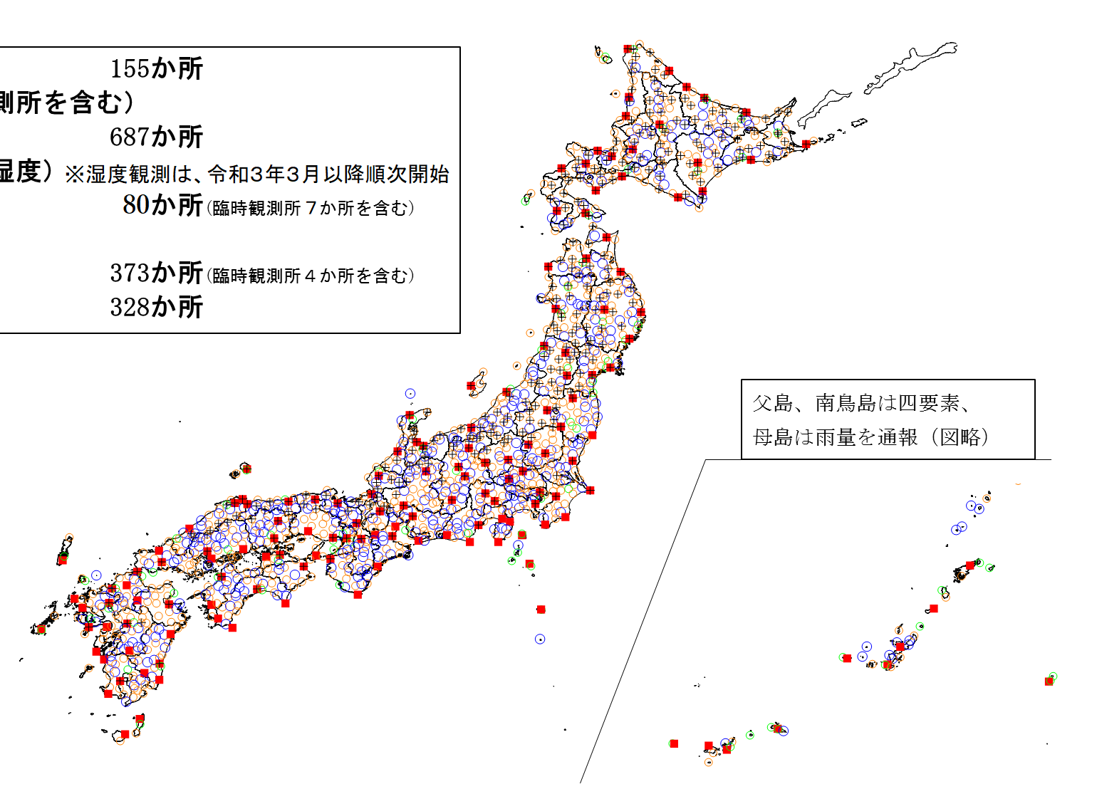
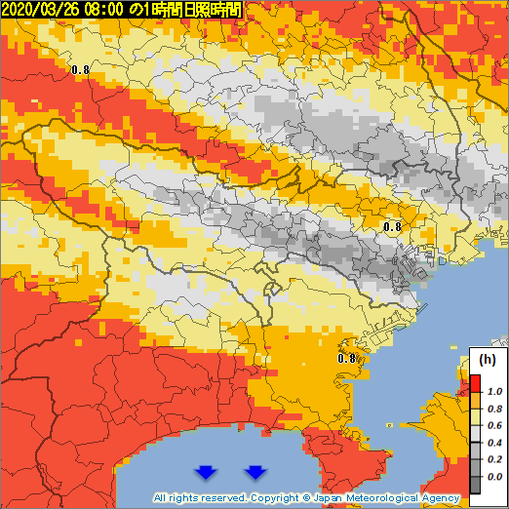
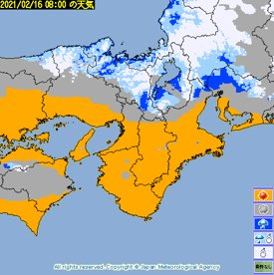
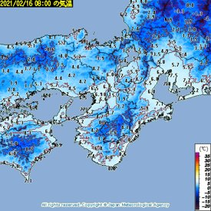
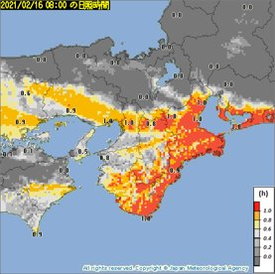
Weather Analysis Map (WAM)
JMA operates surface meteorological observation network
"the Automated Meteorological Data Acquisition System (AMeDAS)"
・about 1300 stations
・average intervals is 17 km
To meet user demands for 2-D meteorological information, gridded weather analysis called Weather Analysis Map was developed​.
WAM is 2-D information of surface latest meteorological conditions estimated from in-situ and remote sensing observation data, and NWP-based data.
Frequency: hourly
Region: Japan's land area (except for a part of islands )
Resolution: 1 x 1 km² size mesh
Provide: Images on JMA's website [ https://www.data.jma.go.jp/obd/bunpu/index_en.html ]
Binary data (GRIB2) dissemination (via the Japan Meteorological Business Support Center)
？
！
AMeDAS
WAM
One hour sunshine duration in Tokyo area.
WAM shows meteorological information in areas
distant from AMeDAS stations
as well as other region!
Weather
(2016.3-)
Surface air temperature
(2016.3-)
One-hour sunshine duration ​
(2020.9-)

Slide 3
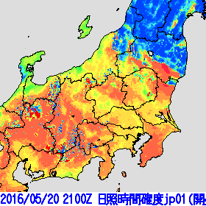
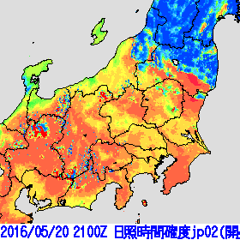
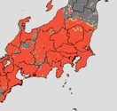
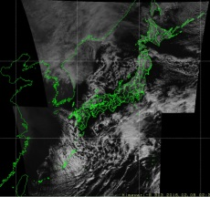
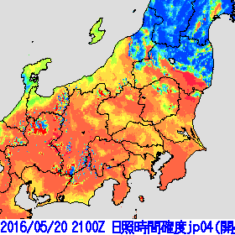
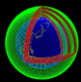
Outline of Algorithm
Sunshine durations are defined as period "direct solar radiation intensity is at least 120W/m²".
(This value corresponds to an interception less than around 91% relating to cloud, atmosphere, and terrain.)
Estimate sunshine probability in every 2.5-minute Himawari-8 observation scene, determine whether there is sunshine or not at each scenes and integrate number of sunshine scenes to be sunshine duration
Satellite obs.
Sunshine probability
Sunshine duration
Estimate
probability
Determine sunshine
Integrate
every
2.5minues
NWP based
・snow detection
・shadow detection
・correction by AMeDAS obs.

Slide 4
Estimation of Sunshine Probability
Gradient-Boosting Decision-Tree※ machine learning (ML) is used
Decision Tree
Teacher data:
AMeDAS sunshine duration data excluding the scene obviously affected by shadows from surrounding obstacle
Input data:
conditional branch
Element ​ | Notes ​
R_{0.64}/cos(Sunz) ​ | Geom. ​
R_{1.61}/cos(Sunz) ​ | ​
T_{10.4}-T_{srf} ​ | Geom., NWP ​
Surface Temperature (T_{srf}) ​ | NWP ​
Cloud top height ​ | Geom., NWP-based ​
Atmospheric transmittance ​ | NWP-based ​
Sun zenith angle (Sunz) ​ | ​
Sun azimuth angle (Suna) ​ | ​
Latitude ​ | ​
Geom.
point
result
result
Estimated point
※ Tianqi, C., et al, 2016: XGBoost: A Scalable Tree Boosting System. In 22nd SIGKDD Conference on Knowledge Discovery and Data Mining, 2016
R_{λ}: reflectivity of Himawari-8 λ μm
Sunz: sun zenith angle
T_{10.4}: Himawari-8 10.4 μm brightness temperature
Calculation of Sunshine Duration
Integrate number of scene with probability greater than threshold
Sunshine
probability
example
example
65%
Threshold
55% (example)
60%
example
output of ML
+Exception
100%: Clear sky snow covered area
0%: Mountain shadow area
example
50%
Constant
stratified by sun zenith angle and time variation of sunshine probability
+ Correction
to be consistent with neighbor AMeDAS observations
40%
No
＋0min.
No
＋0min.
Sunshine
＋2.5min.
Sunshine
＋2.5min.
Total 5minutes
Output is always multiple of 2.5 minutes

Slide 5
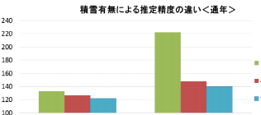
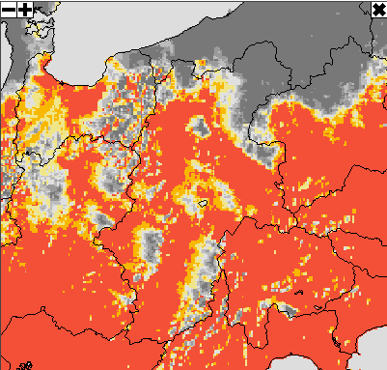
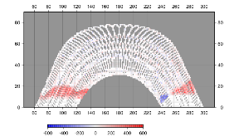
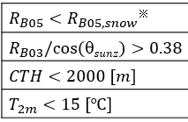
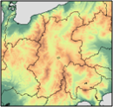
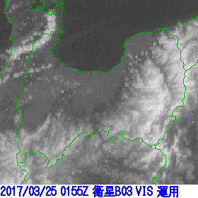
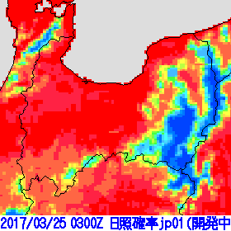
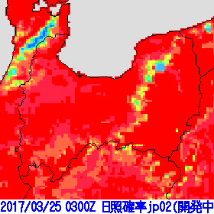
Clear Sky Snow Covered Area Detection
Mountain shadow detection
ML estimates high sunshine probability at much of clear sky snow coverd area.
Since thick snow area in mountain have no AMeDAS i.e. no teacher data and out of ML treatment, clear sky area has sometimes small sunshine probability.
Detect stational target with simple snow detection as Clear sky snow covered area.
Clac. Method comparison
Against AMeDAS obsaevation
Term:2017.5-2018.4
Mountain shadow is calculated from 1km mesh elevation data assuming straight sun light.
10 minute sunshine duration
RMSE [sec]
Rogistic regression
Nural network​
Gradient Boosting​
Decision Tree
AMeDAS observation can be affected by local terrain and tree.
Therefore, WAM sunshine duration is often longer than AMeDAS observation in morning and evening, and has better regional representativeness, sometimes.
Without snow
With snow
09JST 14th Jan. 2018, Nagano area
Hida
mountain range shadow
10min. Sunshine duration difference WAM-OBS at AMeDAS Minami Shinano
Kiso
mountain range shadow
Local
terrain or tree
Altitude angle [deg]
Detected by considering temporal movement of local part and overall R_{0.64} image
Low top height
Ice particle
Cold ground surface
Akaishi
mountain range shadow
East South West
Moutatain of 1km mesh elevation data
Cloud
Snow
Cloud
Snow
Cloud
Snow
Before
After
Mount Fuji shadow
R_{0.64}
SunShine Pribability
SunShine Pribability

Slide 6
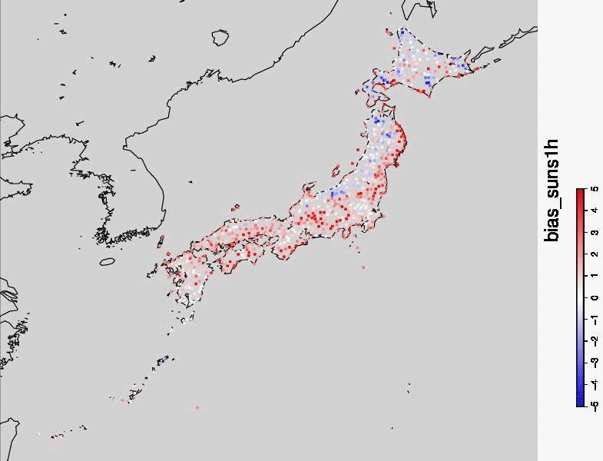
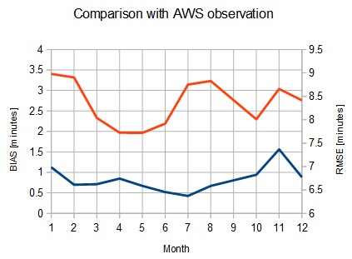
Evaluation
Setting
​Element: One-hour sunshine duration
Term: July 2018 - Jun 2020
BIAS at each AMeDAS point in January
Too small by
misjudgement of clear sky snow cover
Sarabetsu
Kamisatsunai
・Overall positive BIAS
←Difference of local obstacle treatment leads positive BIAS
・Summer large RMSE
←The sub-pixel cloud leads too much or too small estimation
・Winter large RMSE
←The misjudgement of clear sky snow cover area leads
too small estimation
​Result
Kuroishi
RMSE (ave.:8.26min)
Kaidakogen
Honkawa
BIAS (ave.:0.73min)
Positive BIAS by difference of local obstacle treatment
[min]
Summary
・Sunshine duration product from 2.5-minute Himawari obs. data is introduced.
・In the product, sunshine duration is calculated by summation of sunshine scene of 2.5-minute Himawari obs.. To determine whether sunshine or not, Gradient-Boosting Decision-Tree ML calculation, snow covered area detection and mountain shadow detection are done.
・RMSE of one-hour sunshine duration against AMeDAS is 8.26 minutes. There is positive BIAS in morning and evening, and negative BIAS in snow covered area.

