Slide 1
AOMSUC-11 and FY User Conference
Welcoming Remarks
James F.W. Purdom, PhD
Chair, AOMSUC International Conference Steering Committee

Slide 2
CMATC, AuBOM-VL, WMO-SP
AOMSUC-11 began at the end of last week with a two-day training event
AOMSUC-11
Training event
October 18-19, 2021

Slide 3
The next four days will be the Conference portion
Of the AOMSUC-11
&
FY-USERCON
2021
CMA/NSMC
AOMSUC-ICSC
AOMSUC Sponsors
Speakers

Slide 4
The fifth day is reserved for a WMO RA-II/RA-V
Satellite Coordination Meeting
WMO SP
AOMSUC Sponsors

Slide 5
Eight AOMSUC Sponsors
5 Representing Asia/Oceania Satellite Operators
All representing Users across Asia/Oceania
China (AOMSUC-11 Host)
Australia, Russian Federation, Japan,
Indonesia, Korea, India, WMO

Slide 6
Eight AOMSUC Sponsors
5 Representing Asia/Oceania Satellite Operators
All representing Users across Asia/Oceania
China (AOMSUC-11 Host)
Australia, Russian Federation, Japan,
Indonesia, Korea, India, WMO
Also, Thanks to NOAA and EUMETSAT for their continued support across Asia/Oceania with free and open access to their polar and geostationary satellite data and products and enthusiastic participation in the AOMSUC since its beginning in Beijing in 2010

Slide 7
Congratulations to CMA on the 50 years Anniversary of China’s Meteorological Satellite System Recent landmark achievements include: A) The first hyperspectral sounder in Geostationary Orbit B) A geostationary satellite rapid imager with 250-meter resolution C) The FY-3 Early Satellite to fill a major gap in the WIGOS Polar Constellation and to support NWP We will hear more about these in session-1 and the FY-Users’ Conference

Slide 8
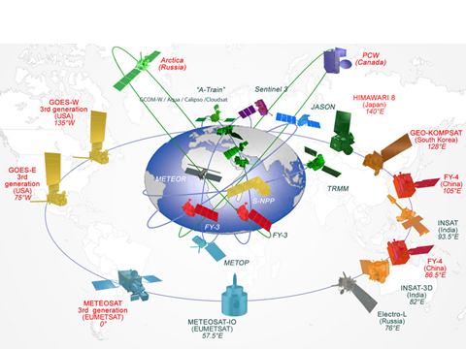
The space agencies are meeting the challenge of providing a vibrant polar and geostationary satellite constellation
Vision for WIGOS 2020

Slide 9
Vision for WIGOS 2020
Arctica-M
providing “quasi-geoststionary” observations in Northern Polar regions
FY-3 Early providing badly needed data for global NWP
GROUND-BREAKING ACHIEVEMENTS
THIS YEAR

Slide 10
The science portion is
about to start
You have a very well-planned conference over the next four days. Relax, enjoy and learn.
Four days of wonderful presentations. All sessions begin with a Keynote Presentation that is “State of the Art”
Each session ends with a panel period during which questions will be addressed.

Slide 11
Relax, enjoy and learn.
AND ONCE AGAIN
THANK YOU TO ALL INVOLVED IN PUTTING THESE EVENTS TOGETHER

Slide 12
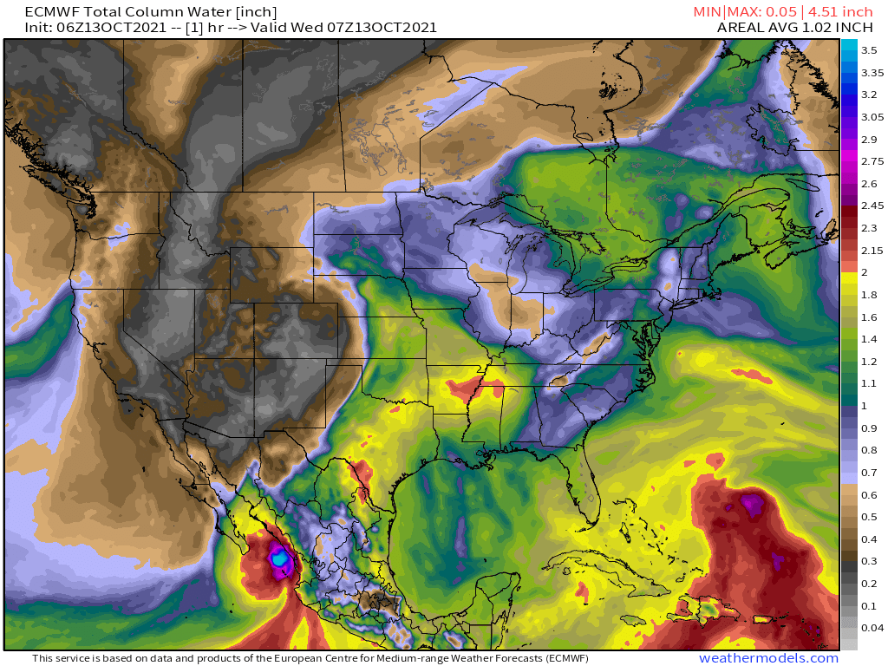
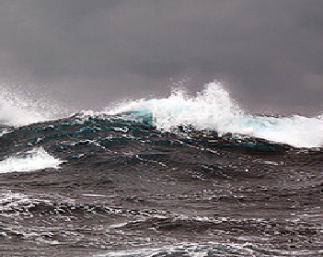
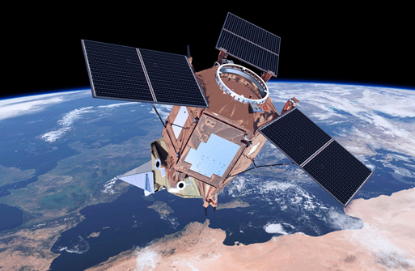
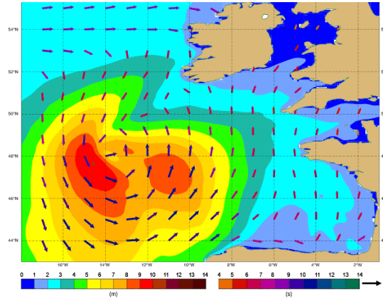
Can You Imagine modern NWP without satellite data???
Conference Keynote Address:
Satellite Data Assimilation for NWP
By Niels Bormann, ECMWF
Meteorological satellites provide essential data for weather forecasting across the globe
Notes:
Basic notes are on this slide. The images are Sea Surface temperature (upper left), Hurricane (upper right), an artist rendition of the space based GOS (middle), the Ozone Hole (lower left) and a severe storm (lower right).

Slide 13
AOMSUC-11 CONFERENCE KEYNOTE ADDRESS
“Satellite Data Assimilation for NWP” By Dr. Niels Bormann, ECMWF*
He began his career at ECMWF in 2000 after receiving his PhD from Victoria University of Wellington in New Zealand. His major satellite related interest include investigations of satellite derived atmospheric motion vectors, microwave data and hyperspectral sounder data for use in Numerical Weather Prediction.
Niels is a Principal Scientist in the ECMWF Research Department, leading a team responsible for the exploitation of satellite observations from microwave radiances and Atmospheric Motion Vectors (AMVs) as well as the general processing of observations for assimilation.
*European Center for Medium-range Weather Forecast

